Slide 1
The Value of ISO 50001 for Advancing APEC Energy Efficiency Goals
September 11, 2016
Li Pencheng
APEC EGEE&C Workshop on ISO 50001
Tarapoto, Peru

Slide 2
Energy management systems (ENMS) – a key tool for meeting National goals

Slide 3
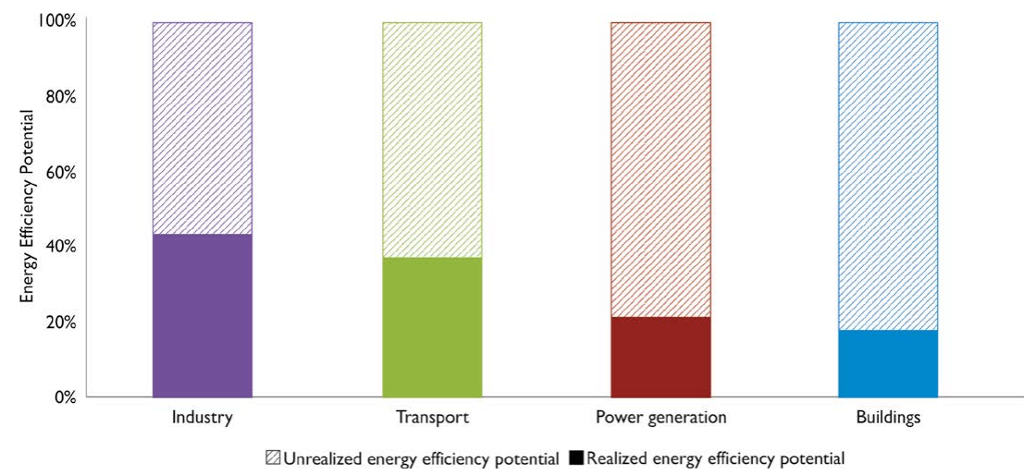
Despite Significant Benefits…Lots of Untapped Potential
Source: World Energy Outlook, IEA 2012
Supportive policies are needed to remove barriers and facilitate market adoption

Slide 4
Current practice: Project-Based approach to energy efficiency
Project - based approach focuses more on investments in new, more efficient technologies.
The result is that over time energy performance fluctuates and efficiency potential goes unrealized!
Technological Change
Key challenges with this approach:
Investments in projects are cyclical
Energy saving of projects are often not sustained
Energy & Cost Savings (over time)
Notes:
Currently most organizations approach energy efficiency on a project-by-project basis. They conduct energy audits/assessments, identify opportunities and execute specific projects.
There are a lot of drivers that influence investments in energy efficiency projects such as energy prices, breakdown or equipment replacement schedules, cost of capitol, sustainability goals or other regulatory and political environment, etc.
These drivers can be either periodic in nature or in constant flux meaning that over time, based on current environment or realities, energy efficiency projects , even if they are cost effective, may not be pursued.
Also, a project-based approach tends to favor technology-based energy conservation measures that are more tangible and easier to evaluate and quantify in terms of cost-effectiveness, versus measures such as operational or process improvements.
However, the energy performance of more efficient technologies depend a lot of operational practices. Without proper operational monitoring or controls, often the energy performance of potential of new technologies are not sustained over time.
Animation: Given these factors, a project based approach to efficiency results in inconsistent energy performance and thus unrealized energy efficiency potential.
.

Slide 5




What is Missing in the Project-Based Approach to Energy Efficiency?
But what about…
Project-Based Focus on Technological Change
Holistic strategies?
People?
Raw Materials and
Energy Sources?
Controls?
Notes:
Operational control
Commitment to do large projects
Maintenance of the small stuff
Culture and behavior

Slide 6
A more Comprehensive approach to Energy Efficiency is needed
Organizations that target behavioral and organizational barriers, as well as technological, can achieve continual improvement in energy performance.
Comprehensive Energy Management
Technological Change
Organizational Change
Behavioral Change
Continuous improvement!
Energy & Cost Savings
(over time)
Staff at every level of an organization need to be engaged and involved in order to achieve energy goals!

Slide 7
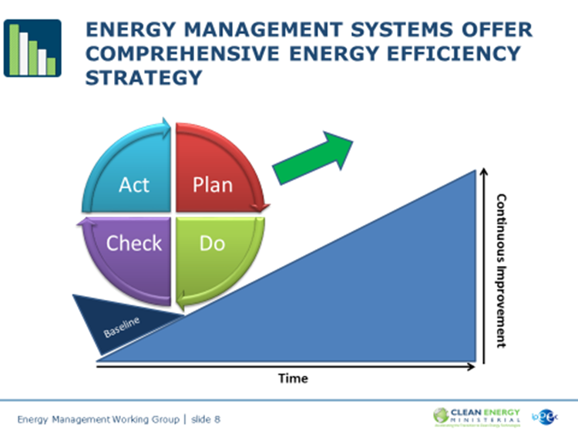

Slide 8


ISO 50001 Delivers Significant Impacts
Global Savings Potential to 2030
~62 exajoules of cumulative energy savings
$600 billion in energy costs
6,500 Mt of CO₂ emissions avoided
ISO 50001 International Standard
Almost 9 gigawatt-hours of energy saved in 2014
$900,000 savings in first year with 4 month payback
Improved energy performance by 15.2% 2 years

Slide 9


ISO 50001 International Standard - a strong Policy Tool for meeting Energy and Climate goals
Business-friendly practices and requirements
Applicable to any organization that uses energy
Goes beyond projects, and promotes institutional change within organizations to ensure energy efficiency is integrated into day-to-day operations.
Over 50 countries currently involved in standard-making process – many countries adopting ISO 50001 as national standard
Thus, it is the global best practice standard for energy management that can help measure real progress toward energy efficiency goals at national and international levels.
Achieving certification requires organizations to set energy performance goals and to meet those goals within a regulatory or voluntary policy environment.
14,000+ certified sites worldwide as of Sept. 2014
Notes:
9

Slide 10
Turning Best Practice Standards into Robust and consistent Implementation
Global Standard Development
International Engagement
Development of robust policies, programs, and resources for national and international use
Sharing of best practices to ensure robust and consistent implementation of the standard
Government, international organizations, utilities, energy service companies and others work on the ground to help organizations implement best practice standards
Local Implementation
ISO 50001 Standard Technical Committee plays an important role in defining international best practice standards and guidance.
Notes:
ISO and TC 301 plays an important role in helping governments achieve energy and climate goals; the ISO 50001 family of standards and guidance provide a valuable framework to maximize energy savings.
At the implementation level, Governments play critical roles to facilitate successful ISO 50001 outcomes in industry:
Develop supportive policies and programs to address barriers to implementation:
Technical and financial resources and tools
Pilot projects and demonstrations
Workforce development programs
Coordination among national bodies to build quality infrastructure for programs
Work with national accreditation, certification, and training bodies to ensure that skilled professionals are available to meet national energy and climate goals.
Provide recognition to businesses that adopt ISO 50001.
But international engagement with international partners is needed to ensure that domestic programs promote and are consistent with international best practices on ISO 50001 implementation to ensure robust results for national industries, and ensure that ISO 50001 continues to be comparable benchmark across countries.

Slide 11
Background on the Iso 50001 family of standards and guidance

Slide 12
Unique role of Governments
Governments are best suited to fulfill certain needs to promote ISO 50001.
Actions that facilitate successful ISO 50001 outcomes in industry:
Develop supportive policies and programs to address barriers to implementation
  Technical resources and tools
  Pilot projects and demonstrations
  Workforce development programs
  Coordination among national bodies to build quality infrastructure for programs
Work with national accreditation, certification, and training bodies to ensure that quality infrastructure meets national energy and climate goals.
Provide recognition to businesses that adopt ISO 50001 and contribute to national energy and climate goals.
Leverage IPEEC and EMWG participation to ensure that domestic programs promote and are consistent with international best practices on ISO 50001 implementation.

Slide 13
ISO 50001 Standard Development
Technical Committee - TC 301
TC 301
(China and U.S., Co-leads)
Participating countries: 50
Observing countries: 24 (and international organizations such as UNIDO and others)
WG 1 – ENMS
WG 2 – Energy Performance Metrics
JWG 3
(with TC 257)
Measurement & Verification
WG 4
Opportunities for Improvement
50001
Implementation Guidance
EnMS Auditing
Energy Performance Indicators
Baselines
Measurement and Verification
Energy Auditing
ISO 50004
Guidance for the Implementation of an EnMS
ISO 50003
Requirements for audit and certification of an EnMS
ISO 50006
Measuring Energy Performance using Energy Baselines and EnPI
ISO 50015
Measurement and Verification
ISO 50002
Energy Audits
These standards are a strong foundation for programs and resources to be developed for industry to implement energy management and ISO 50001.
Plus more standards planned through these WGs:
WG 5
Energy Services
WG 6
Data for EnMS

Slide 14
ISO 50001 Family
ISO 50001
Energy management systems – Requirements with guidance for use
Use for energy review
ISO 50002
Energy Audit
Energy Planning
ISO 50004
EnMS – Guidance for the implementation, maintenance and improvement of an EnMS
ISO 50006
Measuring Energy Performance
Implementation and operation
Providing the methods for monitoring, measurement, and verification of energy performance
ISO 50015
M&V Guidance and Principles for Organizations
Checking
Improvement
ISO 50003
Bodies providing audit and certification of EnMS
Internal Audit
Certification
EnMS certification process
ISO/IEC 17021
Conformity assessment – requirements for bodies providing audit and certification of management systems
Graphical representation based on presentation by Alvaro B A Pinto, Eletrobras, EEMODS, 2013.

Slide 15
Measurement and Verification of Energy Performance
ISO 50015
M&V Guidance and Principles for Organizations
Provides a set of principles and guidelines for Measurement and Verification, thereby increasing the credibility of energy performance.
ISO 50003
Bodies providing audit and certification of EnMS
Specifies requirements for competence, consistency and impartiality in the auditing and certification of energy management systems (EnMS) for bodies providing these services.
In order to ensure the effectiveness of EnMS auditing, it addresses the auditing process, competence requirements for personnel involved in the certification process for energy management systems, the duration of audits and multi-site sampling.
Intended to be used in conjunction with ISO/IEC 17021.

Slide 16
Energy Baselines and Energy Performance Indicators
ISO 50006
Measuring Energy Performance
Provides guidance to organizations on how to establish, use and maintain energy performance indicators (EnPIs) and energy baselines (EnBs) as part of the process of measuring energy performance.
ISO 50004
EnMS – Guidance for the implementation, maintenance and improvement of an EnMS
Provides practical guidance and examples for establishing, implementing, maintaining and improving an energy management system (EnMS) in accordance with the systematic approach of ISO 50001.
ISO 50002
Energy Audit
Specifies the principles of carrying out energy audits, requirements for the common processes during energy audits, and deliverables for energy audits.

Slide 17
For energy audits and energy calculation of baseline
Optional:
TC 257: Energy Savings Determination and Evaluation
ISO/DIS 17741: General technical rules for measurement, calculation and verification of energy savings of projects
ISO 17742: General calculation methods on energy efficiency and savings for countries, regions or cities
ISO/DIS 17743.2: Definition of a methodological framework applicable to calculation and reporting on energy savings,
ISO/CD 17747 (joint working group with the TC 242 (JWG4): Determination of energy savings in organizations
The topics in the above standards are covered in ISO 50006 and ISO 50002.

Slide 18
International Engagement on ISO 50001

Slide 19

















Energy Management Working Group
(EMWG)
The EMWG leverages the extensive expertise of its 17 member governments to accelerate the adoption and use of energy management systems such as ISO 50001 in industry and in commercial buildings worldwide.
Australia
Canada
Chile
Fora: The EMWG is an initiative of the Clean Energy Ministerial and IPEEC and also reports out to the G20 Energy Efficiency Action Plan.
Partners: A range of organizations promoting energy efficiency and energy management (e.g., UNIDO, Institute for Industrial Productivity, etc.).
The EMWG is a Category A Liaison to ISO TC 301.
European Commission
Finland
Germany
India
Indonesia
Japan
Korea
Saudi Arabia
Mexico
EMWG’s Energy Management Campaign: Driving action to reach 50,001 global certifications to ISO 50001 by 2020.
www.driveto50001.org
South Africa
Sweden
United Arab Emirates
United States
China (observer)
http://www.cleanenergyministerial.org/EnergyManagement
Notes:
Membership: Government representatives from ministries leading domestic energy efficiency efforts in the public, commercial and industrial sectors.
Governments action is needed to facilitate successful ISO 50001 outcomes in industry:
Develop supportive policies and programs to address barriers to implementation:
Technical and financial resources and tools
Pilot projects and demonstrations
Workforce development programs
Coordination among national bodies to build quality infrastructure for programs
Work with national accreditation, certification, and training bodies to ensure that skilled professionals are available to meet national energy and climate goals.
Provide recognition to businesses that adopt ISO 50001.
Coordinate with international partners to ensure that domestic programs promote and are consistent with international best practices on ISO 50001 implementation.

Slide 20
EMWG Background
CEM, IPEEC, G20, Campaign
CEM8

Slide 21

Energy Management Campaign
Through this campaign, public and private partners will drive action to reach [50,001] global certifications to the ISO 50001 international by 2020.
The Energy Management Campaign recruits partners to:
Endorse key principles for quality implementation of ISO 50001;
Pledge concrete actions to promote uptake of the standard and principles;
Contribute to international technical exchange through CEM;
Recognize leadership through CEM Energy Management Leadership Awards, and;
Track and share progress on uptake of the standard.
www.Driveto50001.org

Slide 22
Energy Management Campaign
The Energy Management Campaign: A Drive to [50,001] Energy-Saving Partners
Leaders are rallying around ISO 50001’s business-friendly approach, which draws upon best practices from over 50 countries and is already demonstrating steep improvements among the 12,000+ early adopters.
Who can participate:
Governments: National governments, municipalities, and other sub-national governments implementing programs and policies to accelerate transformative change in energy use within their jurisdictions
Companies: Energy end users who are leaders in executing innovative business strategies that address both sustainability and profitability goals
Supporting Organizations: Companies, organizations, and initiatives providing essential support for advancing clean energy and sustainability solutions in the industrial and commercial sectors

Slide 23






















Campaign launched at the 7th Clean Energy Ministerial in June 2016:
Endorsement from 15 countries, 6 companies, 4 supporting orgs

