Slide 1
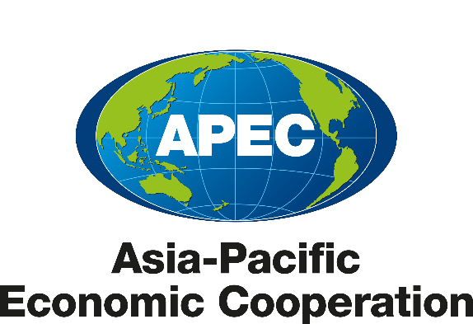
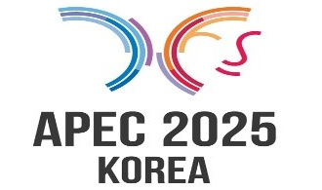
Energy Working Group (EWG) updates
EGEEC 65 and EGNRET 63 Joint Meeting
19 November 2025
Alignment with APEC Priorities
Alignment with 2025 Host Priorities
EWG Activities and Deliverables
Future Plan and Collaborations
EWG Lead Shepherd
SHAN Weiguo

Slide 2
Alignment with APEC Priorities
As the region’s leading forum for discussion of energy policy issues, EWG works towards ensuring energy security, resilience and access in the region, and accelerating clean, sustainable, just, affordable and inclusive energy transitions. EWG’s work is guided by
Instructions from APEC Leaders and Energy Ministers.
APEC guiding principles, as defined in
And EWG consensus
the Putrajaya Vision 2040 (PV2040)
the Aotearoa Plan of Action (APA)，and
the ECOTECH Medium Term Priorities.
the Energy Access Initiative(2020),
the Energy Resilience Principle(2020),
the Energy Security Initiative (2022),
the Just Energy Transition Initiative (2024),
the APEC Policy Guidance to Develop and Implement Clean and Low-carbon Hydrogen Policy Frameworks in the Asia-Pacific (2024)……

Slide 3
Alignment with APEC Priorities
EWG has set two collective goals:
We are on the way to approach these goals:
To achieve these goals, EWG has undertaken a wide range of activities over the years.
Within EWG, APEC economies proposed 14 APEC-funded projects in 2023, 15 projects in 2024, and 20+ workshops since EWG69 early this year, covering various areas such as policy dialogues, workshops, and peer reviews for low-carbon energy policies.
These capacity building and technical assistance initiatives are at the core of EWG's work, as EWG supports economies in their transition towards a more sustainable economic growth.
to reduce APEC's aggregate energy intensity by 45% by 2035, compared to 2005 levels.
to double the share of modern renewables in the energy mix by 2030, relative to 2010.

Slide 4

Alignment with APEC 2025 priorities
Under the overarching theme of “Building a Sustainable Tomorrow”, the EWG is guided by the priority of “Accelerating Affordable, Reliable, Secure and Innovative Energy for a Prosperous Future” and set 3 key agendas for 2025 APEC EMM, together with the 2025 APEC host ROK:
Prosper
to expand electricity supply to meet Future demand.
Connect
to strengthen power grid security and reliability.
Innovate
to power the Future with AI-driven energy innovation.

Slide 5
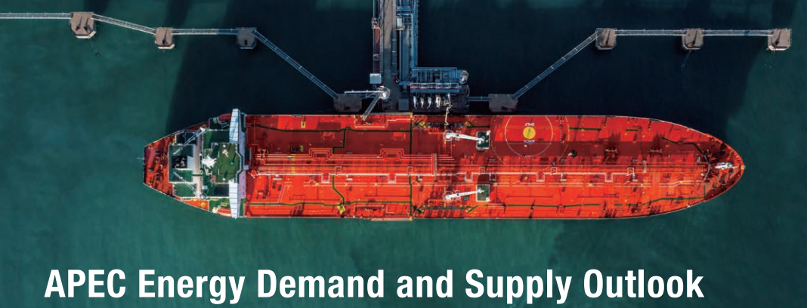
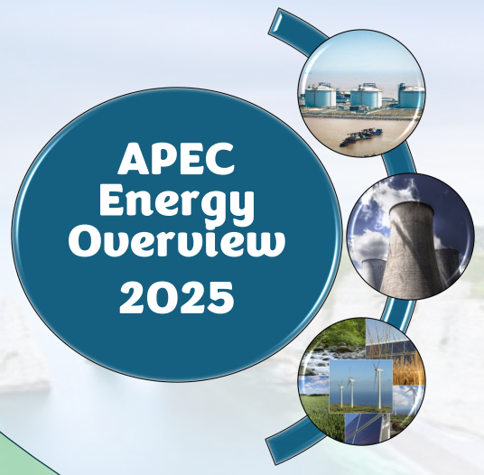
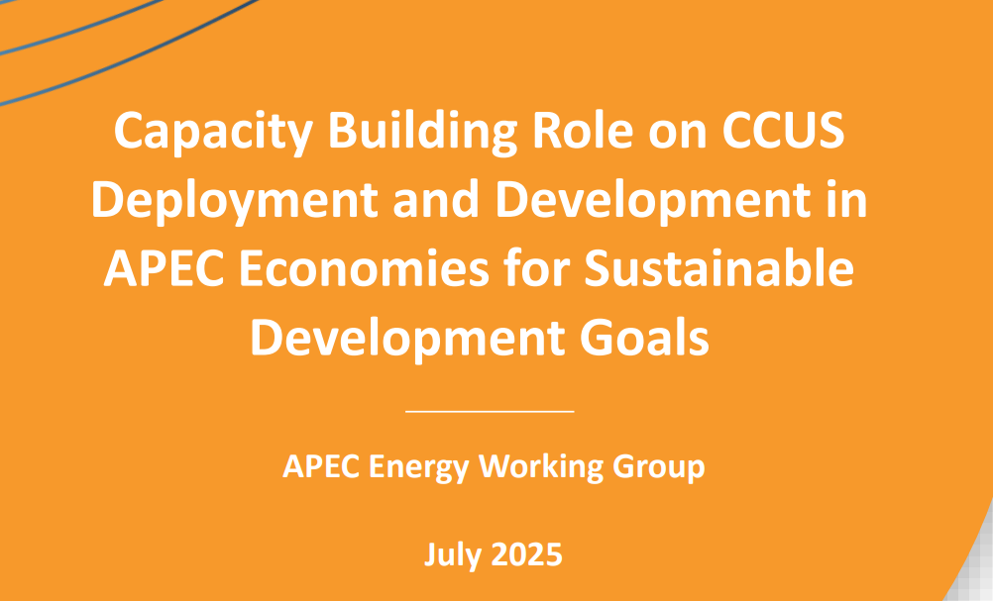
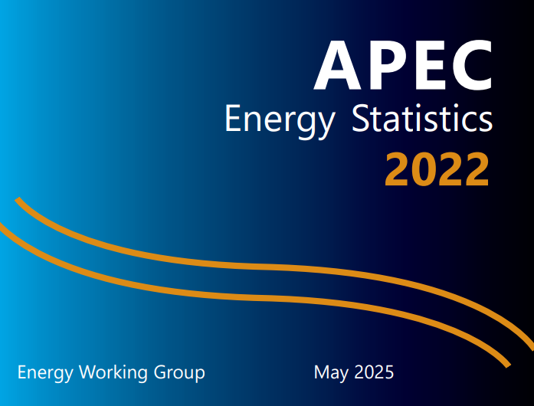
Key Fora Deliverables in 2025
1
Ministerial statement for 15th EMM
2
Implementation Plan of the APEC Policy Guidance to Develop and Implement Clean and Low-Carbon Hydrogen Policy Frameworks in the Asia-Pacific（already endorsed）
3
Summary reports or workshops based on 20+ projects.
Vol 1 of the 9th edition of APEC Energy Demand and Supply Outlook (submitted in Nov and to be published by APERC. It is published every 3 years, and it is the basis of energy policy dialogue within EWG and among APEC energy ministers)
4
5
APEC Urban Energy Report ( Storage Enables Transition. published by APSEC late this summer)

Slide 6
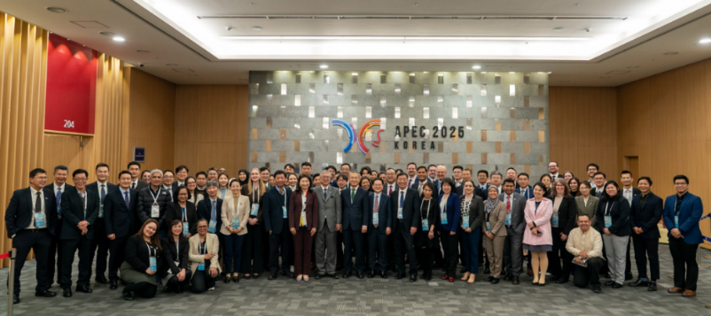
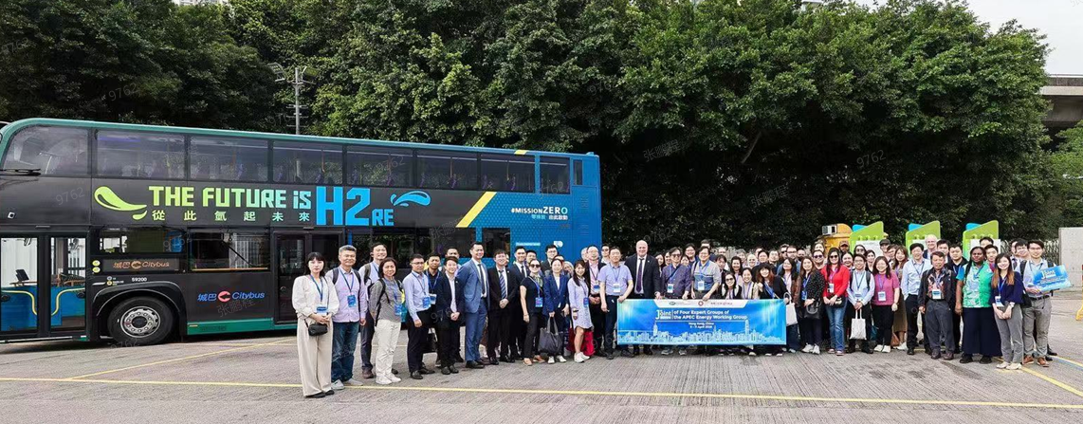
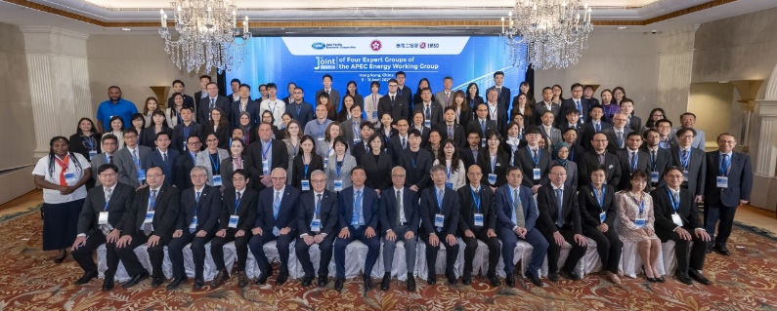
Major Activities in 2025
EWG 69 & Associated Meetings from 24 to 27 February in Gyeongju
EWG 70 & Associated Meetings from 25 to 26 August in Busan
1st Joint Expert Group Meeting (EGEEC, EGNRET, EGEDA and EGCFE) from 8 to 11 April in Hong Kong, China
8 virtual meetings: with Auto Dialogue, IEA, APEC Sec & ROK team
20+ EWG workshops in 2025.
15 APEC funded projects has been endorsed （ 6 in Project Session I & 9 in PS II ）, for future workshops and training programs.
EWG LS reported to the APEC Senior Officials' Steering Committee on Economic and Technical Cooperation (SCE) in early March and the Energy Ministers' Meeting (EMM15) in late August.

Slide 7

Cross-Fora Collaborations
Experts are invited both from inside and outside APEC to join our workshops & projects
with APEC Automotive Dialogue & the Transportation Working Group（TPTWG) on EV & Batteries, Fuel Cells
with the Policy Partnership on Science, Technology and Innovation (PPSTI) & Sub-Committee on Standards and Conformance (SCSC) on energy resiliency
with Small and Medium Enterprises Working Group(SMEWG) & IEA on hydrogen & energy efficiency
with PPSTI & PPWE & IRENA on New Smart Materials for Sustainable Energy +Just Energy Transitions
with UN ESCAP, IRENA and ADB on energy storage
With IEA, IEF & IRENA on energy data
note： UN ESCAP：Economic and Social Commission for Asia and the Pacific

Slide 8
EWG Strategic Plan for 2025-2030
EWG’s annual fora report was submitted and endorsed by EWG and SCE in late Sep, and used for the 2025 APEC Senior Officials’ Report on Economic and Technical Cooperation.
Seek endorsement of the updated ToR of EWG and EGCFE within the year.
After 11 rounds of consultations with various economies, EWG Strategic Plan (2025-2030) is almost finalized. Before its endorsement, it may be changed in accordance with further discussion of the EWG ToR.
4 Pillars for EWG Activities
Build an open, dynamic, resilient and peaceful Asia-Pacific community
Strengthen Energy Security
Enhance Energy Resilience
& Promote Energy Access
Facilitate Energy Trade & Investment
Accelerate Clean, Sustainable, Just, Affordable, and Inclusive Energy Transitions

Slide 9

Thank you.
Energy Working Group – Lead Shepherd Mr. Shan Weiguo

