Slide 1

EGEDA Update
The 65th APEC EGEEC and 63rd APEC EGNRET Joint Meeting
19-20 November 2025 – Seoul, Republic of Korea
Ms Elvira Torres Gelindon
EGEDA Secretariat

Slide 2
Outline
Data collection and processing update
EGEDA training courses and workshops
International cooperation
Progress on APEC goals

Slide 3
Data collection and processing update

Slide 4
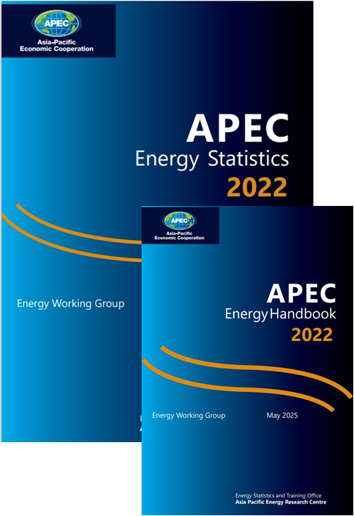
Regular APEC energy data collection
The APEC Energy Statistics 2022 was published online, while the APEC Energy Handbook 2022 was both published and printed in May 2025.
The secretariat has finished processing the 2023 annual energy supply and demand data from member economies. Preparations for the publication are ongoing: drafting of the chapters, graphs and figures, etc
Other data collection
  Annual energy prices
  Annual GHG emissions
    CO₂, CH₄ and N₂O emissions from energy combustion and fugitive emissions
    CO₂ transported and stored
  Energy efficiency indicators
  Monthly oil and gas supply and demand (JODI)
  Quarterly energy supply
  Major economic indicators
  Energy-related indicators

Slide 5
Smiley faces of JODI Gas in APEC (January-June 2025)
Compared to Jan – Jun 2024
-1
+1
Compared to Jul – Dec2024
-1
-1
Notes:
This is the Smiley faces table of JODI Oil.
For sustainability, most of member economies have smiley faces, other than PNG.
7 member economies don’t have smiley for timeliness and 5 member economies don’t have smiley for completeness during this period.
Compared to the same period last year, +2 Smiley faces has increased for sustainability, -1 Smiley face has decreased for timeliness. +1 Smiley face has increased for completeness.
(Compared to the last assessment (Jan – Jun 2022), No change for sustainability and -2 smileys decreased for timeliness, +1 Smiley has increased for completeness.)

Slide 6
Smiley faces of JODI Gas in APEC (January-June 2025)
-1
+1
Compared to Jan – Jun 2024
-1
-1
Compared to Jul – Dec2024

Slide 7
EGEDA training courses and workshops

Slide 8
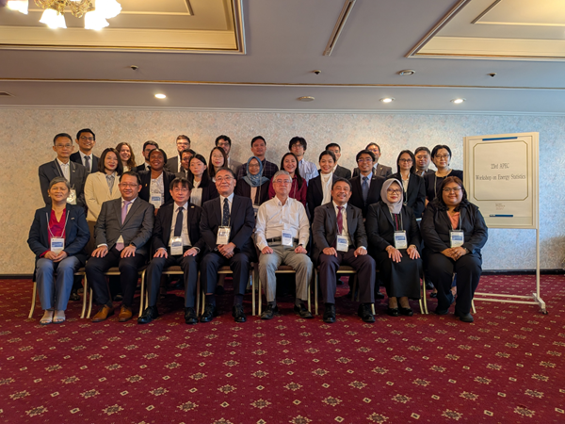
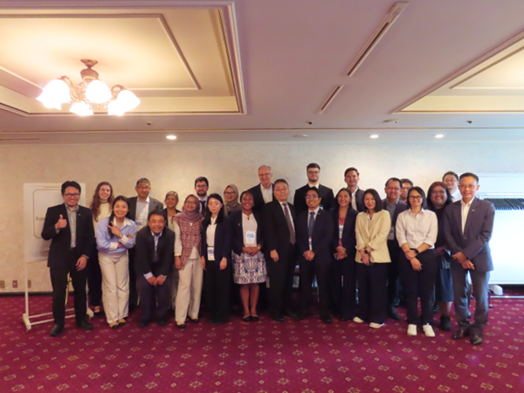

23rd APEC workshop on energy statistics- completed
Dates: 17-19 September 2025
Venue: Tokyo Prince Hotel, Tokyo, Japan
Theme: Conducting end-use energy consumption surveys
Objectives:
  The workshop's main objective involved the sharing of energy consumption survey practices among member economies such as:
    Sampling methodologies
    Preparation of questionnaires and enumerator’s manual
    Conduct of pilot survey
  The workshop facilitated dialogues on the issues and challenges encountered in end-use energy consumption surveys and how these can be addressed.

Slide 9
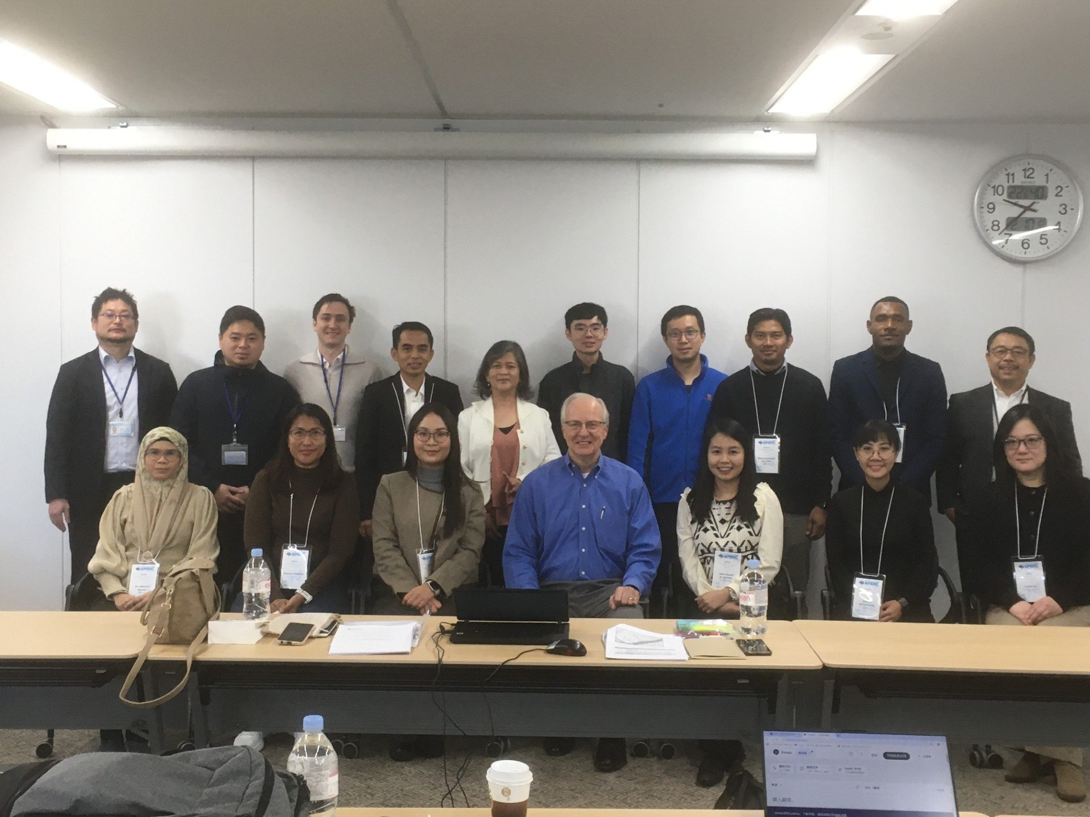
Energy statistics course (planned)
Dates: 19-30 January 2026
Venue: APERC Headquarters, Tokyo, Japan
Trainers​: APERC ESTO Researchers (EGEDA secretariat)
Objectives
  Increase the capacity of energy statisticians in APEC economies
  Keep members up-to-date with new developments.
  Enhance the human resource network between APEC economies and APERC
  Increase the level of understanding of the APEC energy database by APEC economies
  Introduce world trends in energy statistics to APEC economies
  Improve the reliability of the APEC energy database
Energy statistics training course in 2025

Slide 10
Performance levels for collecting/reporting energy statistics
Level | Performance
1 | Economy collects energy production data for administrative purposes (e.g., managing private oil and gas companies) Electricity data (only that collected by the state electricity company); no estimates of renewable energy production Economy does not compile energy statistics/balances; does not complete APEC annual energy collection templates.
2 | Collects energy data from administrative sources; energy balances are incomplete Energy consumption data are aggregated and limited to major sectors (i.e., industry, transportation, buildings, etc.) Economy does not complete the APEC annual energy data collection templates
3 | Collects energy data from administrative sources; energy balances are incomplete Some energy consumption data are categorized by subsectors; no end-use data Does not complete the APEC annual energy data collection templates
4 | Collects energy data from administrative sources; energy balances are largely complete Energy consumption data are broken down into subsectors Conducts end-use energy consumption surveys; but does not submit end-use data in the APEC EEI template Completes the APEC annual energy data collection templates
5 | Collects energy data from administrative sources; prepares complete and accurate energy balances Categorizes energy consumption data by subsector Conducts end-use energy consumption surveys; submits end-use energy consumption data in the APEC EEI template Completes the APEC annual energy data collection templates

Slide 11
Currently a wide range of collection and reporting capabilities
Majority of the members are not able to complete the APEC annual energy data collection templates.
Most of the data submitted does not reflect the preferred degree of granularity for energy use (fuel by end-use)

Slide 12
International cooperation

Slide 13
Secretariat’s participation in international meetings
JODI Inter-secretariat working group (ISWG) meeting (10 September 2025, online).
JODI Energy Market Transparency Seminar on Global Perspectives on Energy Market Transparency and Energy Data Reporting: JODI and Beyond (25 November 2025, Riyadh, Saudi Arabia).
Task Team for the Revision of Standard International Energy Classification (TT-SIEC) under International Energy Statistics Working Group (InterEnerStat) (approximately once every two months, online).
Committee on Energy Statistics (11-12 November 2025, online), regular meetings between the IEA and various energy statistics organizations, to discuss updates on energy statistics.

Slide 14
Results of TT-SIEC discussions
The TT-SIEC has finalized its proposed SIEC revisions for global consultation; revisions include:
    Conventional and non-conventional crude oils are put under 1 section
    Additional section is added for cooling called “Cold” to account for energy used for cooling
    Another section for Hydrogen and Derived Synthetic Fuels was added
    Number of sections increased from 10 to 11
    Solid biofuels were disaggregated per types of biomass
The revised SIEC structure will be submitted to 2025 UNCEISC meeting for recommendation.
Final revised structure will be submitted to the UN Statistical Commission in 2026 for endorsement.

Slide 15
Progress toward APEC’s energy intensity and renewable doubling goals

Slide 16
APEC’s final energy intensity improved from previous year
Annual change in APEC final energy intensity, 2006-22
 | 2006 | 2007 | 2008 | 2009 | 2010 | 2011 | 2012 | 2013 | 2014 | 2015 | 2016 | 2017 | 2018 | 2019 | 2020 | 2021 | 2022 | 2023 | 2005-23
Change in Final Energy Consumption (FEC) | 2.4% | 3.6% | 0.8% | -1.2% | 5.8% | 4.2% | 2.0% | 1.4% | 0.3% | 0.6% | 0.4% | 1.4% | 3.2% | 0.3% | -3.8% | 4.9% | 2.6% | 2.6% | 36.1%
Change in GDP (PPP, constant 2021 US dollars) | 5.4% | 5.5% | 3.1% | -0.3% | 5.7% | 4.3% | 4.3% | 3.9% | 3.9% | 3.7% | 3.5% | 4.1% | 4.2% | 3.5% | -1.1% | 6.4% | 2.9% | 3.8% | 92.0%
Change in final energy consumption intensity | -2.9% | -1.8% | -2.2% | -0.9% | 0.0% | 0.0% | -2.2% | -2.4% | -3.4% | -3.0% | -2.9% | -2.6% | -0.9% | -3.1% | -2.7% | -1.5% | -0.3% | -1.2% | -29.2%
Sources: APEC statistics (EGEDA), WB (GDP PPP), CT (WEO), APERC analysis
Goal: decrease energy intensity of TFEC by 45% relative to 2005 by 2035.
GDP increased to 3.8% in 2023, almost one percentage point increase from 2022; average growth between 2011 and 2019 (just after the financial crisis and before COVID-19).
FEC growth in 2023 was unchanged (same as 2022), while final energy intensity has improved by almost one percentage point from the 2022 level.

Slide 17
Likely that share of modern renewables has already doubled
Final energy consumption, PJ
Electricity generation, TWh
 | 2010 | 2023 | % change
Non-renewables | 165,114 | 192,148 | 16.4%
Coal | 32,126 | 27,638 | -14.0%
Oil | 64,214 | 70,041 | 9.1%
Gas | 26,155 | 37,069 | 41.7%
Electricity | 34,519 | 44,345 | 28.5%
Heat | 7,884 | 12,679 | 60.8%
Other non-renewables | 217 | 375 | 73.0%
Traditional biomass | 3,209 | 2,558 | -20.3%
Modern renewable energy | 10,753 | 23,362 | 117.3%
Electricity | 6,286 | 16,581 | 163.8%
Heat | 62 | 358 | 474.8%
Modern biomass | 2,816 | 3,131 | 11.2%
Other renewables | 1,589 | 3,292 | 107.2%
Total | 179,076 | 218,068 | 21.8%
Modern RE share | 6.00% | 10.71% | 78.4%
 | 2010 | 2023 | % change
Non-renewables | 11,334 | 14,305 | 26.2%
Coal | 6,577 | 8,183 | 24.4%
Oil | 325 | 150 | -54.0%
Gas | 2,687 | 4,053 | 50.9%
Nuclear | 1,658 | 1,844 | 11.2%
Other non-renewables | 87 | 75 | -14.0%
Modern renewable energy | 2,108 | 5,329 | 152.8%
Modern biomass | 67 | 269 | 300.9%
Hydro | 1,780 | 2,450 | 37.6%
Geothermal | 46 | 60 | 29.1%
Solar | 9 | 1,056 | 11642.6%
Wind | 163 | 1,461 | 798.3%
Other renewables | 43 | 34 | -21.6%
Total | 13,442 | 19,634 | 46.1%
Modern RE share | 15.68% | 27.14% | 73.1%
Note: Consumption of electricity and heat from renewables is calculated from the share of total electricity and heat production.
Sources: APEC statistics (EGEDA), APERC analysis
Renewable shares to final energy consumption and electricity generation constantly show good progress.

Slide 18
Pursuing and encouraging efforts to triple global renewable energy capacity by 2030

Slide 19
Support for tripling global renewable energy capacity
COP28 Declaration (excerpt)
To accelerate the energy transition, the COP 28 Presidency took a leading role in launching the Global Renewables and Energy Efficiency Pledge. With the endorsement of 130 national governments (as of 11 December, including the European Union (EU)), the Pledge stipulates that signatories commit to work together to triple the world’s installed renewable energy generation capacity to at least 11,000 GW by 2030….. (COP28 UAE, 2023)
2023 APEC Leaders’ Golden Gate Declaration (excerpt)
We will pursue and encourage efforts to triple renewable energy capacity globally through existing targets and policies as well as demonstrate similar ambition with respect to other zero and low emissions technologies including abatement and removal technologies in line with domestic circumstances by 2030.

Slide 20
Global installed renewable energy capacity in 2023
Estimated global RE capacity (GW)
Current and target global RE generation capacity (GW)
Source for both figures: IRENA
The COP28 target for 2030 is 11 000 GW of installed renewable generation capacity.

Slide 21
APEC’s share of global RE capacity in 2023
Estimated APEC RE capacity (GW)
APEC and global level relative to 2030 target (GW)
2,409 GW
Sources: EGEDA, IEA
In 2023, APEC accounted for 62% of global RE capacity.

Slide 22
Summary
Following the pandemic, APEC GDP and energy consumption both rebounded, however, final energy consumption was stable between 2022 and 2023
Though not much, final energy intensity in 2023 has improved compared with 2022.
Renewable energy, specifically solar and wind, was the fastest-growing energy source in APEC power generation in 2023.
In 2023, APEC accounted for approximately 62% of global renewable generation capacity. APEC plays a big role in the global tripling capacity goal.

Slide 23
Thank you.
https://aperc.or.jp

