Slide 1


Progress Report on EGCFE
Mitsuhito TAKADA
Vice President, APERC
On behalf of Yoshiomi YOSHINO
Chair of Expert Group on Clean Fossil Energy (EGCFE)
19-20 Nov. 2025
Notes:
Thank you.
My name is Mitsuhito Takada, Vice President of APERC.
As Mr. Yoshiomi Yoshino, Chair of EGCFE, is unable to attend today’s meeting, I will present the Progress Report on EGCFE on his behalf.

Slide 2
EGCFE and related APEC Events（2025）
EGCFE 2025 meeting was held at Joint Expert Group Meeting in April in Hong Kong, China
OGSI（APEC Oil and Gas Security Initiative）
  Oil and Gas Security Exercise (OGSE): The 6th OGSE was held in Indonesia in February
  Oil and Gas Security Network (OGSN): The 8th OGSN Forum was held in Hong Kong, China in April
  Oil and Gas Security Studies (OGSS)
    OGSS 20, “What are the Energy Security Implications of Recent Declines in Both APEC and Global Spare Petroleum Refining Capacity?” (Apr. 2025)
APERC Fossil Fuel Reports 2024
    Gas (May 2025), Oil (May 2025), Hydrogen (Mar. 2025), Coal (Mar. 2025)
Notes:
First, I would like to provide an overview of EGCFE and related APEC events in 2025.
The EGCFE 2025 meeting was held in April during the Joint Expert Group Meeting in Hong Kong, China.
Regarding OGSI-related activities, three major events took place:
February, Indonesia
The 6th Oil and Gas Security Exercise (OGSE) was successfully held. We extend our sincere appreciation to Indonesia for hosting this important exercise.
April, Hong Kong, China
The 8th Oil and Gas Security Network (OGSN) Forum was convened back-to-back with the Joint Expert Groups Meeting.
April
The 20th publication of Oil and Gas Security Studies (OGSS) was released.
Its title:
“What are the Energy Security Implications of Recent Declines in Both APEC and Global Spare Petroleum Refining Capacity?”
Regarding APERC Fossil Fuel Reports, four reports were published in 2025:
March: Hydrogen Report and Coal Report
May: Gas Report and Oil Report
These reports provide key insights into fossil fuel trends and developments across the APEC region.

Slide 3
Future EGCFE and related APEC Events
EGCFE 2026 meeting will be held jointly with the 9th APEC OGSN Forum (Jun. 2026, Hokkaido, Japan, TBD)
  with site visit to Tomakomai CCS Demonstration Project by JCCS (Japan CCS Co., Ltd.)
APEC Workshop on Cleaner and More Efficient Operation of the Fossil Energy Industry (Dec. 2025, Tokyo)
The 1st Annual Convention for APEC Clean and Low-Carbon Hydrogen Policy Network Project (May 2026, HKC)
APEC Oil and Gas Security Exercise (OGSE): The 7th OGSE will be held in Malaysia (Feb. 2026)
Notes:
Then, I would like to explain briefly future EGCFE and related APEC events under preparation.
The EGCFE Meeting, held back-to-back with the APEC OGSN Forum, is scheduled for June 2026 in Hokkaido.
The program will include a site visit to the Tomakomai CCS Demonstration Project operated by Japan CCS Co., Ltd.
The Tomakomai CCS Demonstration Project is Japan’s pioneering initiative in Carbon Capture and Storage (CCS), driven by the private sector with strong support from the Japanese government.
Japan CCS Co., Ltd. (JCCS), the operator of the site, was established in 2008 in response to national policy promoting CCS as a key measure against global warming.
JCCS brings together major private companies with expertise in electricity, oil refining, oil development, and plant engineering to advance CCS technologies.
We expect that the meeting and site visit will provide participants with valuable insights into CCS and its role in achieving decarbonization goals.
Further details of the meetings will be announced in due course. We warmly invite and encourage broad participation in this important opportunity.
Next, I would like to introduce three forthcoming events;
December 2025, in Tokyo, APEC Workshop on Cleaner and More Efficient Operation of the Fossil Energy Industry.
May 2026, in Hong Kong, China, The 1st Annual Convention for the APEC Clean and Low-Carbon Hydrogen Policy Network Project.
APEC Oil and Gas Security Exercise (7th Exercise) is currently under coordination to do in February 2026 in Malaysia.
Further details will be announced in due course.

Slide 4
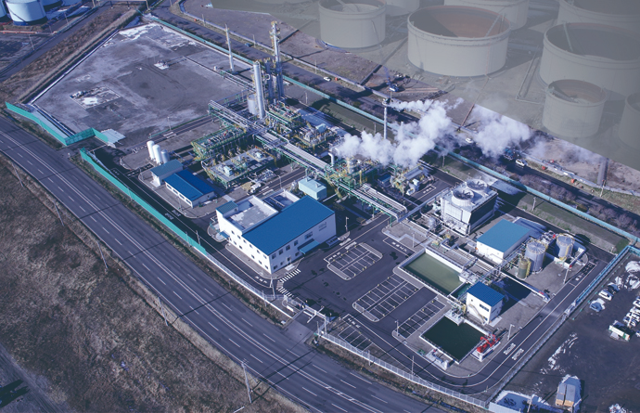
Tomakomai CCS Demonstration Facilities
Source: JCCS
Notes:
This is a picture of Tomakomai CCS Demonstration Facilities, provided by JCCS.
The site locate just side-by-side with large petroleum complex.

Slide 5
Thank you for your kind attention.​
We would like to see more Project Proposals coming through EGCFE.
Notes:
That concludes my explanation.
I look forward to seeing you all at future OGSI events and at the EWG and EMM in August.
Thank you for your attention.

