Slide 1
EGEEC Report
Joint Meeting of EGEEC 65 and EGNRET 63
Seoul, Republic of Korea
19 November 2025

Slide 2
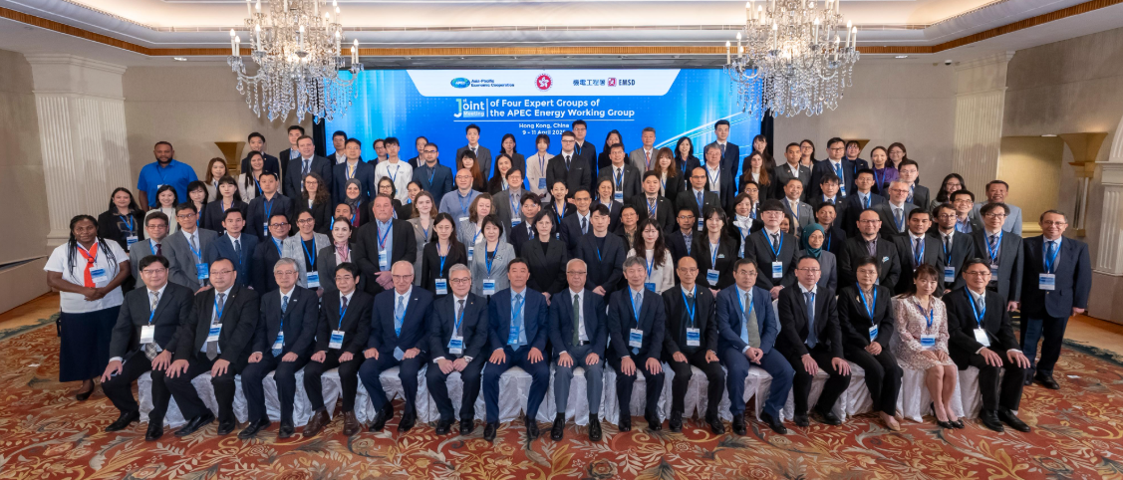
The EGEEC 64 meeting
Highlights
The EGEEC64 meeting was hosted by Hong Kong, China from 9 to 10 April 2025, as part of the joint meeting of four EWG Expert Groups.
APEC Workshop on “Promoting Energy Efficiency Enhancement in Electricity Generation” was organised by Hong Kong, China on 8 April 2025.
A full-day technical visit was organised on 11 April 2025.

Slide 3
Participating Economies and Organisations
Economies (18): Australia; Brunei Darussalam; Canada; Chile; People's Republic of China; Hong Kong, China; Indonesia; Japan; Republic of Korea; Malaysia; Papua New Guinea; Peru; The Philippines; The Russian Federation; Singapore; Chinese Taipei; Thailand; and Viet Nam
EWG Sub-Fora (8): APEC Secretariat; EWG; EGEDA, EGEEC, EGNRET, EGCFE, APERC, APSEC
Non-APEC Organisations (6): IEA; IRENA; IEF; Collaborative Labelling and Appliance Standards Program (CLASP); United Nations Environment Programme (UNEP); Energy Efficiency Hub (EE Hub)

Slide 4
Presentations
Cross-Fora Updates (8): APEC Secretariat; EWG; EGEDA, EGEEC, EGNRET, EGCFE, APERC, APSEC
Economy Updates (17): Australia; Brunei Darussalam; Chile; People's Republic of China; Hong Kong, China; Indonesia; Japan; Republic of Korea; Malaysia; Papua New Guinea; Peru; The Philippines; The Russian Federation; Singapore; Chinese Taipei; Thailand; and Viet Nam
Invited Presentations (6): IEA; IRENA; IEF; CLASP; UNEP; EE Hub
Projects Updates and Concept Note (3): Hong Kong, China; Japan / APERC; Chinese Taipei

Slide 5
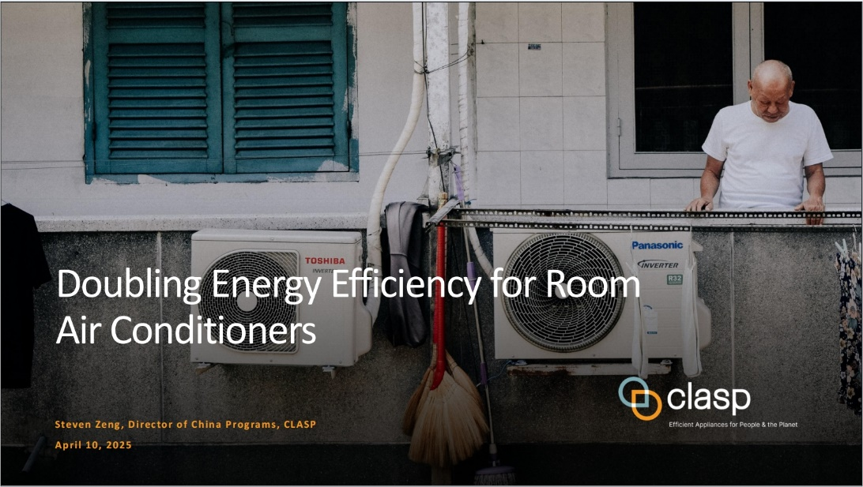
Cross Fora and Organisations Cooperation
Collaborative Labelling and Appliance Standards Program（CLASP）
CLASP presented its report on pathways for improving the energy efficiency of appliances, with a focus on room air conditioners.
The presentation highlighted China’s progress in air conditioner efficiency and stressed the urgent need of robust global policies, standards, and incentives to scale up appliance efficiency and support the clean energy transition.

Slide 6
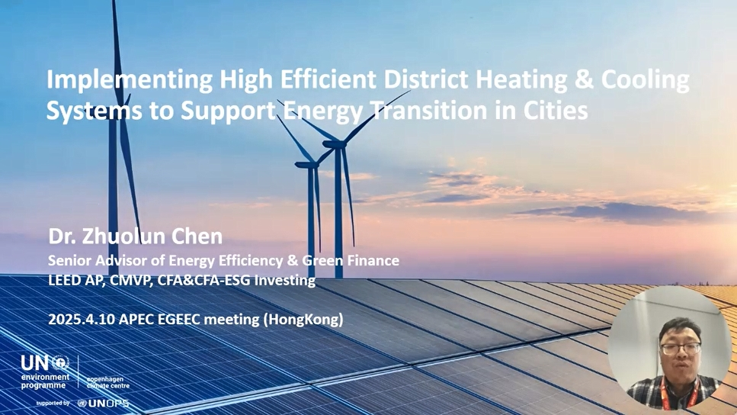
Cross Fora and Organisations Cooperation
United Nations Environment Programme (UNEP)
UNEP shared since 2024 in advancing district energy systems in emerging economies, especially district heating and cooling systems.
The presentation underscored their importance in addressing global energy challenges, particularly in developing regions, and offered practical insights on implementation.

Slide 7
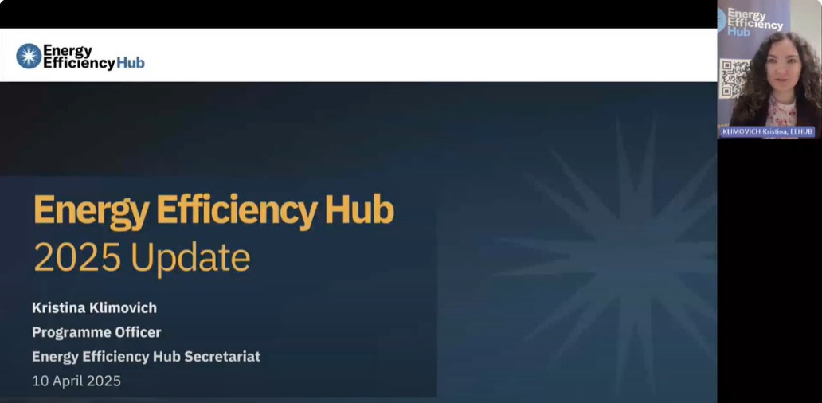
Cross Fora and Organisations Cooperation
Energy Efficiency Hub (EE Hub)
EE Hub shared the latest work of the five Task Groups:-
  Digitalisation Working Group (DWG) - lead by China
  Super-Efficiency Equipment & Appliance Deployment Initiative (SEAD) - lead by UK
  Top Ten Energy Efficiency Best Available Technologies and Practices (TOP-TENs) - lead by China
  Energy Efficiency in Buildings (EEB) - lead by EU and Germany

Slide 8
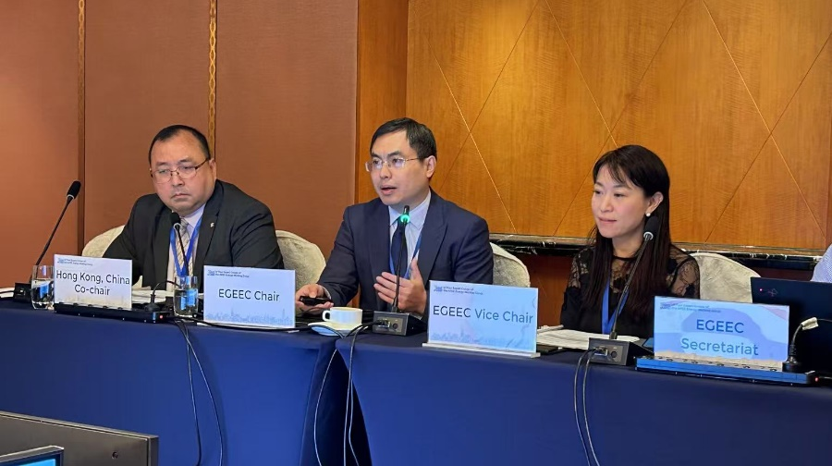
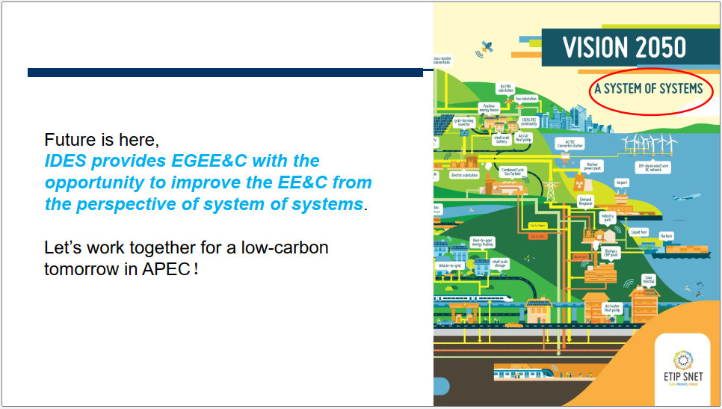
Chair’s Presentation
Integrated District Energy Systems (IDES) by Dr LIU Meng
Chair introduced the concept of Integrated District Energy Systems (IDES) as an advanced, energy-efficient framework that integrates heating, cooling and power supply to optimise energy use at the district level.
Chair shared global perspectives and his role as International Organization for Standardization (ISO) Convener of two Working Groups, tasked with developing IDES standards by 2026.
Chair encouraged members to share best practices and successful case studies on IDES, with the goal of reducing energy intensity across the APEC region.

Slide 9
EGEEC Governance Issues
New Term of EGEEC Chair and Vice Chair for the term from July 2025 to June 2027
The draft EGEEC ToR for 2026-2029 is endorsed by EGEEC members as no comments were received as of 10 January 2025. The draft was submitted to the EWG members for their endorsement.
CLASP has accepted EGEEC’s invitation to be EGEEC guest member. The application has been endorsed by the EWG and SOM on 21 April 2025. The guest status will be valid until 31 December 2027.
  EGEEC Chair: Dr Liu Meng People's Republic of China
  EGEEC Vice-chair: Ms CHEUNG Man Chit Jovian Hong Kong, China

Slide 10
THANK YOU

