Slide 1
APERC Update
EGEEC65 and EGNRET63 Joint Meeting
19 November 2025 – Seoul, Korea
Mitsuhito TAKADA, Vice President, APERC

Slide 2
APERC Activities (2025)
1. Research Activities
  APEC Energy Demand and Supply Outlook
  APEC Energy Overview
  Fossil Fuel Reports
2. Policy Cooperative Activities
  CBWS/EECP (Capacity Building Workshop on Energy Efficiency and Conservation Policy)
  OGSI (Oil and Gas Security Initiative)
3. Energy Data Management and Training on Data & Modelling
Notes:
Thank you.
First, I would like to provide an overview of APERC’s activities in 2025.
At the end of October, APERC hosted an official preview event for the APEC Energy Demand and Supply Outlook, our flagship publication, in collaboration with the APEC Secretariat in Singapore.
While the full report will be published at a later date, the event served as a platform to highlight the key themes and analyses that the Outlook will cover.
Another major publication, the APEC Energy Overview, was released in July 2025, as many of you may already know.
In addition, APERC published four Fossil Fuel Reports in 2025:
March: Hydrogen Report and Coal Report
May: Gas Report and Oil Report
Second, I would like to report on recent Policy Cooperation Activities.
Yesterday, we successfully held a Capacity Building Workshop on Energy Efficiency and Conservation Policy, with XX participants from YY member economies.
We sincerely appreciate the active participation and contributions from all attendees.
As this workshop marks the beginning of a new initiative, we encourage all member economies to join us on this journey to advance energy efficiency and conservation policies.
In addition, I would like to provide an update on Oil and Gas Security Initiative:
The Oil and Gas Security Exercise with Indonesia was successfully conducted in February, and its report was published in October.
The 20th report in the Oil and Gas Security Study series, titled “What are the Energy Security Implications of Recent Declines in Both APEC and Global Spare Petroleum Refining Capacity?”, was published in April.
Third, on Energy Data Management and Training in Data & Modelling.
The 23rd APEC Workshop on Energy Statistics was held in Tokyo in September, with XX participants from YY member economies.
This workshop focused on capacity building for conducting household energy consumption surveys, which are a critical foundation for developing effective energy efficiency and conservation policies.
Once again, thank you for your active participation and contributions.

Slide 3
APEC Energy Demand and Supply Outlook
The APEC Energy Demand and Supply Outlook is APERC’s flagship report that presents projections of energy demand and supply for each of the 21 APEC member economies and for the APEC Region as a whole.
The 9th edition is set to be published soon.
The highlights of the 9th edition:
  Projections: 2022-2060
  Two scenarios: the Reference (REF) & the Target (TGT)
  Strong growth in electricity consumption
  Fossil fuel remains significant in primary energy supply
  Dispatchable power matters in a high-renewable grid
  Transition costs for power systems & hydrogen
  CO₂ emission
Notes:
Now, I’d like go a little in detail.
The APEC Energy Demand and Supply Outlook
is APERC’s flagship publication that present projections of energy demand and supply for each of the 21 member economies and for the APEC region as a whole.
The Outlook is published every three years, and the 9th edition is scheduled for release this year.
Final tuning and editorial work are nearly complete.
At the end of October, APERC, in collaboration with the APEC Secretariat, hosted an official preview event in Singapore to highlight the key themes and analyses that will be featured in the report.
The major highlights of 9th edition are as follows;
Projections from 2022 to 2060
Two scenarios; Reference or REF scenario as base line and Target or TGT scenario based on member economies policy objectives or targets at maximum implementation.
Strong growth in electricity consumption.
Fossil fuel remains significant in primary energy supply
Dispatchable power matters in high-renewable grid
Transition costs for power systems & hydrogen
CO2 emission projection
Among these, the calculation of transition costs is a new initiative in the Outlook, although it comes with certain reservations and limitations.

Slide 4
APEC Energy Overview
The APEC Energy Overview is an annual publication that highlights the current energy situation in each of the 21 APEC economies.
The most recent one, APEC Energy Overview 2025, was published on both the APEC and APERC websites in July 2025.
The Overview also reports progress toward meeting the two APEC energy goals, namely:
1. Energy intensity reduction of 45% by 2035 (relative to 2005).
2. Doubling the modern renewable energy share in the APEC energy mix by 2030
(relative to 2010).
The current situation of these goals will be reported in EGEDA updates later.
Notes:
The APEC Energy Overview
is an annual publication that provides a comprehensive snapshot of the current energy situation in each of the 21 APEC economies.
The most recent edition was published in July 2025, following endorsement by the EWG.
The Overview also tracks progress toward achieving the two APEC energy goals:
Reducing energy intensity by 45% by 2035 (relative to 2005).
Doubling the share of modern renewable energy in the APEC energy mix by 2030 (relative to 2010).
The latest status of these goals will be reported in upcoming EGEDA updates.

Slide 5
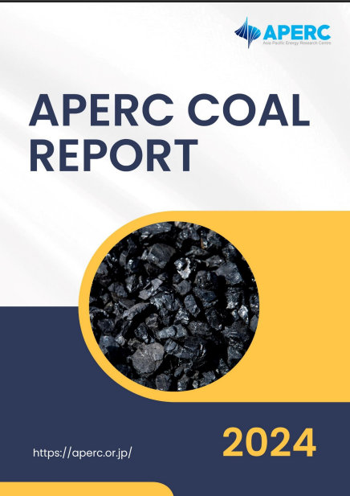
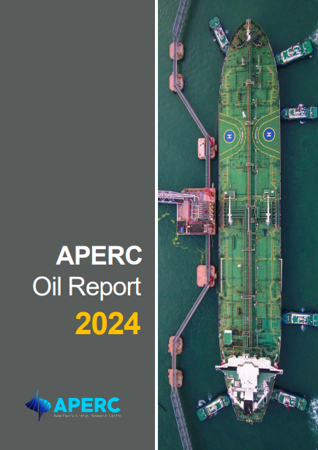
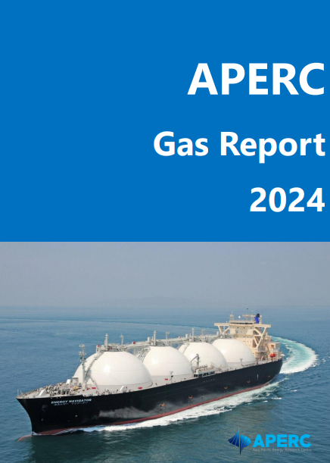
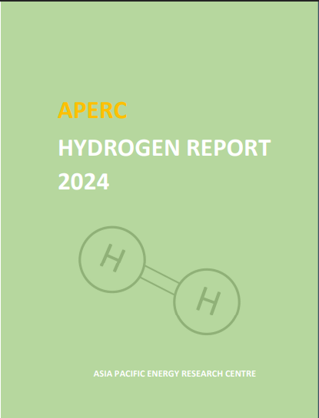
Fossil Fuel Reports
Studies focusing on fossil fuels (coal, oil and natural gas) to support the Expert Group on Clean Fossil Energy (EGCFE) have been published since 2017.
APERC Hydrogen Report has been published to support both EGCFE and Expert Group on New and Renewable Energy Technologies (EGNRET) since 2023
APERC published APERC Coal Report 2024 and APERC Hydrogen Report 2024 in March 2025, and APERC Oil Report 2024 and APERC Gas Report 2024 in May 2025.
Notes:
Along with the Outlook and the Overview, APERC continues to conduct research on topics relevant to energy issues and policies across the APEC region.
Studies focusing on fossil fuels (coal, oil and natural gas) to support the Expert Group on Clean Fossil Energy (EGCFE) have been published since 2017.
APERC Hydrogen Report has been published to support both EGCFE and Expert Group on New and Renewable Energy Technologies (EGNRET) since 2023
In 2025, APERC published four reports under the Fossil Fuel series:
May: Gas Report and Oil Report
March: Hydrogen Report and Coal Report
These reports provide in-depth analysis of demand, supply, trade, price, technology and policy in key energy sectors.

Slide 6
Policy Cooperative Activities
CBWS/EECP (Capacity Building Workshop on Energy Efficiency and Conservation Policy)
  Phase I is ongoing.
  Phase II has been approved for funding.
APEC Workshop on Cleaner and More Efficient Operation of the Fossil Energy Industry
  The first workshop will be held in Tokyo, Japan on 3-4 December 2025.
OGSI (Oil and Gas Security Initiative)
  OGSE (Oil and Gas Security Exercise)
    OGSE in Indonesia –Summary report was published in October 2025.
  OGSN (Oil and Gas Security Network)
    OGS Newsletter issue No. 66 was issued in October 2025.
  OGSS (Oil and Gas Security Study)
    OGSS 21 Report, “The Energy Security Implications of Declining LNG Investment” is being finalized.
    OGSS 22 suggested theme, “The Energy Security Implications of Upstream Oil Underinvestment” was approved and literature research is ongoing.
Notes:
Policy Cooperative Activities
Capacity Building Workshop on Energy Efficiency and Energy Conservation Policy
This is a new project following the successful APEC Peer Review of Energy Efficiency (PREE) among APEC member economies launched in 2007.
This workshop focuses on MEPS (Minimum Energy Performance Standards).
MEPS has achieved significant results in promoting energy efficiency and conservation worldwide,
and we believe this workshop will be an excellent opportunity to strengthen member economies' capacity.
The first workshop was held yesterday and was a great success, with xx participants from yy member economies.
We thank everyone for their participation and hope for your continued participation in the future.
The project proposal for the APEC Workshop on Cleaner and More Efficient Operation of the Fossil Energy Industry was endorsed in October 2024.
The capacity building workshop will provide fundamental technical knowledge to policymakers and relevant officials in APEC economies to identify feasible solutions and advice regarding:
Improving energy efficiency in the fossil energy industry,
Reducing fugitive emissions in the fossil energy industry, and
Advancing technologies and best practices that enhance both energy efficiency and emissions reduction.
The first workshop will be held in Tokyo, Japan on 3-4 December 2025.
Oil and Gas Security Initiative is APERC response to the 2014 APEC Ministers Meeting (EMM 11) directives in Beijing.
Oil and Gas Security Exercise with Indonesia was successfully done in February and its report was published in October.
Again, thank you very much for participating the exercise. We believe the exercise gave all participants deep and informative insight at the case of security incidents.
In2026, we are going to have another exercise with Malaysia.
OGS Newsletter issue No. 66 was issued in October 2025.
As Oil and Gas Security Study series report #20, titled “What are the Energy Security Implications of Recent Declines in Both APEC and Global Spare Petroleum Refining Capacity?” was also published in April.
OGSS 21 Report, “The Energy Security Implications of Declining LNG Investment” is being finalized.
OGSS 22 suggested theme, “The Energy Security Implications of Upstream Oil Underinvestment” was approved and literature research is ongoing.

Slide 7
Energy Data Management and Training on Data & Modelling
The APEC Energy Statistics 2022 and APEC Energy Handbook 2022
  Published in May 2025.
The 23rd APEC Workshop on Energy Statistics was held on 17-19 September 2025 in Tokyo.
  The topic of the workshop was the preparation of instruments for end-use energy consumption surveys, which included:
  Discussion on sampling methodologies
  Preparation of survey questionnaire and enumerators’ manual
  Discussion on the conduct of a pilot survey
Notes:
The APEC Energy Statistics 2022 and APEC Energy Handbook 2022
was published in May 2025.
The 23rd APEC Workshop on Energy Statistics was held on 17-19 September 2025 in Tokyo.
The workshop's main objective is to enhance the EGEDA members’ capability in end-use data collection through an energy consumption survey.
The topic of the workshop was the preparation of instruments for end-use energy consumption surveys, which included:
Discussion on sampling methodologies
Preparation of survey questionnaire and enumerators’ manual
Discussion on the conduct of a pilot survey

Slide 8
Future APEC-related Events and Activities (1)
CBWS/NREP (Capacity Building Workshop on New and Renewable Energy Policy
  The first workshop will be held in March 2026 in Bangkok, Thailand.
Clean and Low-Carbon Hydrogen (CLCH) Network
  The first CLCH Annual Convention will be held in May 2026 in Hong Kong, China.
OGSI (Oil and Gas Security Initiative)
  Malaysia will host the next OGSE (Oil and Gas Security Exercise) in February 2026.
  9th OGSN (Oil and Gas Security Network) Forum will be held in June 2026.
  OGS Newsletter Issue No. 67 will be distributed to OGS Network in December 2025.
Notes:
CBWS/NREP, or Capacity Building Workshop on New and Renewable Energy Policy
This is a new project following the successful APEC Peer Review on Low-Carbon Energy policy (PRLCE) since 2012
This workshop focuses on capacity building for policy makers in the APEC region under the theme of “RE Policies: Are we on the Right Track?”.
This will be a one-day in-person, stand-alone workshop that will be held in Bangkok, Thailand in March 2026.
Further details of the meetings will be announced in due course.
We warmly invite and encourage broad participation in this important opportunity.
Clean and Low-Carbon Hydrogen (CLCH) Network project is to assess hydrogen promotion initiatives and to assist APEC member economies in the development and coordination of hydrogen policies.
The project aims to:
Establish a regional network of hydrogen policymakers to enhance information sharing, policy coordination, and strategic planning.
Facilitate regional dialogue and best practice exchange via the APEC CLCH Annual Convention.
Monitor policy progress through a comprehensive APEC CLCH Policy Progress Report.
To continue our work on OGSI,
Malaysia will be hosting the next Oil and Gas Security Exercise in February 2026.
The 9th OGSN Forum is scheduled in June 2026
The 67th Issue of the OGS Newsletter will be distributed in December 2025. We welcome article contributions from the members.

Slide 9
Future APEC-related Events and Activities (2)
Energy Data Management and Training on Data & Modelling
  The 32nd APEC Seminar on Energy Modelling will be held in Tokyo from 2-6 March 2026.
  Preparation for the APEC Energy Statistics 2023 and APEC Energy Handbook 2023 publications is ongoing.
  The next short-term course on energy statistics will be held in Tokyo in January 2026.
  The next APEC Workshop on Energy Statistics is scheduled in September 2026.
Notes:
our activities on energy data management, networking and training will continue as follows:
The 32nd APEC Seminar on Energy Modelling will be held in Tokyo from 2-6 March 2026
Preparation for the APEC Energy Statistics 2023 and APEC Energy Handbook 2023 publications is ongoing
The next short-term course on energy statistics will be held in Tokyo in January 2026.
The next APEC Workshop on Energy Statistics is scheduled in September 2026

Slide 10

Thank you for your kind attention.
https://aperc.or.jp

