Slide 1

AI Empowers the Development of China’s Offshore Wind Power
——Developments, Challenges, and Future of China’s Offshore Wind Industry
Dr. LIU Wei
SPIC Economic and Technological Research Consulting Co., Ltd
Deputy Director

Slide 2
知识产权声明
本文件的知识产权属国家电力投资集团公司及其相关产权人所有，并含有其保密信息。对本文件的使用及处置应严格遵循获取本文件的合同及约定的条件和要求。未经国家电力投资集团公司事先书面同意，不得对外披露、复制。
Intellectual Property Rights Statement
This document is the property of and contains proprietary information owned by SPIC and/or its related proprietor. You agree to treat this document in strict accordance with the terms and conditions of the agreement under which it was provided to you. No disclosure or copy of this document is permitted without the prior written permission of SPIC.

Slide 3
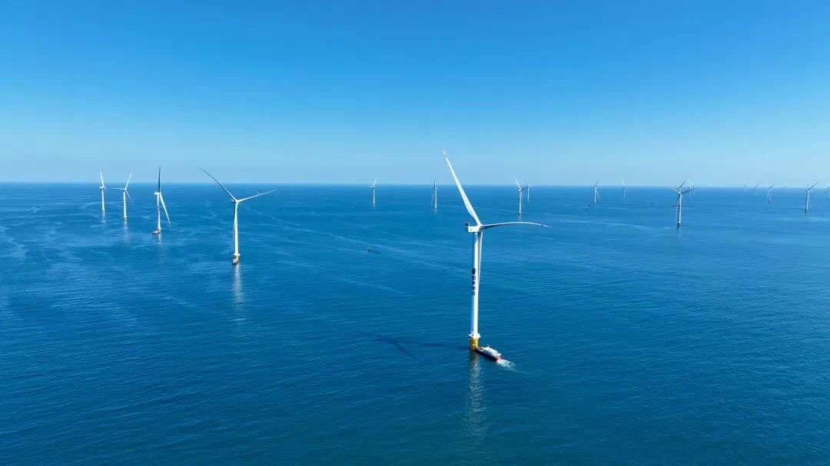
CONTENT
Current Status of China's Offshore Wind Development
Challenges Confronting China's Offshore Wind Industry
The Full-Lifecycle Enabling Role of Artificial Intelligence
Future Development Trends

Slide 4
Current Status of China's Offshore Wind Development
PART 01

Slide 5
1. Current Status of China's Offshore Wind Development
1.1 Policy Framework
Industry Positioning: focusing on sustainable development and energy structure optimization;
Policy Orientation: guided by central planning and adapted through local implementation;
Policy evolution: from early benchmark feed-in tariff mechanism to current market-oriented transaction system, promoting industrial upgrading and sustainable development;

Slide 6
1. Current Status of China's Offshore Wind Development
1.2 Spatial Layout
Core Pattern: large-scale nearshore development combined with deep-distant sea demonstration exploration;
Nearshore Development: large-scale wind power base clusters in Jiangsu, Guangdong, and Fujian;
Deep-Distant Sea Exploration: floating offshore wind demonstration projects to explore pathways for integrated marine energy development;

Slide 7
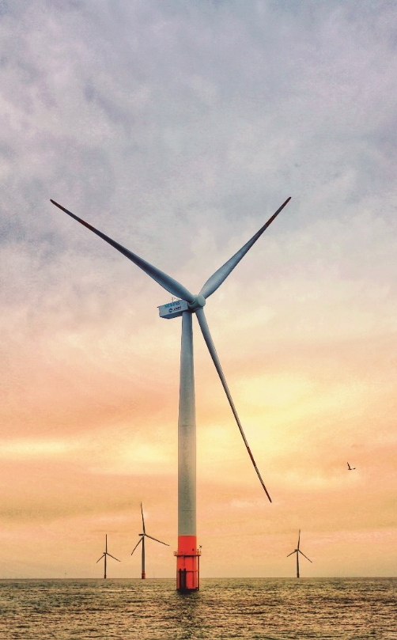
1. Current Status of China's Offshore Wind Development
1.3 Installation & Scale Data
Cumulative installed capacity (2024): 43 GW, accounting for over 50% of the global total
New installations (2024): exceeding 4 GW
Development model evolution: leap from fragmented development to GW-scale cluster-based deployment
Cumulative grid-connected installed capacity (Jun. 2025): 44.2 GW

Slide 8
1. Current Status of China's Offshore Wind Development
1.4 Technological Innovation
Single-turbine capacity: leaped from the early 1.5 MW level to the 25 MW class;
Example: single-turbine capacity offshore fixed wind turbines
  Impeller diameter: exceeding 310 meters
  Swept area: 77,000 square meters
  Annual generation: 100 million kWh of clean electricity
Complete industrial chain coverage: equipment manufacturing, foundation construction, grid connection, operation and maintenance;

Slide 9
1. Current Status of China's Offshore Wind Development

Slide 10
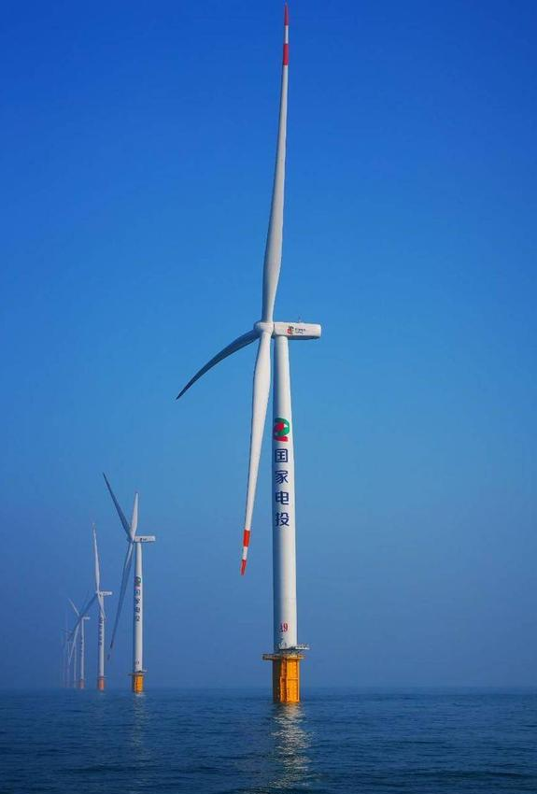
1. Current Status of China's Offshore Wind Development
1.5 Cost Optimization
Average unit investment (2015): approximately 2,670 USD/ kW;
Average unit investment (2024): 1,260 to 1,750 USD/ kW, representing a roughly 50% decrease compared to 2015
LCOE for nearshore projects: fallen to 0.04 USD/ kWh, lower than the cost of coal-fired power

Slide 11
Challenges Confronting China's Offshore Wind Industry
PART 02

Slide 12
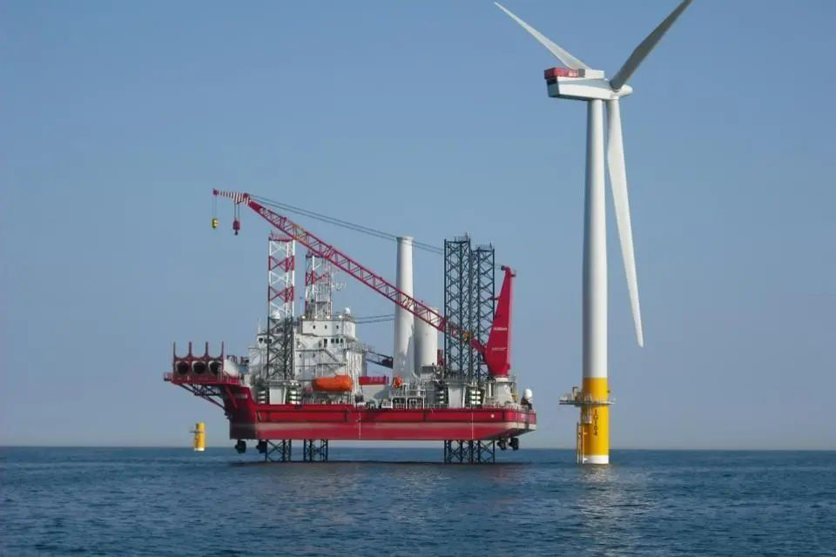
2. Challenges Confronting China's Offshore Wind Industry
2.1 Technological Bottlenecks
Traditional fixed foundations: struggle to adapt to deep-sea environments
Floating foundations: large-scale application needs to overcome challenges related to cost and stability
2.2 O&M Efficiency Challenge
O&M cost ratio: over 30% of the total lifecycle cost of offshore wind projects
2.3 System Integration Compatibility Challenge

Slide 13
The Full-Lifecycle Enabling Role of Artificial Intelligence
PART 03

Slide 14
3. The Full-Lifecycle Enabling Role of AI
3.1 Planning and Design
Accurate prediction of wind resource distribution
Forecasting the probability of extreme weather events
Simulating the mutual influence of air currents
CRRC: AI-based intelligent planning system has shortened the design cycle by 30% and increased the accuracy of annual energy production forecasts to over 95%

Slide 15
3. The Full-Lifecycle Enabling Role of AI
3.2 Equipment Manufacturing
Digital twin technology & Anti-corrosion optimization
Example: high weather-resistant insulation system has extended equipment service life by over 15%
3.3 Construction: Mitigating Risks
and Reducing Costs
Real-time monitoring & Intelligent scheduling & Precision control

Slide 16
3. The Full-Lifecycle Enabling Role of AI
3.4 Operation and Maintenance
Application effect without sufficient historical failure data: over 90% accuracy in fault prediction, 40% increase in detection efficiency, 60% reduction in reliance on manual work
Blade monitoring: vision large models automatically identify defects like cracks and corrosion, cutting inspection costs by 40% and improving efficiency by 50%
Overall transformation: from scheduled inspections to condition-based maintenance

Slide 17
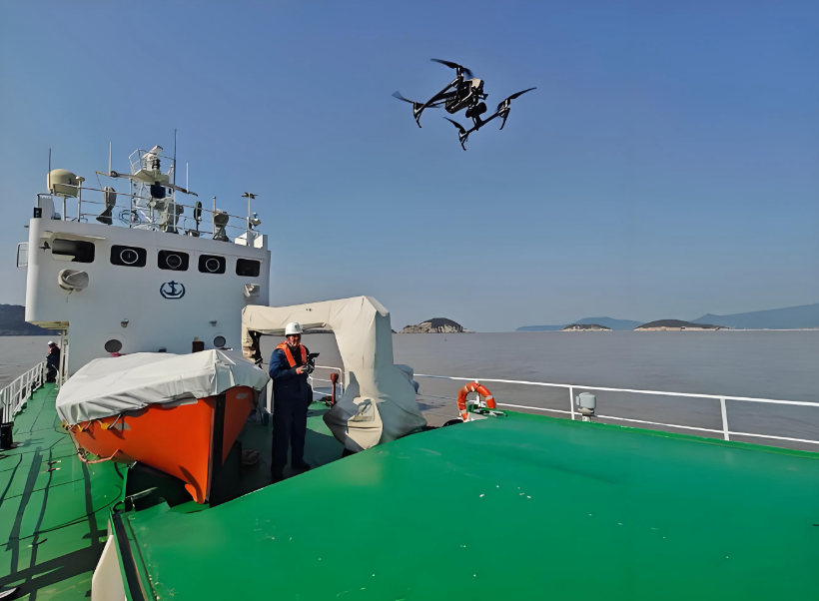
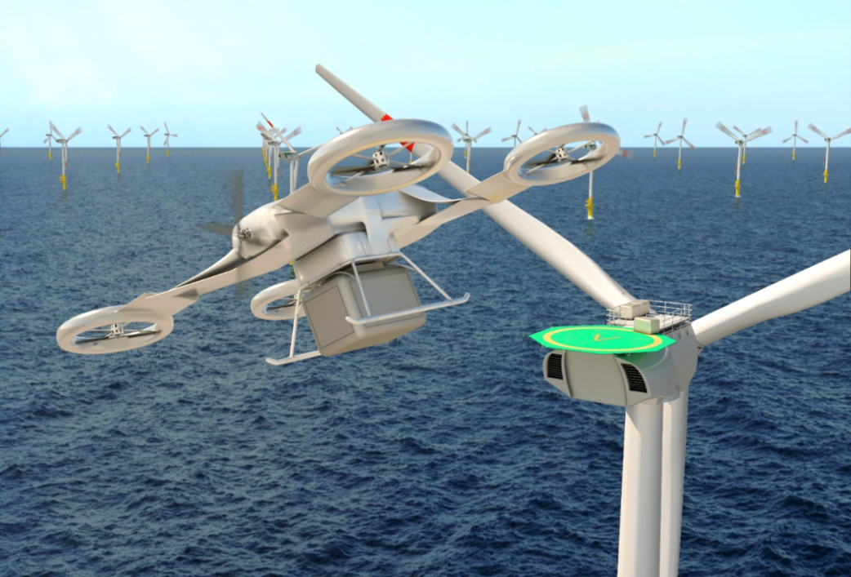
3. The Full-Lifecycle Enabling Role of AI
O&M through the integration of AI and UAVs: AI algorithms analyze videos and photos captured by UAVs in real time, automatically identifying defects.
Image Source: China Water Transport News

Slide 18
Future Development Trends
PART 04

Slide 19
4. Future Development Trends
4.1 Intelligent Deep-Sea Development
Key integration: deep integration of AI and floating technology to overcome key O&M challenges in deep waters
4.2 A Collaborative Ecosystem
Optimizing wind turbine operation
Coordinating the charging and discharging of wind power and energy storage equipment to stabilize power fluctuations
4.3 Global Standards & Industrial Collaboration

Slide 20
Thank you for listening！
As the host of the 2026 APEC Meeting, the People's Republic of China will hold diverse high-value events, showcase practical insights and warmly welcome all distinguished guests!
On behalf of SPIC, we have applied APEC Fund Project "APEC Study on How Zero-carbon Industrial Parks (ZIPs) Help With Energy Transition and Carbon Reduction in APEC Economies". A workshop will be hosted, and we sincerely welcome all participants to share insights and practices related to ZIPs!
Email: liuwei@spic.com.cn
wangxiaoru@spic.com.cn
wangzixin@spic.com.cn

