Slide 1


ENERGY EFFICIENCY AND CONSERVATION ACT
AI-Driven Energy Innovation
19 – 20 November 2025 | EGEEC 65 & EGNRET 63 Joint Meeting

Slide 2

Republic Act No. 11285
Republic Act No. 11285
  Energy Efficiency and Conservation (EEC) Act and Issuances
67 Policy
Issuances
The EEC Act institutionalizes energy efficiency and conservation as a national way of life, enhance the efficient use of energy , and grant incentives to energy efficiency and conservation projects.
Approved and signed by President Rodrigo Roa Duterte on 19 April 2019 and effective on 22 May 2019.
1 MEMORANDUM CIRCULAR (MC)
10 DEPARTMENT ORDERS (DO)
32 DEPARTMENT CIRCULARS (DC)
11 IAEECC RESOLUTIONS
13 IMPLEMENTING GUIDELINES (IG)

Slide 3
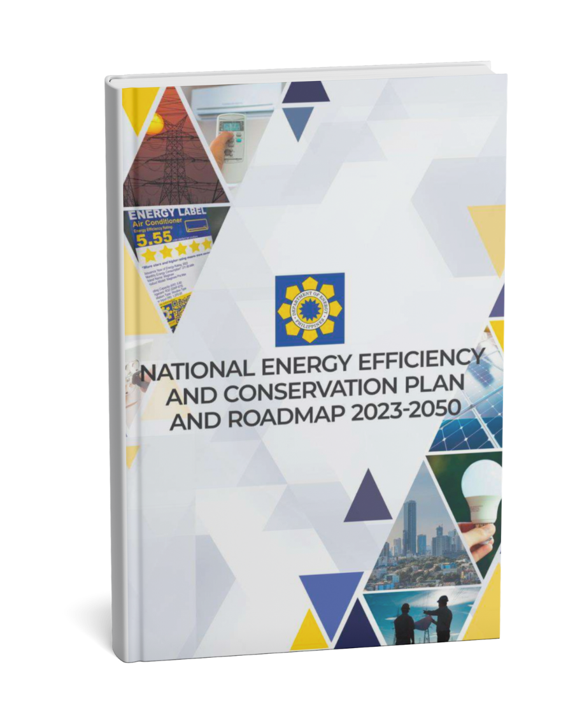
National Energy Efficiency and Conservation Plan (NEECP)
National Energy Efficiency and Conservation Plan (NEECP) and Roadmap 2023 - 2050
Serves as the framework for mainstreaming energy efficiency across all economic sectors
Covers government, commercial, residential, industry, transport, utilities & end-use, along
with cross-sectoral strategies
Defines measurable milestones and performance indicators to track progress in achieving the country’s targets for energy intensity reduction and energy efficiency improvement.
The roadmap provides a structured timeline of interventions to guide short-, medium-, and long-term actions per sector
SECTOR
Short Term (2023 - 2024)
Medium Term (2025 - 2028)
Long Term (2029 - 2050)

Slide 4

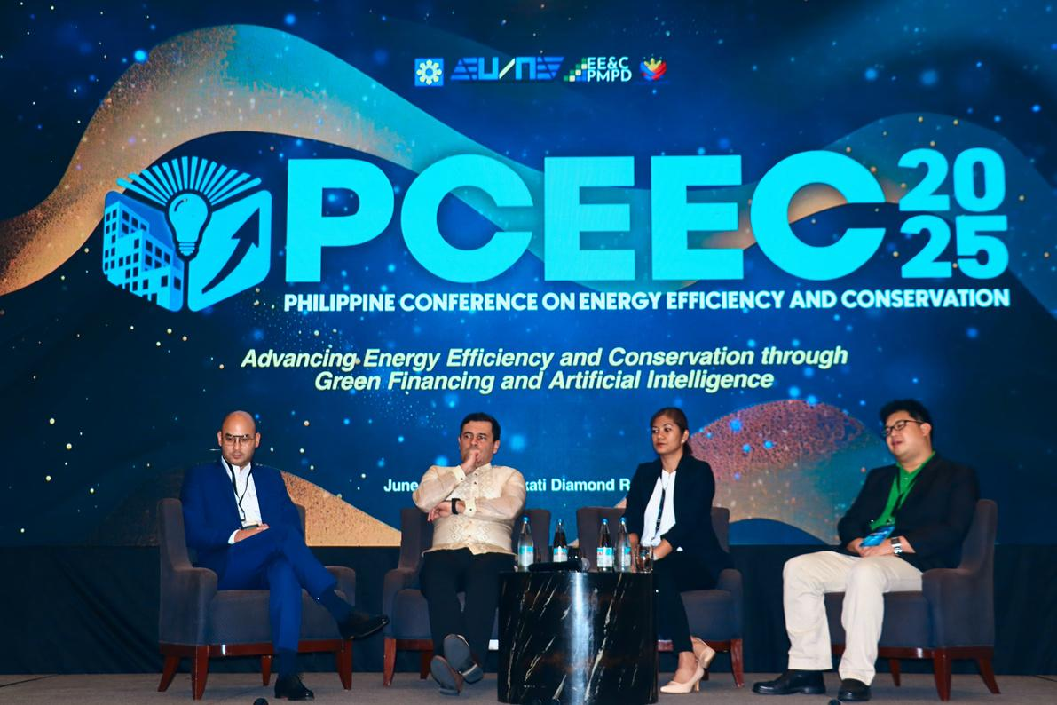
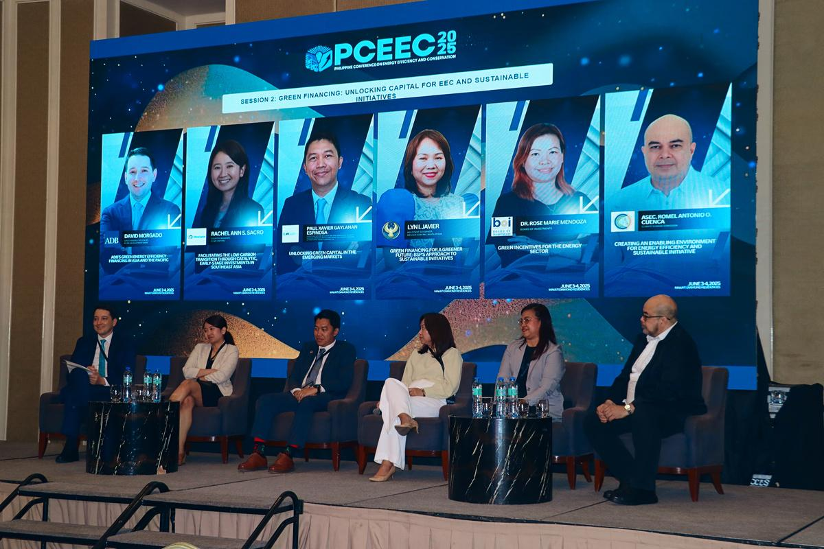
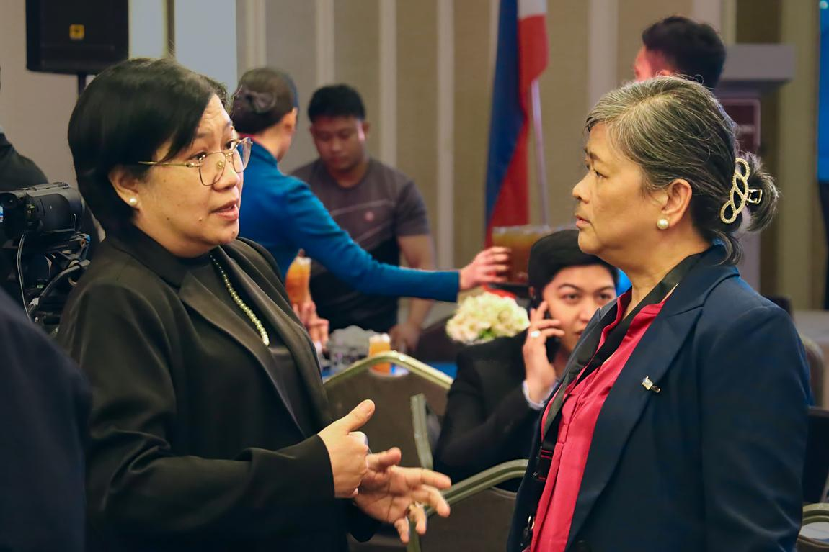
Philippine Conference on Energy Efficiency & Conservation
Philippine Conference
on Energy Efficiency & Conservation
The Inaugural Philippine Conference on Energy Efficiency and Conservation (PCEEC) 2025 convened policymakers, industry leaders, experts, and members of the academe for two days of knowledge-sharing and collaboration—advancing strategies to drive innovation and sustainability in the energy sector.

Slide 5
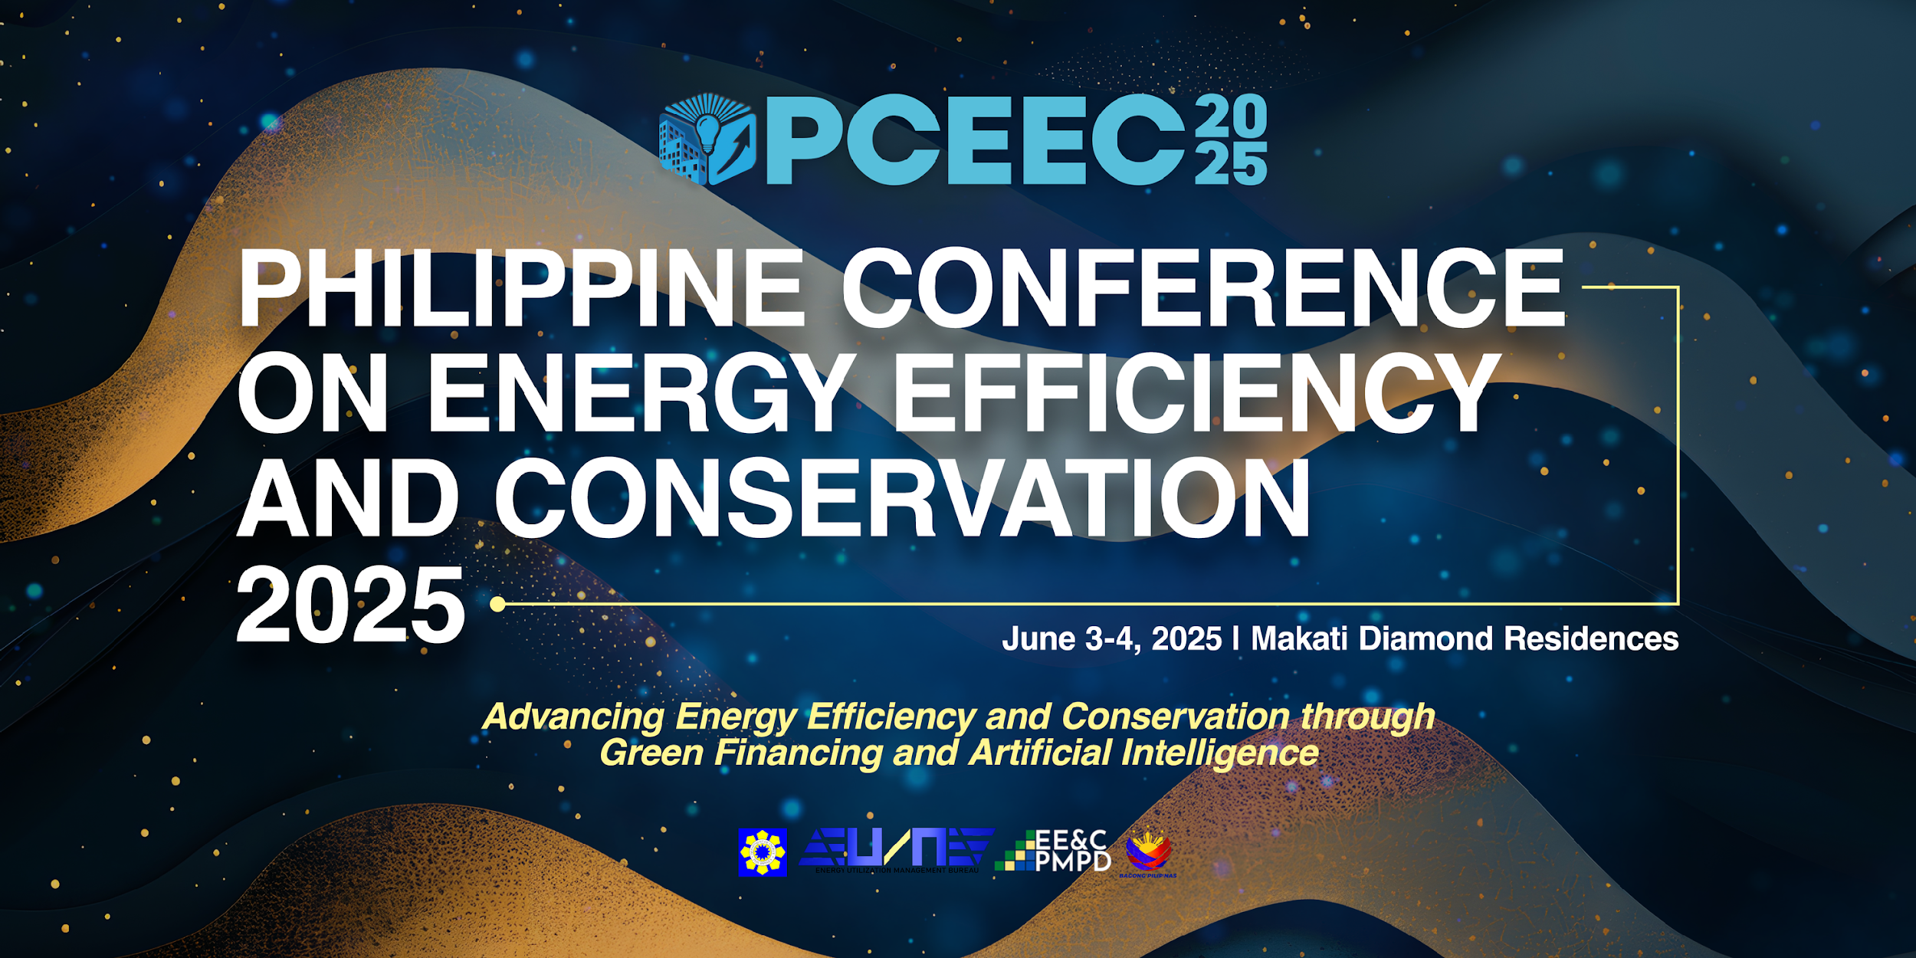

Slide 6
National Energy Efficiency and Conservation Plan (NEECP)
Opportunities and Way Forward
Demand Side Management
Expanding Minimum Energy
Performance Standards (MEPS)
Continuous monitoring of DEs
Enhancement of the
National EEC Database
Enhance implementation
of VFELP
Accelerated implementation
of GEMP

Slide 7
Thank
You
PRESENTED BY
DEPARTMENT OF ENERGY
doe.eumb@gmail.com
doe.epmpd@gmail.com
(02) 8479-2900 local 214

