Slide 1


Doubling energy efficiency with appliances
19 Nov, 2025，APEC EGEEC Workshop

Slide 2
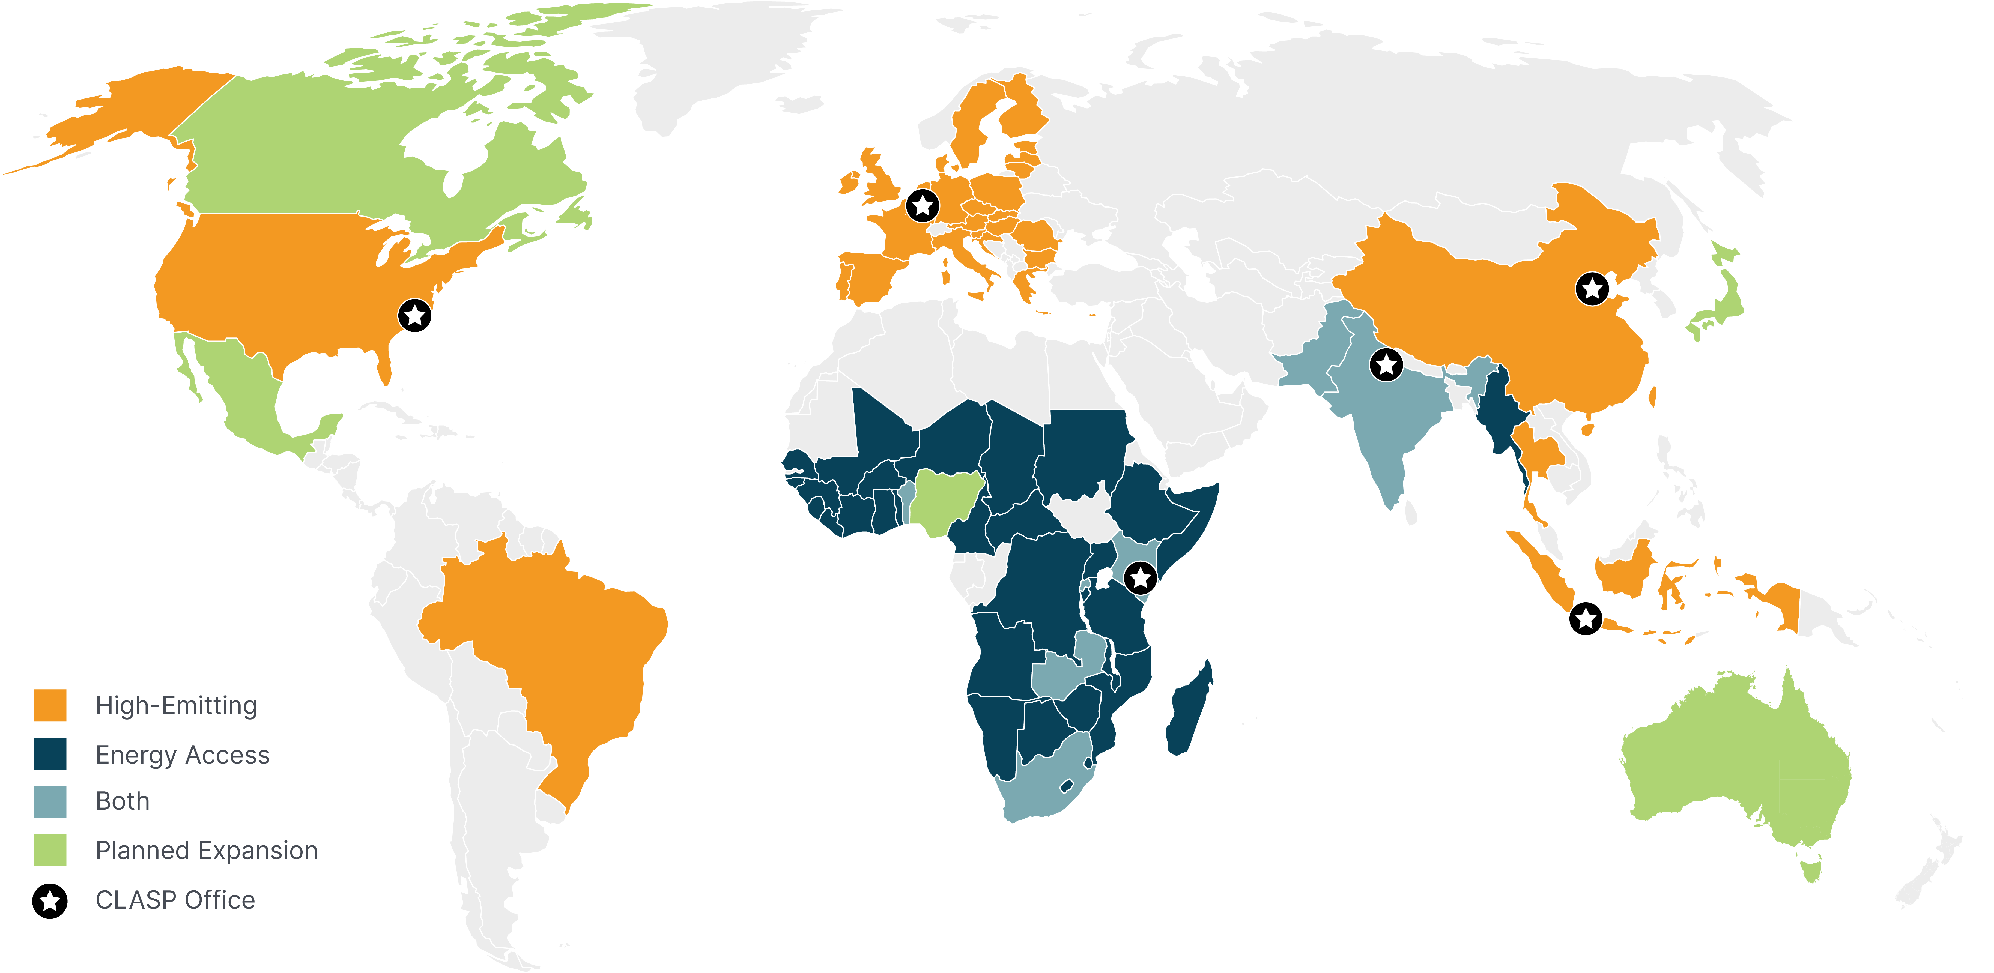
Where we work
CLASP is a trusted global partner with offices in five cities and projects implemented in over 90 economies.

Slide 3
Why appliances matter
Appliances and equipment are responsible for 36% of global final energy consumption:
  Residential buildings
  +
  Commercial buildings
  +
  Electric motor-driven systems
Therefore, appliance energy efficiency must play a large role in meeting the target.
Source: CLASP, Net Zero Heros, November 2023.

Slide 4
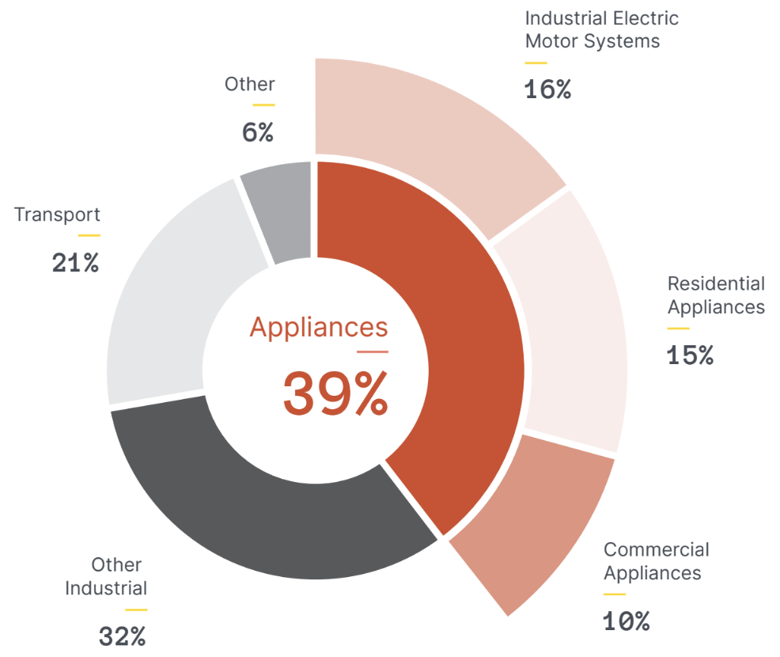
Appliances have a major impact on our climate
Appliances are responsible for 39.3% of energy-related CO₂ emissions.
These emissions are equal to roughly the total CO₂ emissions from China, Europe, and Brazil.
Notes:
Appliance climate impacts are often folded into other sectors, e.g., the builds sector, industrial sector, and power sector. To estimate the total energy and climate impacts of appliances, a few years ago -2021-, CLASP combined the emissions from residential and commercial buildings, industrial electric motors, and biomass cooking and heating. These emissions come either from the direct combustion of fossil fuels that are delivered to the building or indirectly from electricity. Our analysis finds that appliances have a large climate impact, representing 39% of global energy-related CO2 emissions.
These emissions are equal to roughly the total CO2 emissions from China, Europe, and Brazil.
About the data
Data were sourced from IEA (source below)
We apportioned 68% of industrial sector electricity use and resulting emissions to electric motor systems, the remaining emissions are shown in the 'other industrial' category.
You will notice that there is no power sector in this figure. We apportioned relevant power sector emissions across the appliances sector.
Apportioned totals across all sectors (appliances, other industrial, transport and other) total 35.9 Gt.
Data source: CLASP analysis of IEA, “World Energy Outlook 2022,” tbl. WORLD_TFC_STEPS, WORLD_CO2_STEPS, with indirect emissions apportioned among sectors using IEA, “CO2 Emissions from Fuel Combustion,” 2020, tbl. SECTOR, SECTORH, ignoring any electrification between 2018 (latest year available) and 2021. Energy used for desalination, estimated at 2 EJ and originally included in Buildings by IEA moved to Other.

Slide 5
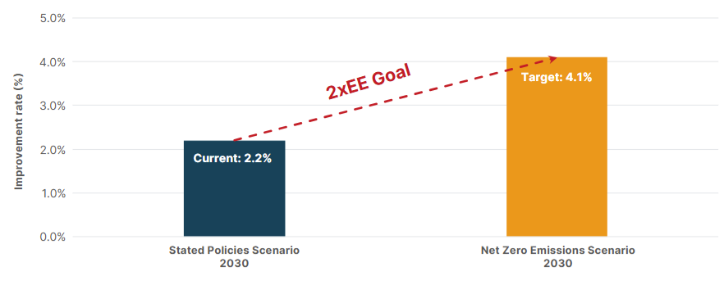
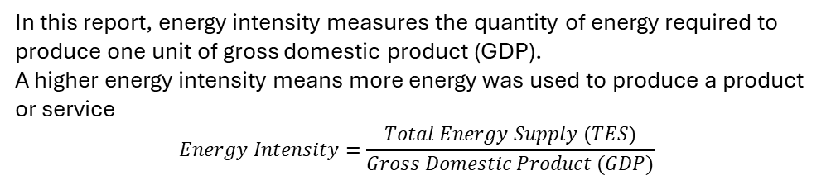
Doubling efficiency progress by 2030
Global annual improvement rate of energy efficiency in 2030 by IEA scenario
Global target from COP28: “double the global average annual rate of energy efficiency improvements (2xEE) by 2030”
Achieving this target is essential to limit global warming and stay on track for net zero emissions by mid-century.
Under existing policies, the global improvement rate is projected to remain at 2% per year by 2030 — half the rate needed to meet the target.
Source: Adapted from IEA, Energy Efficiency 2024 (2024)
In this report, energy intensity measures the quantity of energy required to produce one unit of gross domestic product (GDP).
A higher energy intensity means more energy was used to produce a product or service
$$Energy Intensity=\frac{Total Energy Supply (TES)}{Gross Domestic Product (GDP)}$$

Slide 6
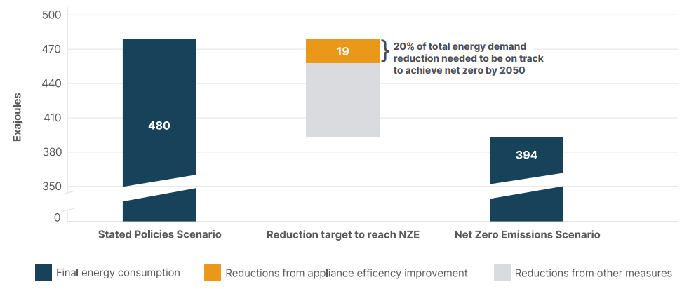
The Path from today’s policies to net zero: reducing 86 EJ
Global final energy consumption in two IEA scenarios, 2030
Meeting this doubling target could keep global annual energy consumption under 400 EJ.
Energy efficiency, behavior change, fuel switching, and other avoided demand make up the reduction (86 EJ) needed to be on track for net zero by 2050.
86
Source: CLASP analysis of IEA report Energy Efficiency – The Decade for Action, June 2023

Slide 7
One-fifth of the net zero energy gap can be closed by appliance efficiency
Global final energy consumption in two IEA scenarios, 2030
CLASP’s recent analysis found:
Appliance efficiency could deliver 20%, of the total 86 EJ reduction in energy demand needed by 2030.
Source: CLASP analysis of IEA report Energy Efficiency – The Decade for Action, June 2023

Slide 8
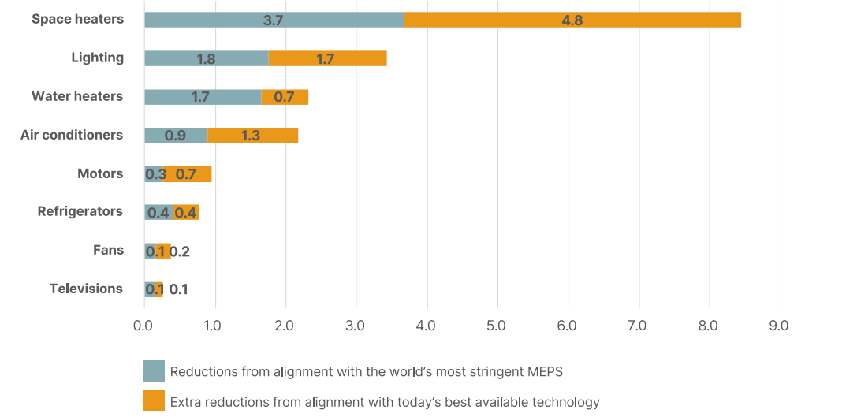
Potential energy savings from 8 appliances
Energy Demand Reductions in 2030 From Improving MEPS
Source: CLASP analysis of market data using the Mepsy tool

Slide 9
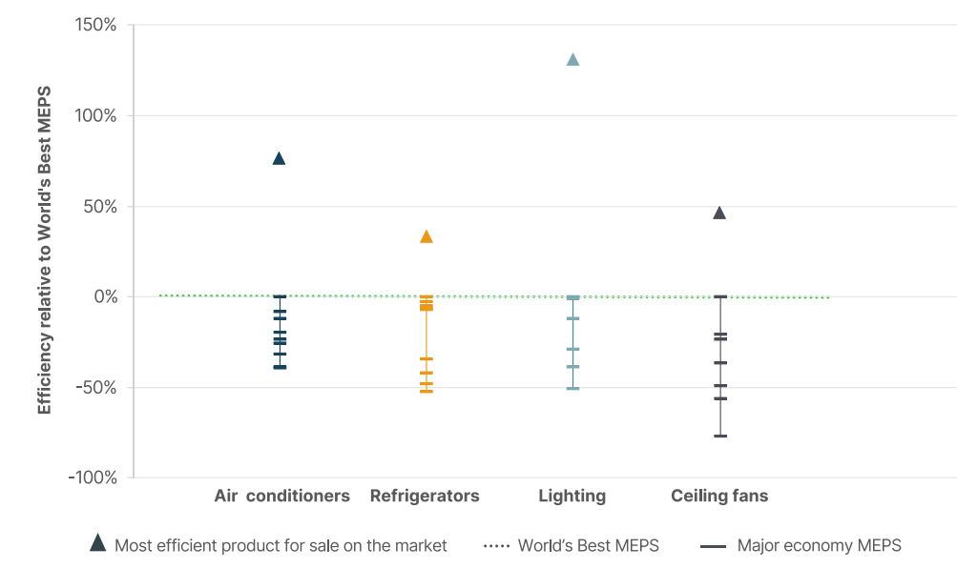
International comparison of efficiency levels for four appliances
Minimum Energy Performance Standards (MEPS) and Best Available Technology (BAT)
Most economies MEPS fall short of the world’s most stringent MEPS
Even best-in-class MEPS remain well below the efficiency levels of the best available technologies
This gap represents an opportunity to further reduce energy use and emissions
Source: CLASP World’s Best MEPS study

Slide 10

  Case studies: Brazil, China, India, Indonesia
    Assessed each economy’s energy efficiency progress
    Examined the potential of strengthening appliance policies
    Highlighted progress, gaps, and opportunities toward global efficiency improvements

Slide 11
Energy efficiency progress in Brazil
Brazil’s 5-year average energy efficiency improvement is flat at 0% (2019–2023)
Nearly 50% of domestic energy is renewable, but the grid is strained by heat waves and rising cooling demand.
Enhancing efficiency is crucial to meet energy needs without expanding fossil fuel use
Source: IEA, “Brazil — Efficiency & demand”, 2025

Slide 12
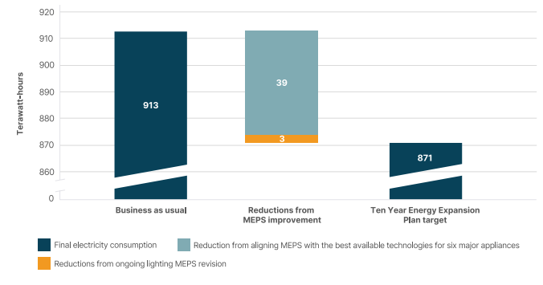
Appliance efficiency opportunities in Brazil
Total electricity consumption in Brazil in 2034
Ten-Year Energy Expansion Plan: 42 TWh savings in 2034
MEPS progress on ACs & refrigerators; lighting standards under revision
Aligning with the BAT could achieve most target savings
Delays in revising standards remain a key challenge
Source: CLASP analysis using the Mepsy tool; Ten-Year Energy Expansion Plan target sourced from the Ministry of Mines and Energy and Energy Research Company, Ten-Year Energy Expansion Plan 2034 (EPE, n.d.), 2025.

Slide 13
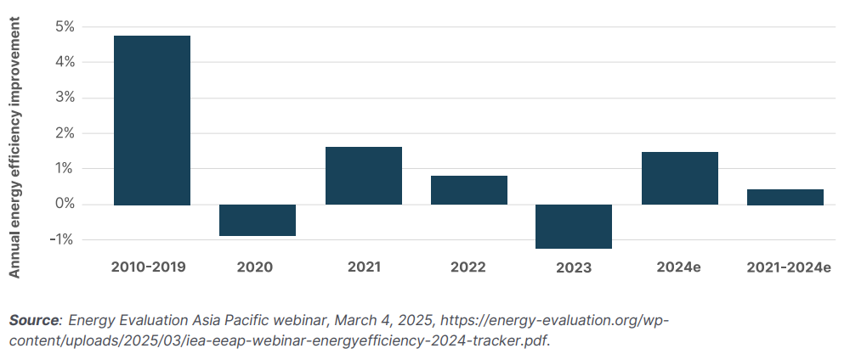
Energy efficiency progress in China
Energy intensity improvement rate, 2020-2024e, China
China led global energy efficiency progress with 3.8% annual improvement (2010–2019), but momentum has slowed since 2020, with a decline in 2023.
With fossil fuels still over 50% of primary energy, efficiency is key to reducing emissions and meeting the 2030 carbon peak goal
Accelerating efficiency in China is essential to achieving the global 2×EE goal.
Energy intensity (annual change%)
1.8%
1.5%
0.8%
-1.1%
Source: IEA (2025), Energy Efficiency 2024 Tracker, Energy Evaluation Asia Pacific Webinar.

Slide 14
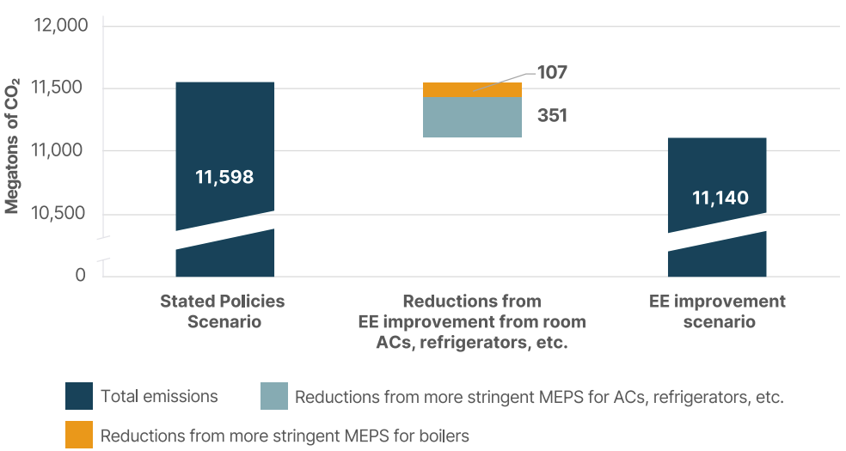
Appliance efficiency opportunities in China
Total CO₂ emissions in China in 2030, based on the IEA scenario
China prioritizes energy efficiency in its national action plan.
Key appliances like ACs, motors, and pumps still have potential for higher MEPS.
  Raising MEPS ambition for ACs, refrigerators, and motors could avoid 351 Mt of CO₂ in 2030.
  Raising industrial boiler efficiency ratings by one level could reduce CO₂ emissions by 107 Mt.
Reductions from higher labeling standards for boilers
Source: CLASP analysis using the Mepsy tool, with technical support from the China team.

Slide 15
Energy efficiency progress in India
India’s energy efficiency has improved steadily at around 2% per year but remains below the pace needed to reach the 4% target by 2030.
Source: IEA (2025), Energy Efficiency 2024 Tracker, Energy Evaluation Asia Pacific Webinar.

Slide 16
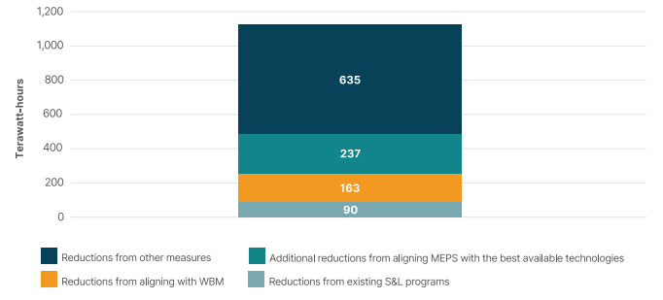
Appliance efficiency opportunities in India
India’s energy use reduction target for doubling efficiency in 2030
2xEEE target: reduce energy use by 1,035 TWh
Current standards and labeling can save 90 TWh annually
Aligning MEPS with the World’s Best MEPS for eight key appliances could save 163 TWh in 2030.
Aligning MEPS with the BAT could save up to 400 TWh in 2030.
Source: CLASP analysis of market data using the Mepsy tool; Total reduction target sourced from Ministry of Power, India, Target of Doubling Energy Efficiency, April 3, 2025.

Slide 17
Energy efficiency progress in Indonesia
Efficiency rebounded modestly in 2023 after a sharp decline (2020–2022)
Energy efficiency progress faces challenges:
  Energy demand is projected to rise 75% by 2040, driven by appliance growth and floor area expansion.
  Fossil fuels still supply around 35% of electricity, making efficiency critical for reducing emissions.
Source: IEA (2025), “Indonesia — Efficiency & demand”

Slide 18
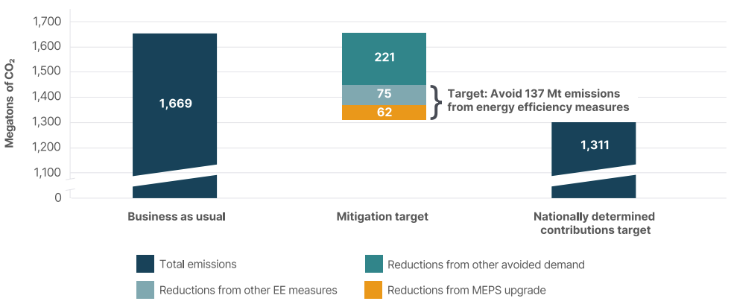
Appliance efficiency opportunities in Indonesia
Indonesia’s CO₂ emissions from the energy sector in 2030
Indonesia’s NDC 1.0 sets a 2030 energy-sector emissions reduction of 358 Mt CO₂
  Energy efficiency measures contribute 137 Mt
Seven current standards and labels can be improved to reach the World’s Best MEPS
NZE Roadmap: Adding 11 appliances and using the MEPS ladder could cut 62 Mt CO₂ (NZE Roadmap)
* Indonesia has recently published NDC 2.0, and the NZE Roadmap is currently under development with CLASP support.
Source: Emissions reduction potentials source from Ministry of Energy and Mineral Resources et al., Net Zero Emission 2060 Roadmap for the Indonesian Energy Sector (Ministry of Energy and Mineral Resources, 2024.

Slide 19
Accelerating Global Progress Toward the 2×EE Goal
Strengthen MEPS and raise ambition
    Economies without or with weak MEPS: Align with the world’s most stringent MEPS
    Leading economies: Tighten existing MEPS and set timelines to match best-performing products
    Use CLASP’s World’s Best MEPS tool for benchmarking
  Set measurable efficiency targets
    Integrate appliance efficiency into NDCs with clear metrics and progress tracking
    Use CLASP’s Net Zero Appliances NDC Toolkit for guidance
  Enhance international collaboration
    Coordinate regionally and internationally to align standards, share expertise, build capacity, and accelerate global energy efficiency gains

Slide 20
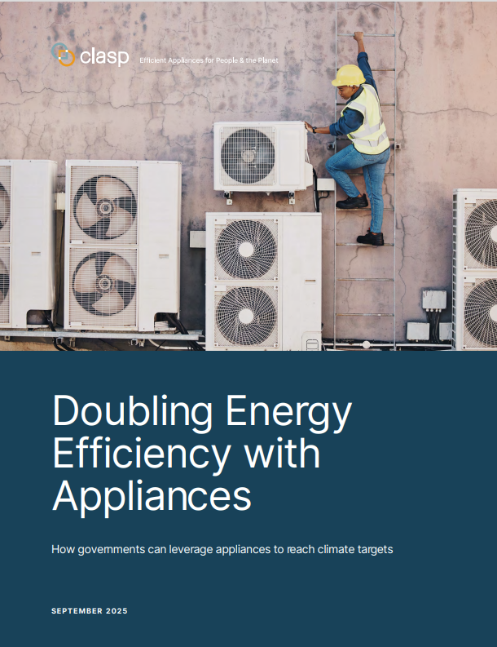


Access this report, and more:
https://www.clasp.ngo/research/all/doubling-energy-efficiency-appliances/
clasp.ngo

Slide 21

Net Zero Appliances NDC Toolkit
clasp.ngo/tools
Incorporate climate-friendly targets for appliance efficiency into NDCs
World’s Best MEPS
Mepsy
CPRC
Comparison of world-leading appliance efficiency standards
Model the impacts of energy and carbon reduction policies
Searchable database of 1500+ quality, water, and efficiency policies
VeraSol
Compliance Toolkit
Computer Testing Tool
Solar-powered and off-grid appliance database
Resources to help design effective compliance strategies
Measure the power and performance of a personal computer

Slide 22


Thank you!
Any questions?
STEVEN ZENG
Director of China Program, CLASP
| szeng@clasp.ngo
clasp.ngo

