Slide 1

Electric Fans Energy Efficiency Improvement in APEC Region: Review of Experience and Best Practices
The 65th Meeting of the APEC Expert Group on Energy Efficiency and Conservation (EGEEC 65)
          Project Update (EWG_206_2024A)
Proposing economies: | Chinese Taipei
Co-sponsoring economies: | Japan, Korea, Thailand, Viet Nam
November 19, 2025
Seoul, Korea

Slide 2
Outline
Project purpose
Project outcome
  Pre-workshop survey
  Workshop: APEC Workshop on Policies, Standards, and Best Practices for Energy-Efficient Electric Fans
Future work

Slide 3
Global electric fan market growth drivers
Both historical trends and future forecasts show that PRC, APAC, and LATAM are consistently the fastest-growing regions in the global electric fan market. (GIA, 2025)
Global and Regional Electric Fan Sales:
Historical (2015–2023) and Future (2024–2030) Growth Trends (%CAGR)
Source: Global Industry Analysts (2025) Electric Fans – A Global Strategic Business Report (MCP24820)

Slide 4
Global electric fan market share
US & EU maintain steady growth and strong share due to their large market base, but PRC & APAC grow rapidly, with PRC projected to become the No.1 market by 2030.
Regional Electric Fan Market Share Comparison:
2015 vs. 2023 vs. 2030
Source: Global Industry Analysts (2025) Electric Fans – A Global Strategic Business Report (MCP24820)

Slide 5
Project Objectives
Choose a relevant case study to investigate strategies for increasing the market share of high-efficiency electric fans.
Examine current energy-saving technologies for electric fans within the context of energy efficiency regulations.
Share project results, best practices, and gather feedback throughout the APEC region.

Slide 6
Outline
Project purpose
Project outcome
  Pre-workshop survey
  Workshop: APEC Workshop on Policies, Standards, and Best Practices for Energy-Efficient Electric Fans
Future work

Slide 7
Questionnaire outline
Policies & Management Systems：
Covers government policies on electric fan energy efficiency, including responsible agencies, standards, and labeling.
Testing Methods：
Reviews current testing methods, alignment with IEC 60879, and future plans, including bladeless fan testing.
Fan Motors：
Collects data on DC motor fan usage and estimates their market share.

Slide 8



Pre-survey summary
Pre-survey completed
9 out of 21 ECs submitted the pre-survey questionnaire.
5 ECs mandatory measures
4 ECs adopted
IEC std.
3 ECs voluntary measures
Note: Thanks to PRC, INA, MAS, MEX, NZ, PH, CT, THA & VN for completing the pre-survey; more ECs are welcome to contribute.

Slide 9
Current EE policy for electric fans in APEC region
Disclaimer: For non-responding economies, information was sourced online. This project is not liable for any errors or resulting losses. 9 out of 21 ECs submitted the pre-survey questionnaire

Slide 10
Outline
Project purpose
Project outcome
  Pre-workshop survey
  Workshop: APEC Workshop on Policies, Standards, and Best Practices for Energy-Efficient Electric Fans
Future work

Slide 11
Workshop agenda
Morning session(Part 1)
Briefing on International Organizations
Afternoon session(Part 2)
Briefing on Member Economies
Time | Content
09:00-09:05 | Welcoming Remarks: Host (Korea)
09:05-09:20 | Opening Remarks & Group Photo
09:20-12:10 | 1.1 Pre-survey outcome Dr. Chi-Chun Huang (Rouff), ITRI
 | 1.2 IEC-60879 intro Ms. Wenxiu Huang, CEI
 | 1.3 Effective policy to improve energy efficiency of electric fans (TBC) Dr. Kevin Lane, IEA
 | 1.4 Electric Fans Energy Efficiency Improvement in China & India Dr. Lei Zeng (Steven) , CLASP Ms. Moumita Chandra, CLASP
12:10-12:30 | Discussion & Q&A
Time | Content
14:00-16:00 | 2.1 Electric Fans Energy Efficiency Improvement in Thailand Dr. Supachai Sampao, DEDE
 | 2.2 Electric Fans Energy Efficiency Improvement in Indonesia Mr. Totok Sulistiyanto, (MASKEEI)
 | 2.3 Electric Fans Energy Efficiency Improvement in Chinese Taipei Dr. Chi-Chun Huang (Rouff), ITRI
16:00-16:45 | Knowledge-Sharing & Q&A
16:25-16:30 | Closing Remark

Slide 12
38 attendees from 11+1 economies and 5 APEC fora
12 economies
CDA, PRC, HKC, INA, ROK, MAS, MEX, PHL, CT, THA, VN, IN
5 APEC fora
EWG, APEC Secretariat, EGEEC, EGNRET, APERC
34% female participation
13/25 (F/M)
APEC economies
APEC Fora
‹#›

Slide 13
8 experts from 4+1 economies and 2 international Org.
Including all speakers and moderators
5 economies (4 APEC economies)
PRC, INA, CT, THA,IN
2 International Organization
IEA, IEC
25% female participation
2/6 (F/M)
APEC economies
International Org.

Slide 14
30 participants from 10 economies and 5 APEC fora
20% of participants applied for APEC support fund for TU, 4 participants from 3 economies (MAS and PHL).
10 economies
CDA, PRC, HKC, ROK, MAS, MEX, CT, PHL, THA, VN
*11 economies attended the EGEEC & EGNRET meeting
(RUS and JPN only join the meeting)
5 APEC for
APEC Secretariat, EWG, APERC, EGEEC, EGNRET
37% female participation
11/19 (F/M)
★

Slide 15
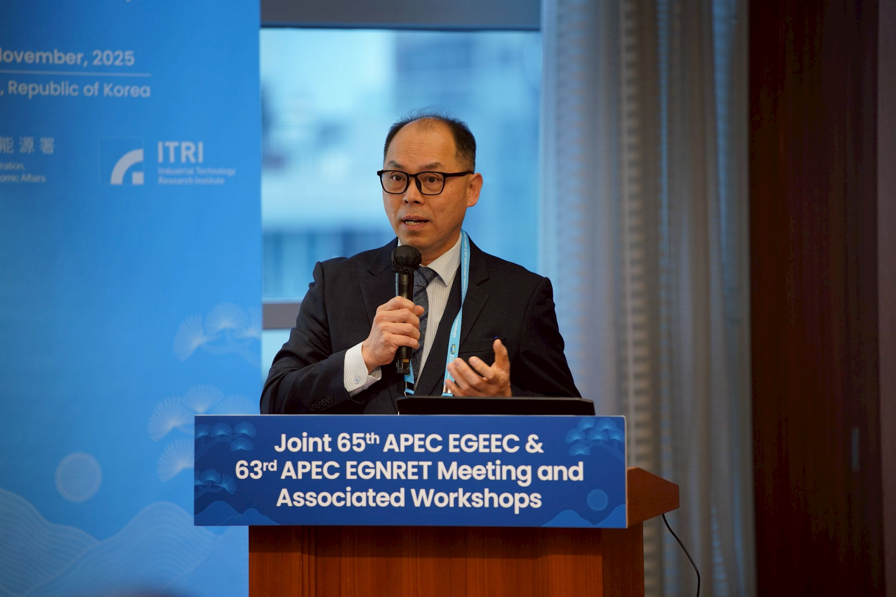
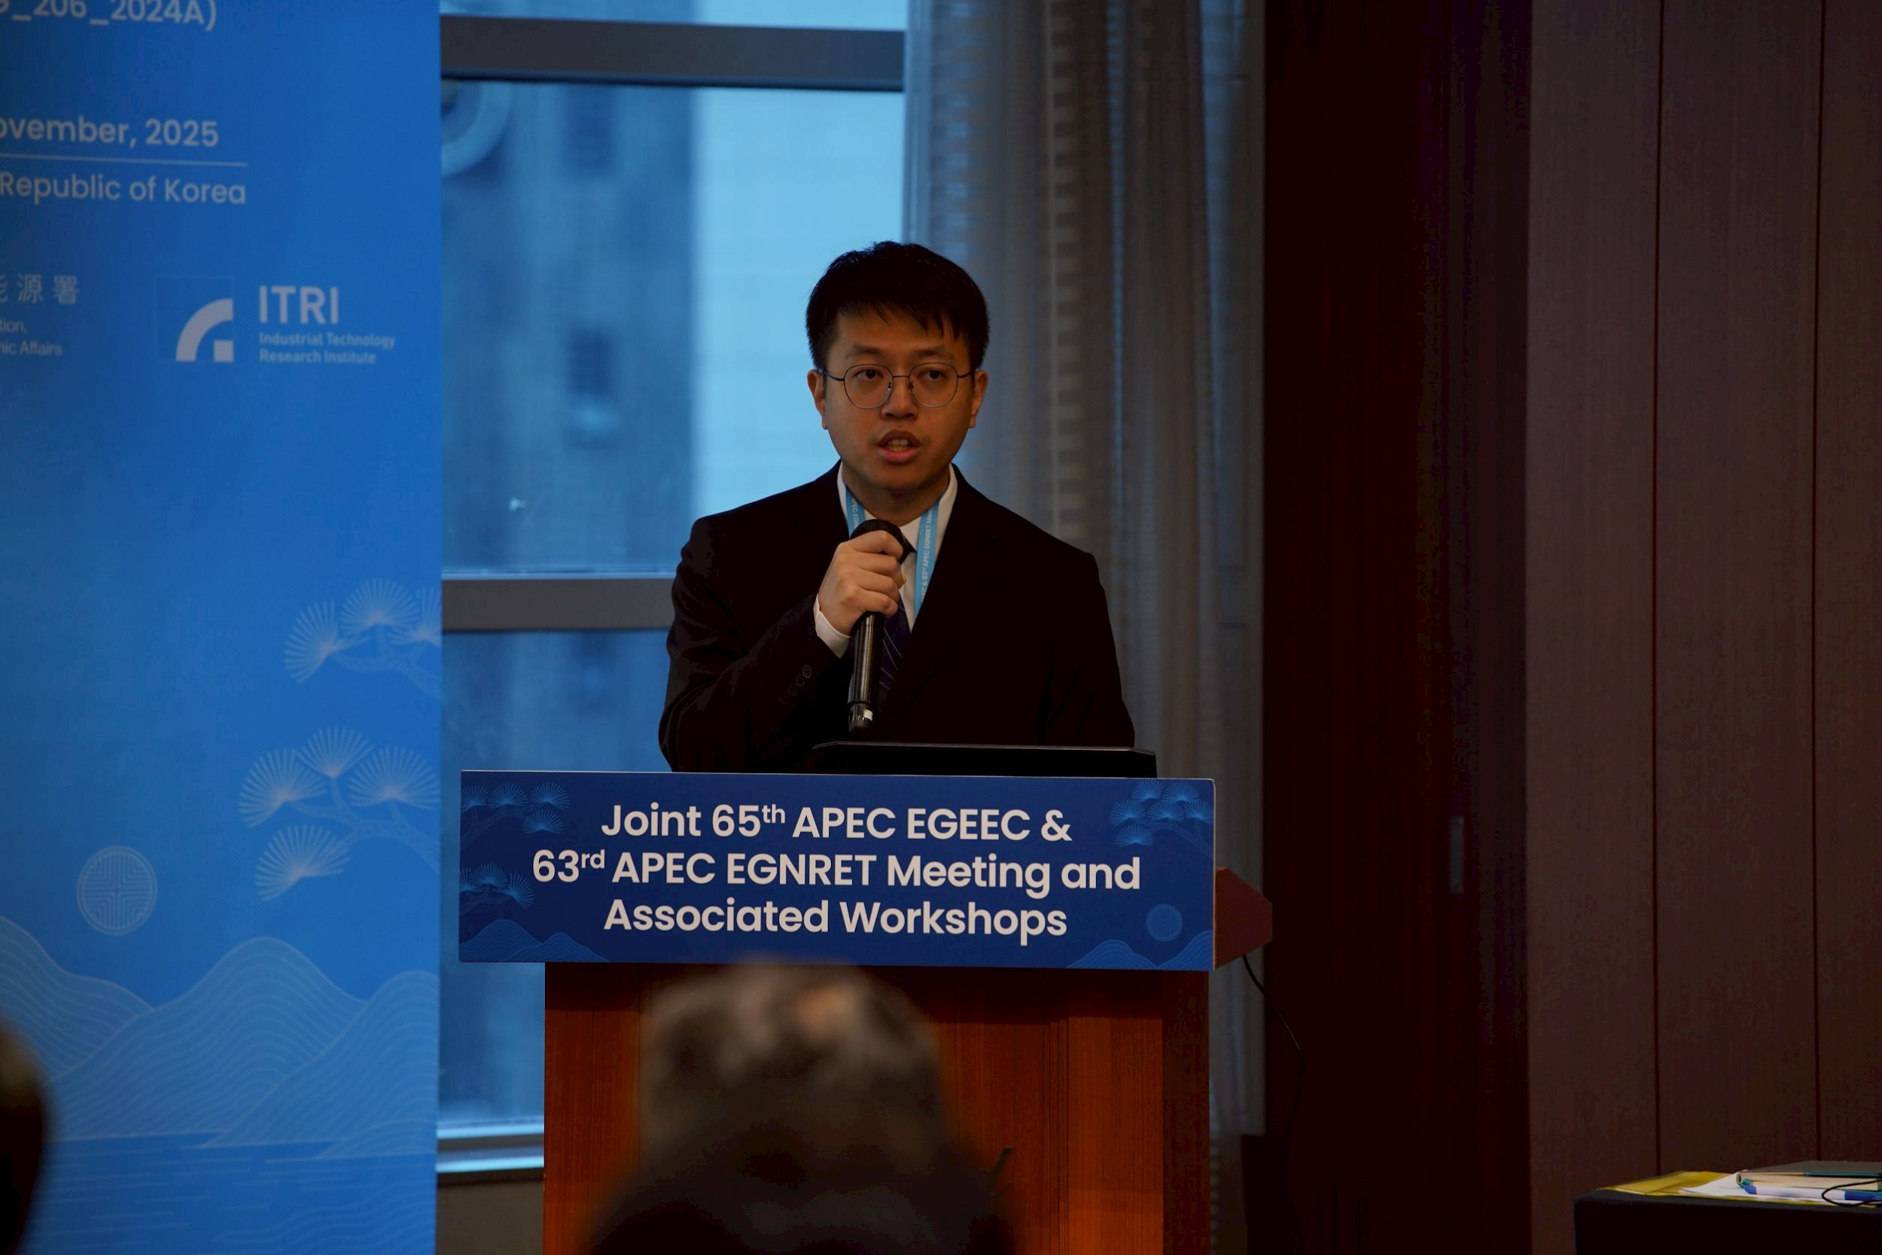
Opening remarks
Mr. Youngsun YOU
Director General
Korea Energy Agency (KEA), ROK
Mr. Chia-Ho CHU
Administrative Coordinator
Energy Administration, MOEA, CT

Slide 16
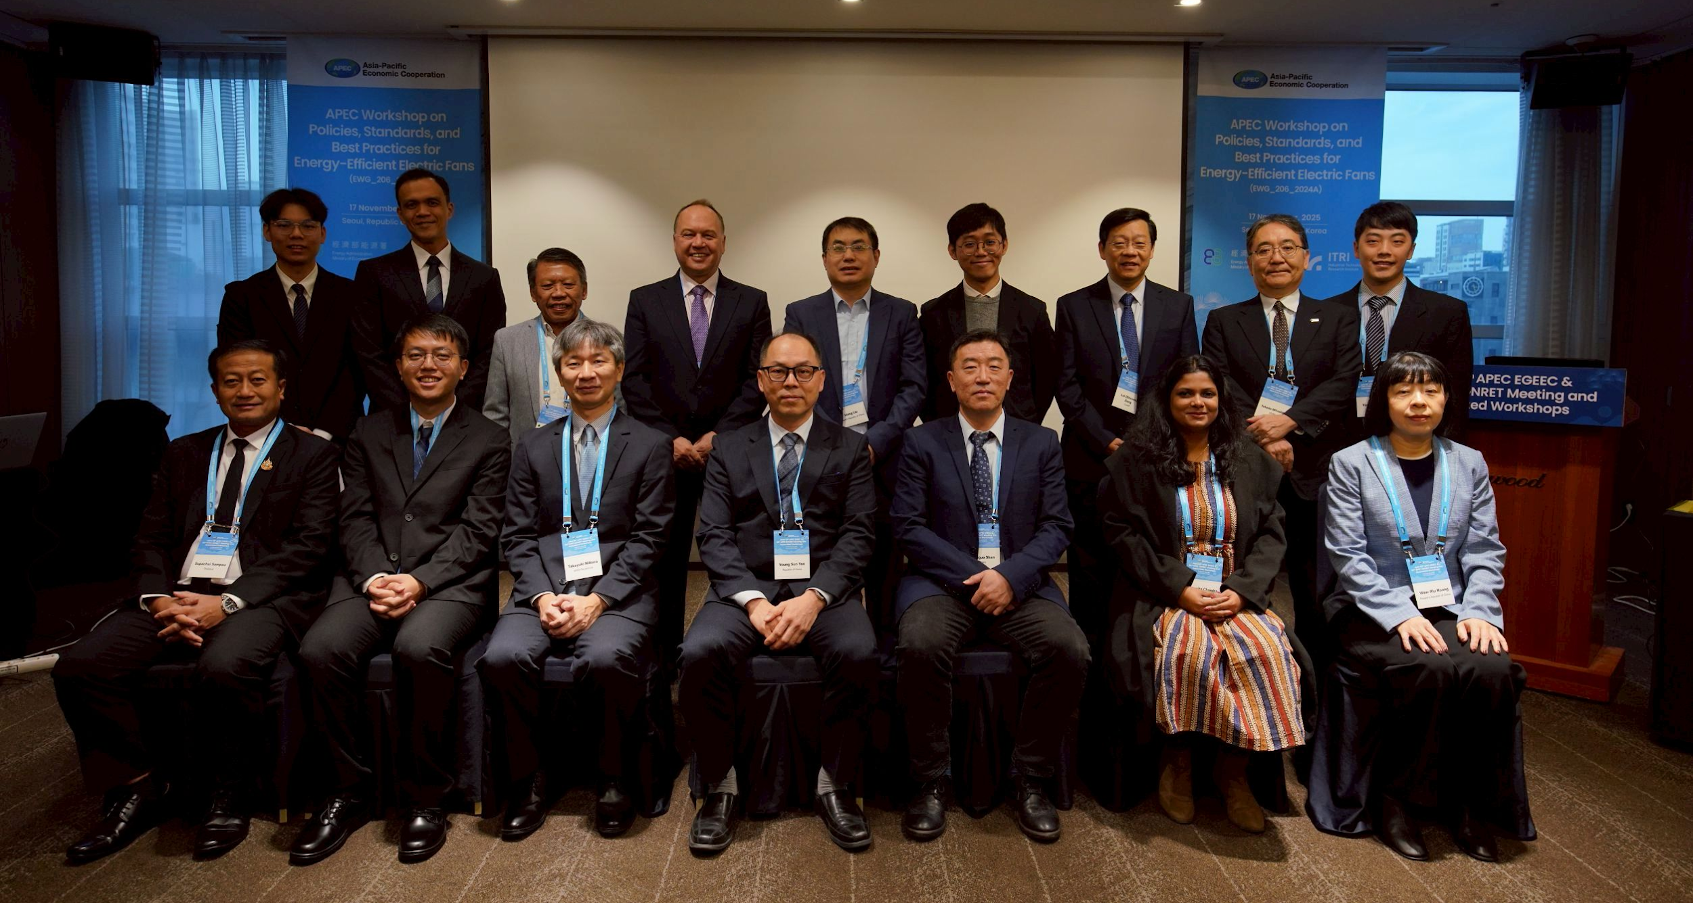
Group photo

Slide 17
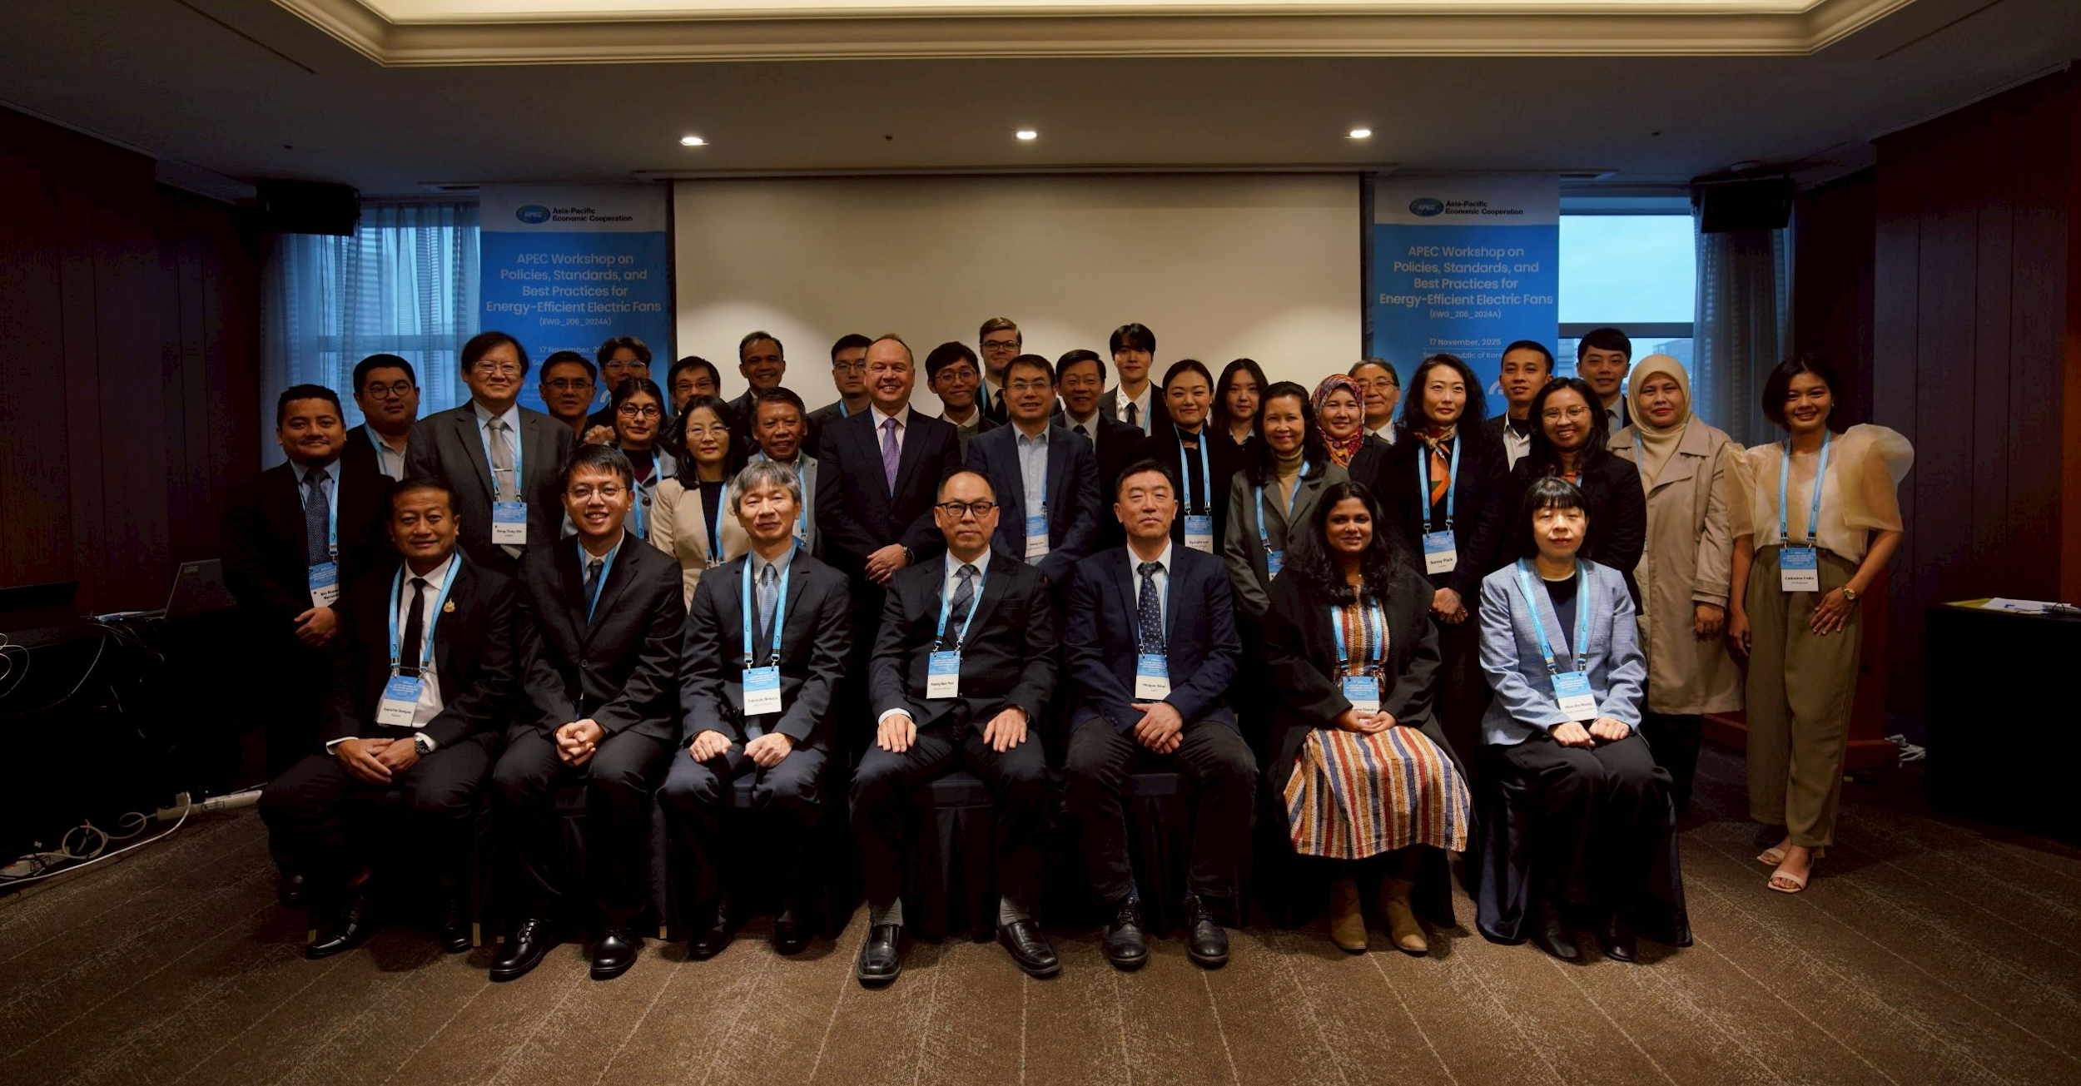
Group photo

Slide 18
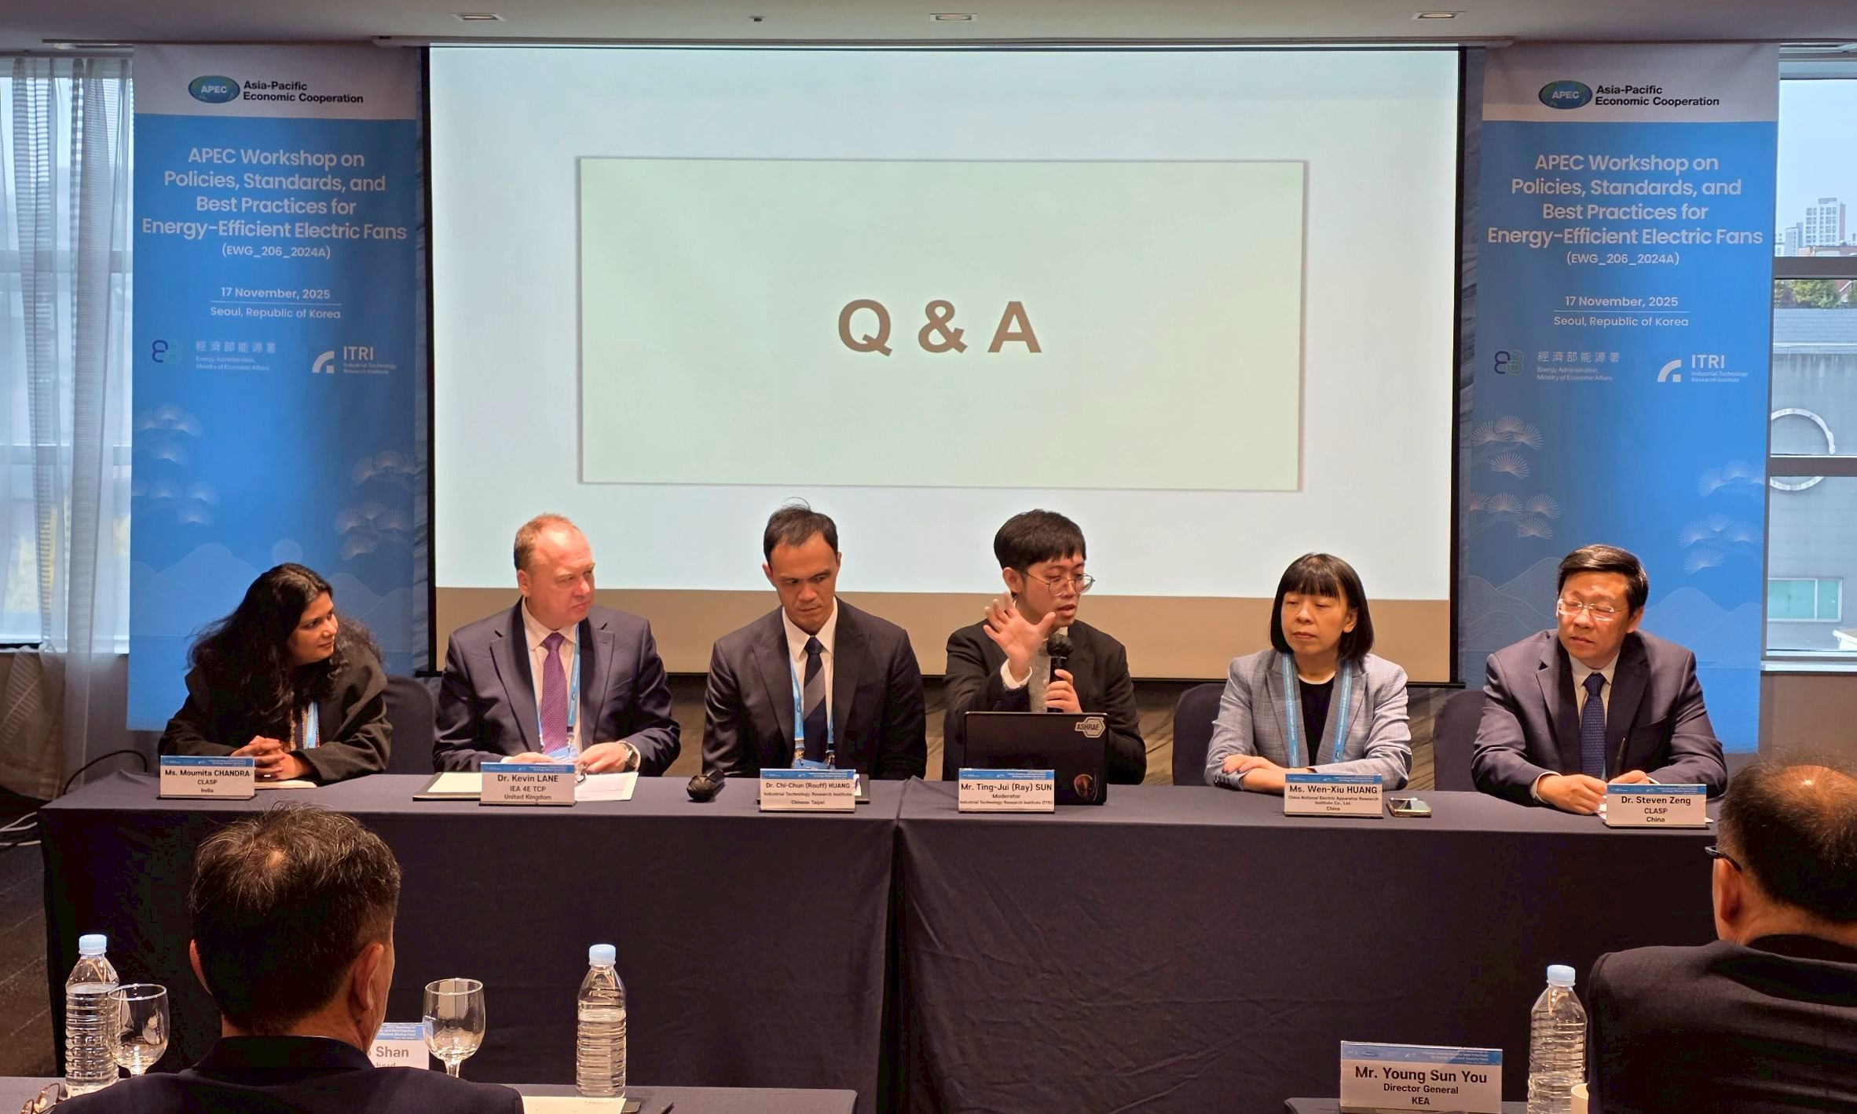
Morning session Q&A

Slide 19
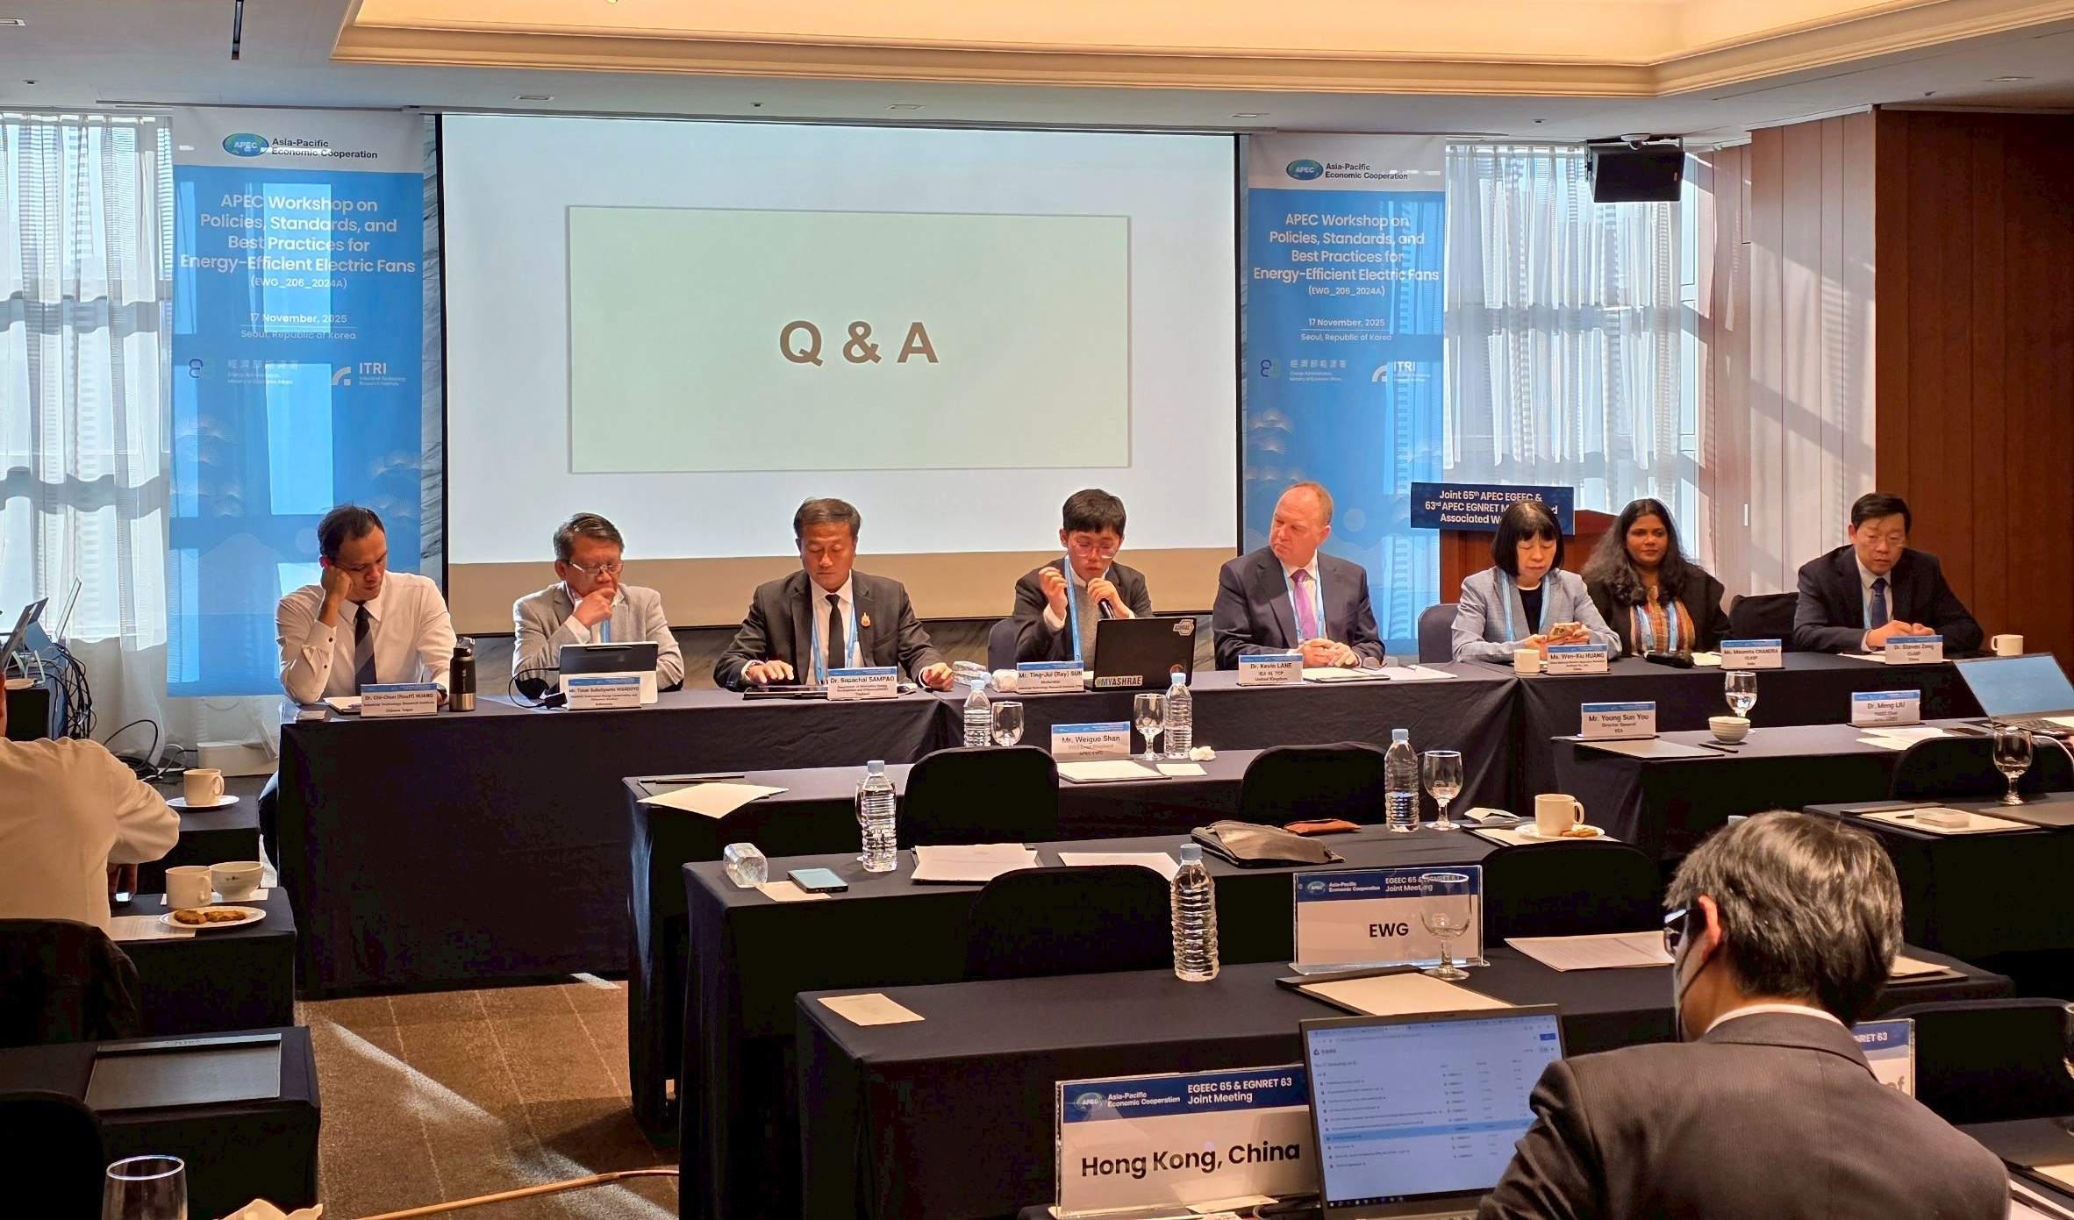
Afternoon session Q&A

Slide 20
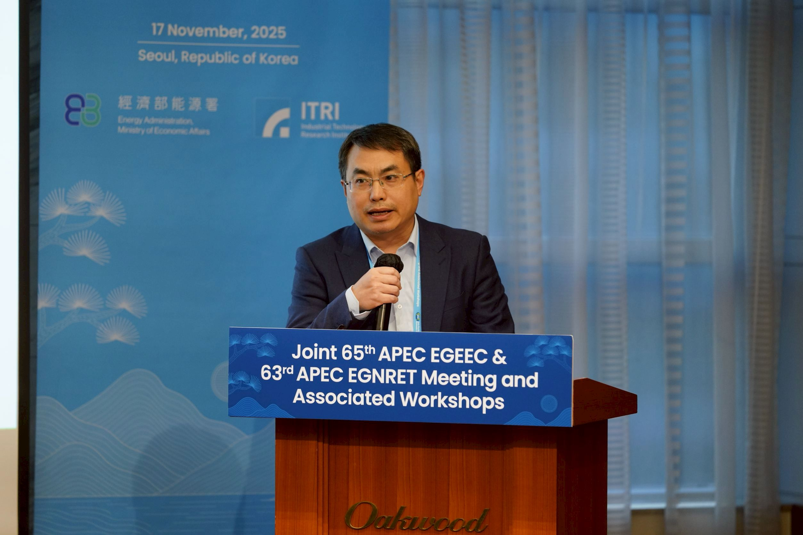
Closing remarks
Dr. Meng LIU
Chair
APEC Expert Group on Energy Efficiency and Conservation (EGEEC)

Slide 21
Outline
Project purpose
Project outcome
  Pre-workshop survey
  Workshop: APEC Workshop on Policies, Standards, and Best Practices for Energy-Efficient Electric Fans
Future work

Slide 22
Future work
Preparation of the completion report is currently underway.
PO welcomes questionnaire submissions by the end of November 2025, especially those providing the latest electric-fan energy-efficiency policies.
Harmonization of electric-fan energy efficiency standards across the APEC region presents significant opportunities and will require continued efforts from all APEC economies, with IEC playing a key leadership role.

Slide 23
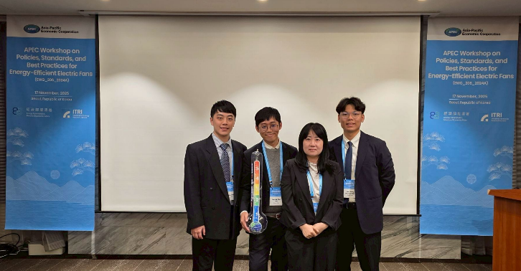
Hope you enjoyed the event. Looking forward to seeing you again.

