Slide 1
EGEEC Governance Issue
The 65th Meeting of APEC Expert Group on Energy Efficiency & Conservation (EGEEC 65)
Notes:
Good afternoon, colleagues.
In this session on governance issues, I will update you on our internal governance, information sharing platforms, and future meeting arrangements.

Slide 2
Contents
EGEEC Contact List
EGEEC Website
Review of EGEEC Terms of Reference
Selection of EGEEC Chair and Vice Chair
Summary of Past EGEEC Meetings
Upcoming EGEEC and EWG Meeting

Slide 3
EGEEC Contact List
The EGEEC Contact List was updated and circulated to members on 9 June 2025.
Members are encouraged to nominate experts from APEC economic members to join the EGEEC.
Members are encouraged to regularly review and update the EGEEC contact list to build capacity and share knowledge in energy efficiency and conservation-related policy.
Notes:
First, regarding the EGEEC Contact List.
We strongly encourage members to regularly review and update this list. More importantly, we encourage you to nominate more experts from your economies to join the EGEEC family.

Slide 4

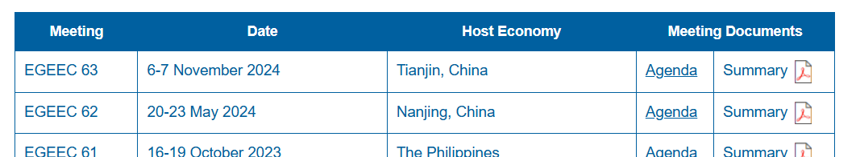
EGEE&C Website https://www.apec.org/egeec
The EGEEC website is available to promote the sharing of energy efficiency and conservation information.
Meeting documents and meeting summary of EGEEC64 held in Hong Kong, China were uploaded on the EGEEC website.
Members are encouraged to send the meeting documents to the EGEEC Secretariat for uploading on the EGEEC website.
Members are encouraged to proposed information to be shared on the EGEEC website.
Notes:
Second, regarding the operation of the EGEEC official website.
Currently, all meeting documents and the summary of EGEEC 64 held in Hong Kong, China, have been uploaded to the website for your reference
To enrich our knowledge base, the Secretariat encourages members to send meeting documents to us for uploading. Additionally, if you have any valuable industry information, policy updates, or technical reports, you are encouraged to propose this information to be shared on the website.

Slide 5
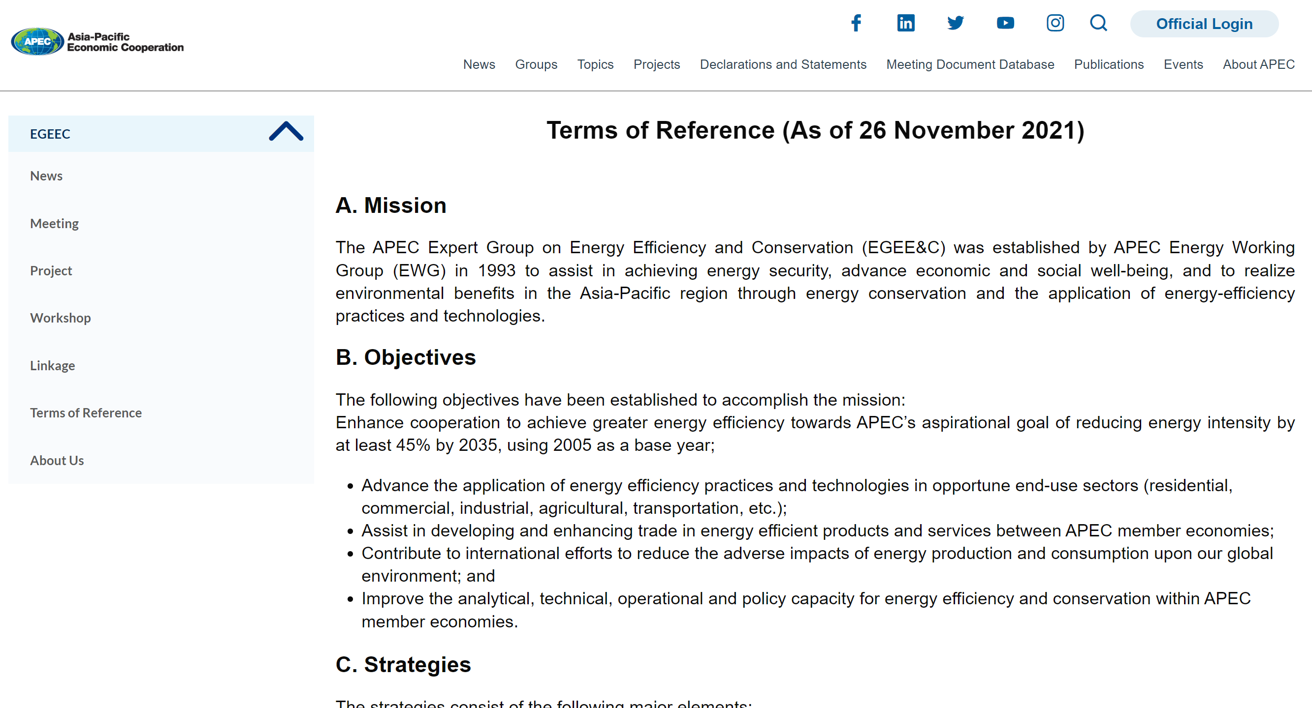
Terms of Reference
The EGEEC ToR was endorsed by SOM on 26 November 2021. The EGEEC ToR has term of four years starting from 1 January 2022 to 31 December 2025.
The draft EGEEC ToR for 2026-2029 is endorsed by EGEEC members as no comments were received as of 10 January 2025. The draft was submitted to the EWG members for their endorsement.
Notes:
The third important item is the review of the EGEEC Terms of Reference (ToR).
As you know, the current ToR was endorsed in November 2021 and has a four-year term starting from 1 January 2022 to 31 December 2025.
the draft EGEEC ToR for the new term—2026 to 2029 has now been submitted to the EWG members for their final endorsement. This will provide a solid institutional foundation for our work over the next four years.

Slide 6
Summary of EGEEC Meetings (2017-2026)
Year | Meeting | Location | Joint Meeting
2017 | EGEEC 49 | Jeju, Republic of Korea | EGNRET 48
 | EGEEC 50 | Moscow, Russia
2018 | EGEEC 51 | Washington D.C, USA
 | EGEEC 52 | Chiang Mai, Thailand | EGNRET 51
2019 | EGEEC 53 | Hong Kong, China | EGNRET 52
 | EGEEC 54 | Cebu, The Philippines
2020 | EGEEC 55 | Hong Kong, China | EGEDA 31
2021 | EGEEC 56 | Chinese Taipei (Online) | EGNRET 55
 | EGEEC 57 | Australia (Online)
2022 | EGEEC 58 | China (Online)
 | EGEEC 59 | Thailand (Online) | EGNRET 57
2023 | EGEEC 60 | Hong Kong, China
 | EGEEC 61 | Manila, The Philippines | EGNRET 59
2024 | EGEEC 62 | Nanjing, China | EGCFE)
 | EGEEC 63 | Tianjin, China | APSEC 10)
2025 | EGEEC 64 | Hong Kong, China | EGCFE, EGEDA 36 & EGNRET62
 | EGEEC 65 | Seoul, Republic of Korea | EGNRET 63
2026 | EGEEC 66 | Thailand | EGNRET 64
 | EGEEC 67 | China
Notes:
Finally, let's look at our meeting schedule.
Looking back, from 2017 to the present, we have maintained a close frequency of cooperation. We have successfully held meetings in locations including Korea, Russia, the USA, Thailand, the Philippines, China, and Hong Kong, China .
Looking ahead, our schedule is clear: In 2026, we have two major meetings planned:
EGEEC 66 will be hosted by Thailand.
EGEEC 67 will be hosted by China.

Slide 7
Upcoming EGEEC Meetings
EGEEC Meetings in first-half of 2027
Member economies who are interested in hosting the EGEEC meeting in the 2027 are encouraged to contact the EGEEC Secretariat.
The secretariat will follow up with Host Economy on the arrangement of the meeting and circulate the detail to all EGEEC members soon.
Notes:
For 2027, we are currently inviting member economies to host the meetings. If your economy is interested in hosting an EGEEC meeting in 2027, please contact the Secretariat. We will follow up with the host economy on arrangements and circulate the details to all members soon.

Slide 8
EGEEC guest member
EGEEC secretary propose to invite EE Hub to join EGEEC guest member
EEhub joined EGEEC 62 Nanjing, China share the progress of energy efficiency policies.
EEhub joined EGEEC 63 Tianjin, China, share the report of global energy efficiency map.
EEhub joined EGEEC 64 Hongkong, China, share the progress of working groups.
follow the APEC guest member regulation, EE hub have qualified to be guest member of EGEEC.
We are soliciting feedback from the economies present at this meeting. Following the meeting, we will also send out an email to all members to solicit their feedback.

Slide 9
THANK YOU
Notes:
Colleagues, the smooth operation of EGEEC relies on the support and contribution of every member. Let us continue to work together to advance energy efficiency in the Asia-Pacific region.
Thank you!

