Slide 1
Concept Note for session 1, 2026
2025/11/ 20
Promoting the Deployment of High-Efficiency Low-Carbon Room Air Conditioners (RACs) in APEC Region

Slide 2
Our Common Challenge
(The "Why")
0 1

Slide 3

Background: A surge in the ownership and use of Room Air Conditioners (RACs) in the APEC region, driven by rising living standards and rising temperatures.
Rising Living Standards
As living standards in the APEC region continuously improve, the pursuit of comfort has led to a gradual increase in the ownership of Room Air Conditioners (RACs) as a key appliance for improving living environments. .
Rising Temperature
Rising temperatures have led to more hot weather, significantly increasing the demand for and surge in the use of RACs to cope with high temperatures.

Slide 4


Question 1 (Energy): A significant increase in electricity consumption
High Volume of RAC Usage
Increased Pressure on Power Supply
The surge in RAC ownership and usage in the APEC region, with many units operating simultaneously, necessarily consumes a large amount of electricity, leading to a significant increase in the region's power consumption.
The sharp increase in electricity consumption places immense pressure on the APEC region's power supply, potentially causing supply shortages and impacting normal production and life.

Slide 5


Question 2 (Climate): Greenhouse gas (GHG) emissions caused by HFC refrigerants
Characteristics of HFC Refrigerants
Exacerbating Climate Issues
HFC refrigerants commonly used in RACs have properties that cause greenhouse gas emissions; GHGs are released during their use, adversely affecting the climate.
The continuous accumulation of GHGs emitted from HFC refrigerants will further exacerbate global climate problems, such as global warming, posing challenges to the ecological environment of the APEC region and the world.

Slide 6
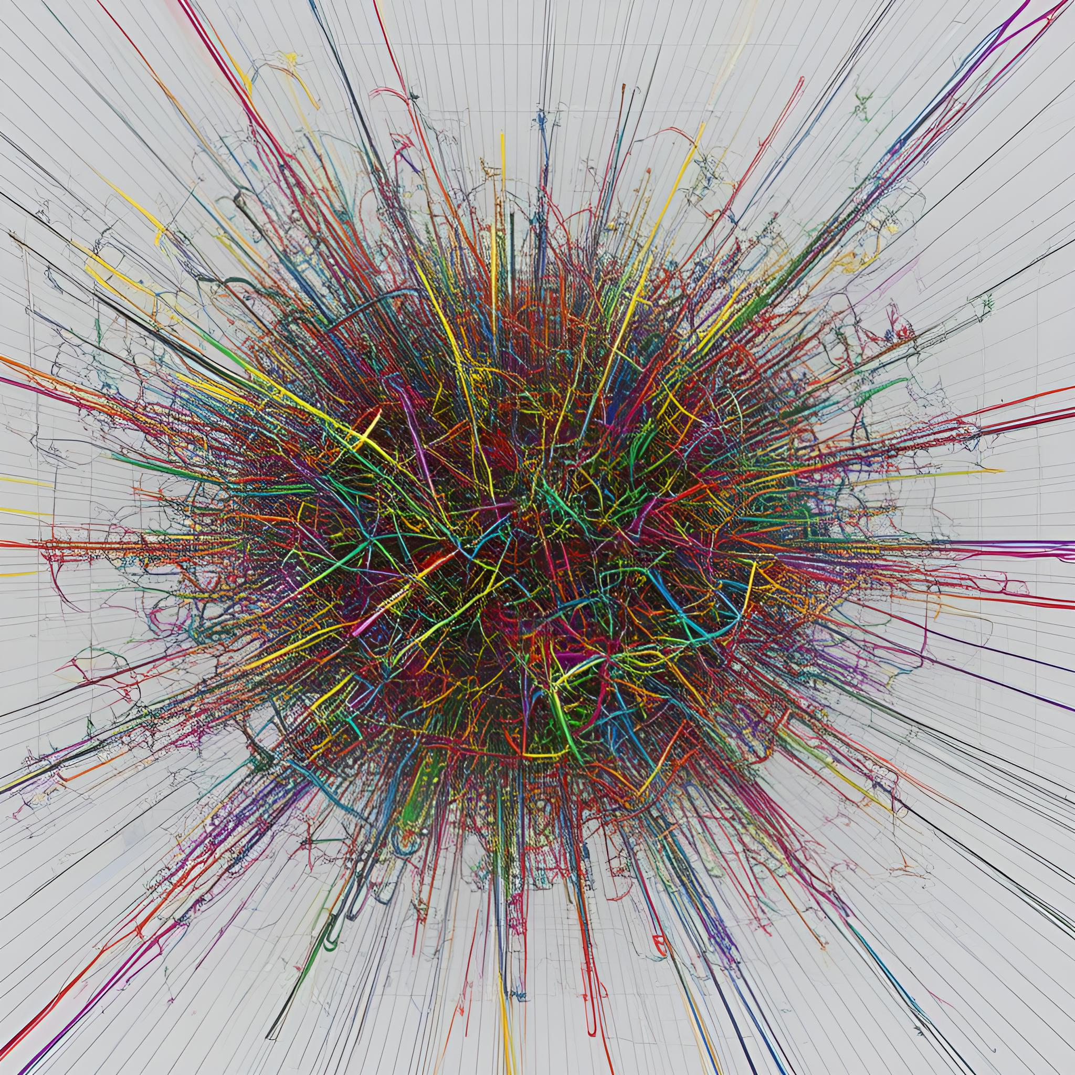
Core obstacle: Significant disparities exist among economies regarding minimum energy performance standards (MEPS), labeling schemes, and incentive policies.
Differences in Minimum Energy Performance Standards (MEPS)
APEC economies have significant differences in MEPS, leading to different energy efficiency requirements for RACs and affecting the unified promotion of high-efficiency products
Differences in Labeling Programs
Inconsistent labeling programs among economies make it difficult for consumers to understand the energy efficiency of RACs through a unified standard, which is not conducive to market selection of efficient products
Differences in Incentive Policies
Significant differences in incentive policies lead to varying levels of promotion for high-efficiency, low-carbon RACs across economies, hindering their widespread adoption in the APEC region.

Slide 7

Consequence: This divergence hinders the market penetration of the most efficient and climate-friendly technologies
Limited Market Selection
Due to differences in standards and policies, it is difficult to promote products in the market according to a unified high-efficiency, climate-friendly standard. [cite_start]Consumer choice is limited, affecting the market penetration of efficient technologies.
Impeded Technology Promotion
In an environment of differing standards and policies, the most efficient and climate-friendly technologies face difficulties entering various economies' markets. [cite_start]Their promotion speed and scope are hindered, which is detrimental to the widespread application of these technologies

Slide 8
Project Objectiv
(The "What")
0 2

Slide 9

Overall objective: Accelerate the deployment of high-efficiency, low-carbon RACs in the APEC region.
Accelerate Deployment of High-Efficiency, Low-Carbon RACs
As RAC ownership and usage surge in the APEC region, bringing energy and climate challenges, this project aims to accelerate the deployment of high-efficiency, low-carbon RACs to mitigate these challenges and promote sustainable development.
Promote and Deploy High-Efficiency, Low-Carbon RACs in the APEC Region
This project focuses on the APEC region, dedicated to promoting the deployment of high-efficiency, low-carbon RACs. It aims to address current energy and climate problems through research and promotion of advanced policies, standards, and best practices.
Focus on Policies, Standards, and Best Practices
The project emphasizes policies, standards, and best practices, aiming to accelerate the deployment of high-efficiency, low-carbon RACs in the APEC region and contribute to sustainable development through research and promotion in these areas.

Slide 10
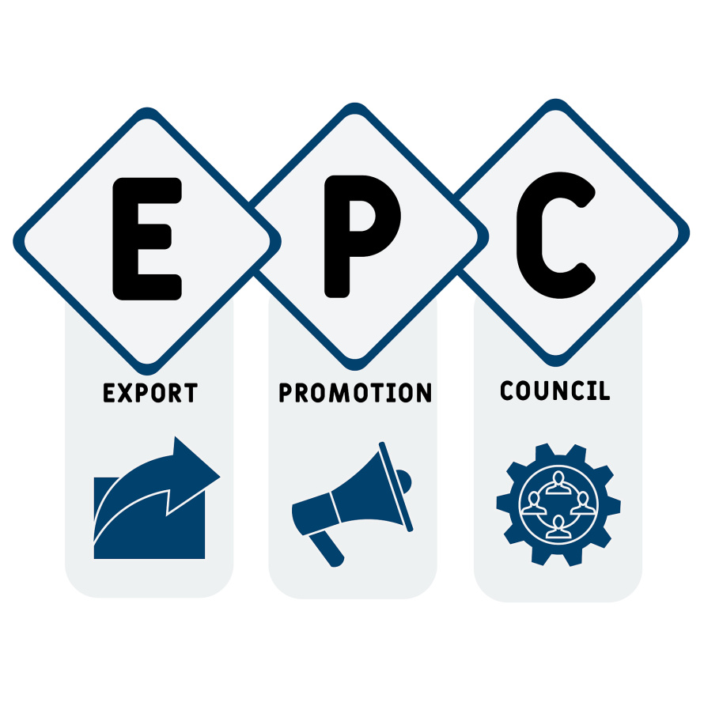
Core approach:Build the capacity of policymakers in APEC economies through policy research, standards comparison, and experience sharing.
Build Capacity through Policy Research
By researching relevant policies and analyzing their pros, cons, and applicability, APEC policymakers will gain a deep understanding of the logic and methods of policymaking
Build Capacity through Standards Comparison
Conducting standards comparisons will allow policymakers to clearly see the differences and advantages of various standards, learning how to formulate more scientific and reasonable standards
Build Capacity through Experience Sharing
Organizing experience-sharing activities enables policymakers to draw on the successful experiences of other economies, allowing them to better formulate and implement relevant policies tailored to their own situations and enhancing their ability to promote high-efficiency, low-carbon RACs

Slide 11
Main Outputs & Deliverables
0 3

Slide 12


Output 1: One "Research Report on RAC Policies, Standards, and Best Practices in the APEC Region
Provide Policy and Standards Research Findings
This report will focus on RACs in the APEC region, conducting in-depth research on relevant policies and standards. [cite_start]It will present the current situation and issues within the region, providing a solid theoretical basis and data support for subsequent promotion and deployment.
Share Best Practice Case Studies
The report will collect and share best practice case studies for RACs within the APEC region. [cite_start]These cases will offer valuable experiences for economies to draw upon, helping to promote the widespread application of high-efficiency, low-carbon RACs.

Slide 13

Output 2: "Capacity-Building Workshop" & "Case Study Workshop"
Enhance Policymaker Capacity
In-depth Discussion of Case Study Experiences
The "Capacity-Building Workshop" will help APEC policymakers enhance their ability to better promote high-efficiency, low-carbon RACs through policy research, standards comparison, and experience sharing.
The "Case Study Workshop" will select relevant cases for in-depth analysis, allowing participants to learn from the practical operational experiences and coping strategies of different economies in promoting RACs.

Slide 14

Output 3: "Guidebook on the Promotion of High-Efficiency, Low-Carbon RACs"
Guide Policy Formulation
Promote Standards Harmonization
This guidebook will provide systematic guidance to APEC economies on promotion policies for high-efficiency, low-carbon RACs, covering advanced MEPS, labeling, and incentive policies to help formulate effective policies.
The guidebook will help economies achieve a degree of uniformity in RAC promotion policies, reducing market barriers caused by policy differences and promoting the market penetration of high-efficiency, low-carbon technologies.

Slide 15

Proposing economy: China
Seek co-sponsorship support
China is actively playing a role in promoting the deployment of high-efficiency, low-carbon RACs in the APEC region and proposes this project to address related energy and climate issues.
We formally request the support of co-sponsoring economies, hoping all parties can work together to jointly advance the project for the promotion and deployment of high-efficiency, low-carbon room air conditioners in the APEC region.
2026 Session 1

Slide 16
thanks
THE END

