Slide 1
EGEEC 65 Outcome
The 65th Meeting of APEC Expert Group on Energy Efficiency & Conservation (EGEEC 65)
Notes:
thanks Chair, I’d like to start by thanking Hong Kong economy for hosting this meeting. Our Hongkong colleagues have worked really hard to make this event a success, and we’re truly grateful for their efforts. A special thanks for them in bringing together the four working groups for this joint meeting—it's been a great way to foster collaboration and meaningful discussions for APEC region energy. its the first 4 working group joint meeting, but not the last. its a good started, so we looking forward next 4 group joint meeting. We really appreciate Hong Kong’s support and contributions."
next, I will give the EGEEC outcomes presentation.

Slide 2
Participating Economies and Organisations
  Economies (9):
  China, Hong Kong China, Japan, Korea, Malaysia, Philippines, Thailand, Chinese Taipei.
  Cross-fora(3):
  EWG, EGEDA, APERC
  Non-APEC Organisation (3):
  Collaborative Labeling and Appliance Standards Program (CLASP)
  Video (2): IEA, Energy Efficiency Hub (EE Hub)
Notes:
this time, EGEEC have 9 ecnomies to paticipate meeting htis morning,
China, Hong Kong China, Japan, Korea, Malaysia, Philippines, Thailand, Chinese Taipei.
besides, APERC; EGEDA, EWG Secretariat, 3 AEPC fora join,
and we invite non-APEC organisation to join, that is CLASP, EE hub, and IEA

Slide 3
Presentations
  Invited presentations (4):
  Collaborative Labeling and Appliance Standards Program (CLASP)
  Energy efficiecny Hub (EE Hub), IEA
  APERC
  Projects updates and Concept Note Presentations (2):
  Projects updates (3): Chinese Taipei, APERC， Viet Nam
  New concept note(1): China
  Members are encouraged to propose new concept note in session 1, 2026.
Notes:
"In the EGEEC 65 meeting, we had a variety of informative presentations:
that is 4 Invited Presentations from CLASP, IEA and energy efficiency Hub, APERC to share the best practises or exprertises in energy promotion.
and Chinese Taipei and APERC give the presentation about the project update
China propose new concept note fot session 1, 2026
Chair encourage members to propose new concept note in session 1, 2026

Slide 4
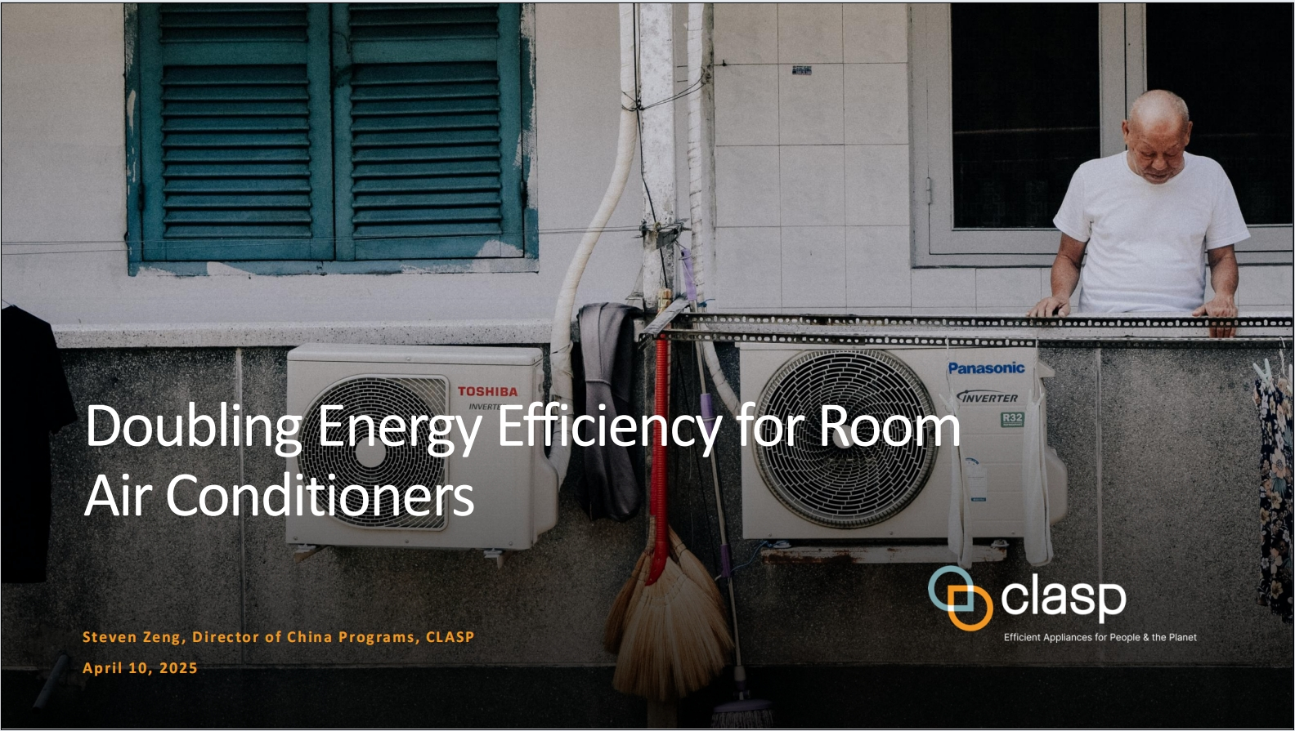
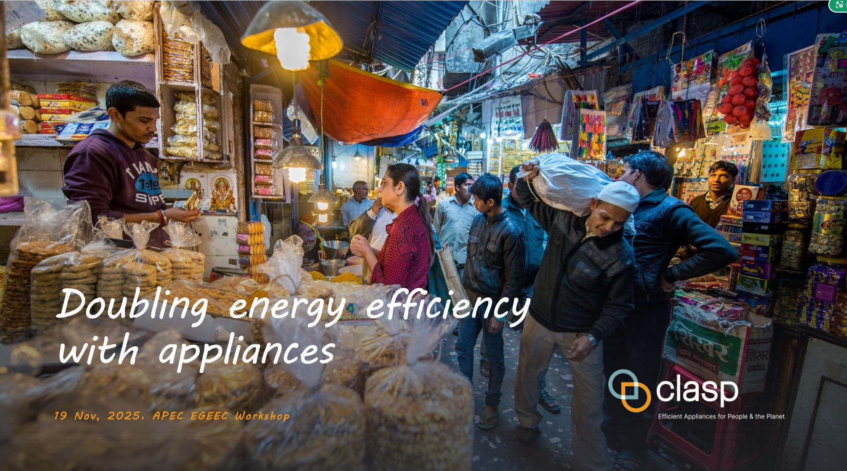
Presentation: CLASP
CLASP emphasizes that appliances and equipment account for 36% of global final energy consumption and are responsible for a significant portion of energy-related CO2 emissions. To achieve the doubling the global average annual rate of energy efficiency improvements by 2030. the report indicates that appliance energy efficiency can bridge 20% of the energy gap required to reach Net Zero emissions.
EGEEC Members are encouraged to explore cooperation opportunities with CLASP on improving energy efficiency of appliances and equipment and reduce emissions through knowledge sharing and APEC Project collaboration.
Notes:
CLASP shared its report on doubling energy efficiency with appliances during the EGEEC 65 meeting.
the report highlights the critical role of improving the energy efficiency of household appliances in combating climate change.
provided case studies from major economies such as Brazil, China, India, and Indonesia, outlining their progress in energy efficiency, the challenges faced
CLASP called for strengthening MEPS, setting measurable energy efficiency targets, and enhancing international cooperation to accelerate global progress
Chair encourage members to explore collaboration opportunities with CLASP to reduce emissions through knowledge sharing and APEC projects.

Slide 5

Presentation： APERC
Preview of the 9th APEC Energy Outlook on Data Centre Electricity Demand
  Data centres are essential to powering the digital economy
  Strong growth in electricity consumption in APEC economy
  Data centres drive significant electricity demand growth in most APEC subregions
  Data centre energy demand varies across economies
Opportunities: Data centres and AI expansion driving economic and energy innovation.
Challenges: Uncertainties remain in long-term energy Planning
Economies may prioritize fast and reliable power to secure competitiveness, even as they face sustainability and system-reliability challenges.
Collaboration among governments and industry is essential to manage grid bottlenecks, scale clean energy, and secure sustainable data centre growth
Notes:
this page shows the report from APERC.
APERC give the presentation about the previes of 9th APEC Energy Outlook on Data Centre Electricity Demand
Due to the rapid deployment of Artificial Intelligence (AI), electricity demand in the APEC region is projected to increase sharply, particularly in the data center sector.
The report points out that data center electricity demand grows significantly, projected to quadruple from current levels by 2035. This growth presents both challenges and opportunities, including increased pressure on the power grid, a conflict between the low-carbon transition and the demand for uninterrupted power, as well as a stimulus for economic development and investment in energy infrastructure."

Slide 6
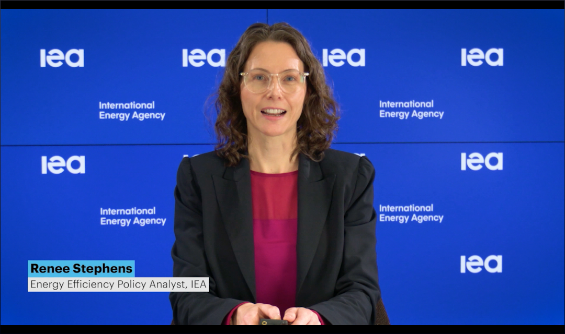
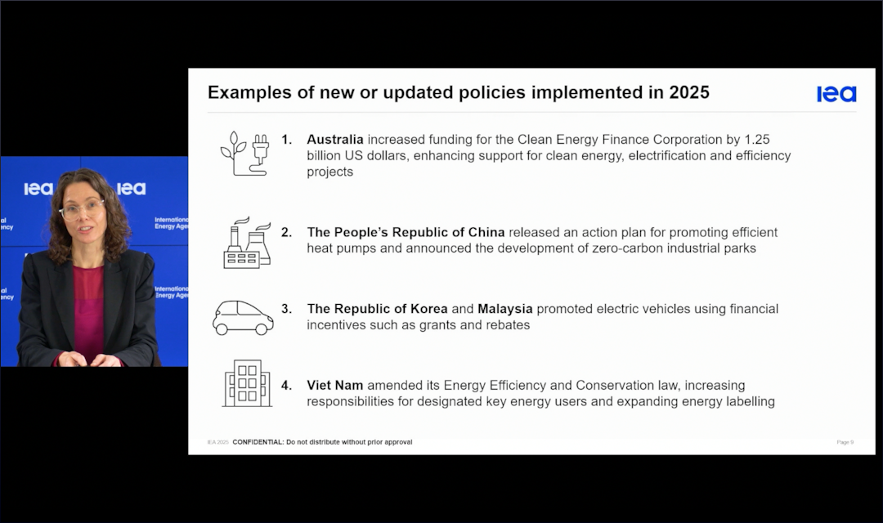
Presentation IEA
IEA Energy Efficiency 2025 Progress Report
Category | Key Insights | 2025 Progress & Policy Action
COP28 Target | Goal: Double the average annual energy efficiency improvement rate to 4% by 2030. | Urgent Need: Global efforts must accelerate, or the target will be missed.
Global Status (2019-2025) | Progress Stalled: The average annual rate of primary energy intensity improvement is only 1.3%, far below the 4% target. | Impediments: 1. Soaring industrial demand. 2. Energy efficiency standards lagging behind technology. 3. Electricity demand outpacing renewables supply. 4. Surge in cooling demand (ACs).
2025 Highlights | Uptick Expected: The estimated improvement rate for 2025 is 1.8% (up from 1% in 2024). | Policy Acceleration: Economies covering over 85% of global energy demand implemented new efficiency policies.
While energy efficiency shows signs of an uptick, progress remains in "low gear" (1.3%); policymakers must act immediately to raise standards and fill policy gaps to meet the 4% doubling target by 2030.
Notes:
IEA通过视频方式做了关于2025年全球能源效率发展最新情况的报告，报告分析了造成进展缓慢的四大趋势，包括工业能耗增长、政策滞后于技术进步以及空调需求上升等，同时强调了亚太地区政策制定正在加速，并提出了通过提高现有政策雄心和填补政策空白来加速能效进展的建议。
The IEA (International Energy Agency) delivered a video presentation reporting on the latest developments in global energy efficiency in 2025.
The report analyzed four major trends contributing to the slow progress, including increased energy consumption in the industrial sector, policy implementation lagging behind technological advancements, and rising demand for air conditioning.
Simultaneously, it highlighted the accelerating pace of policy development in the Asia-Pacific region and put forward recommendations for accelerating energy efficiency progress by increasing the ambition of existing policies and filling policy gaps.

Slide 7
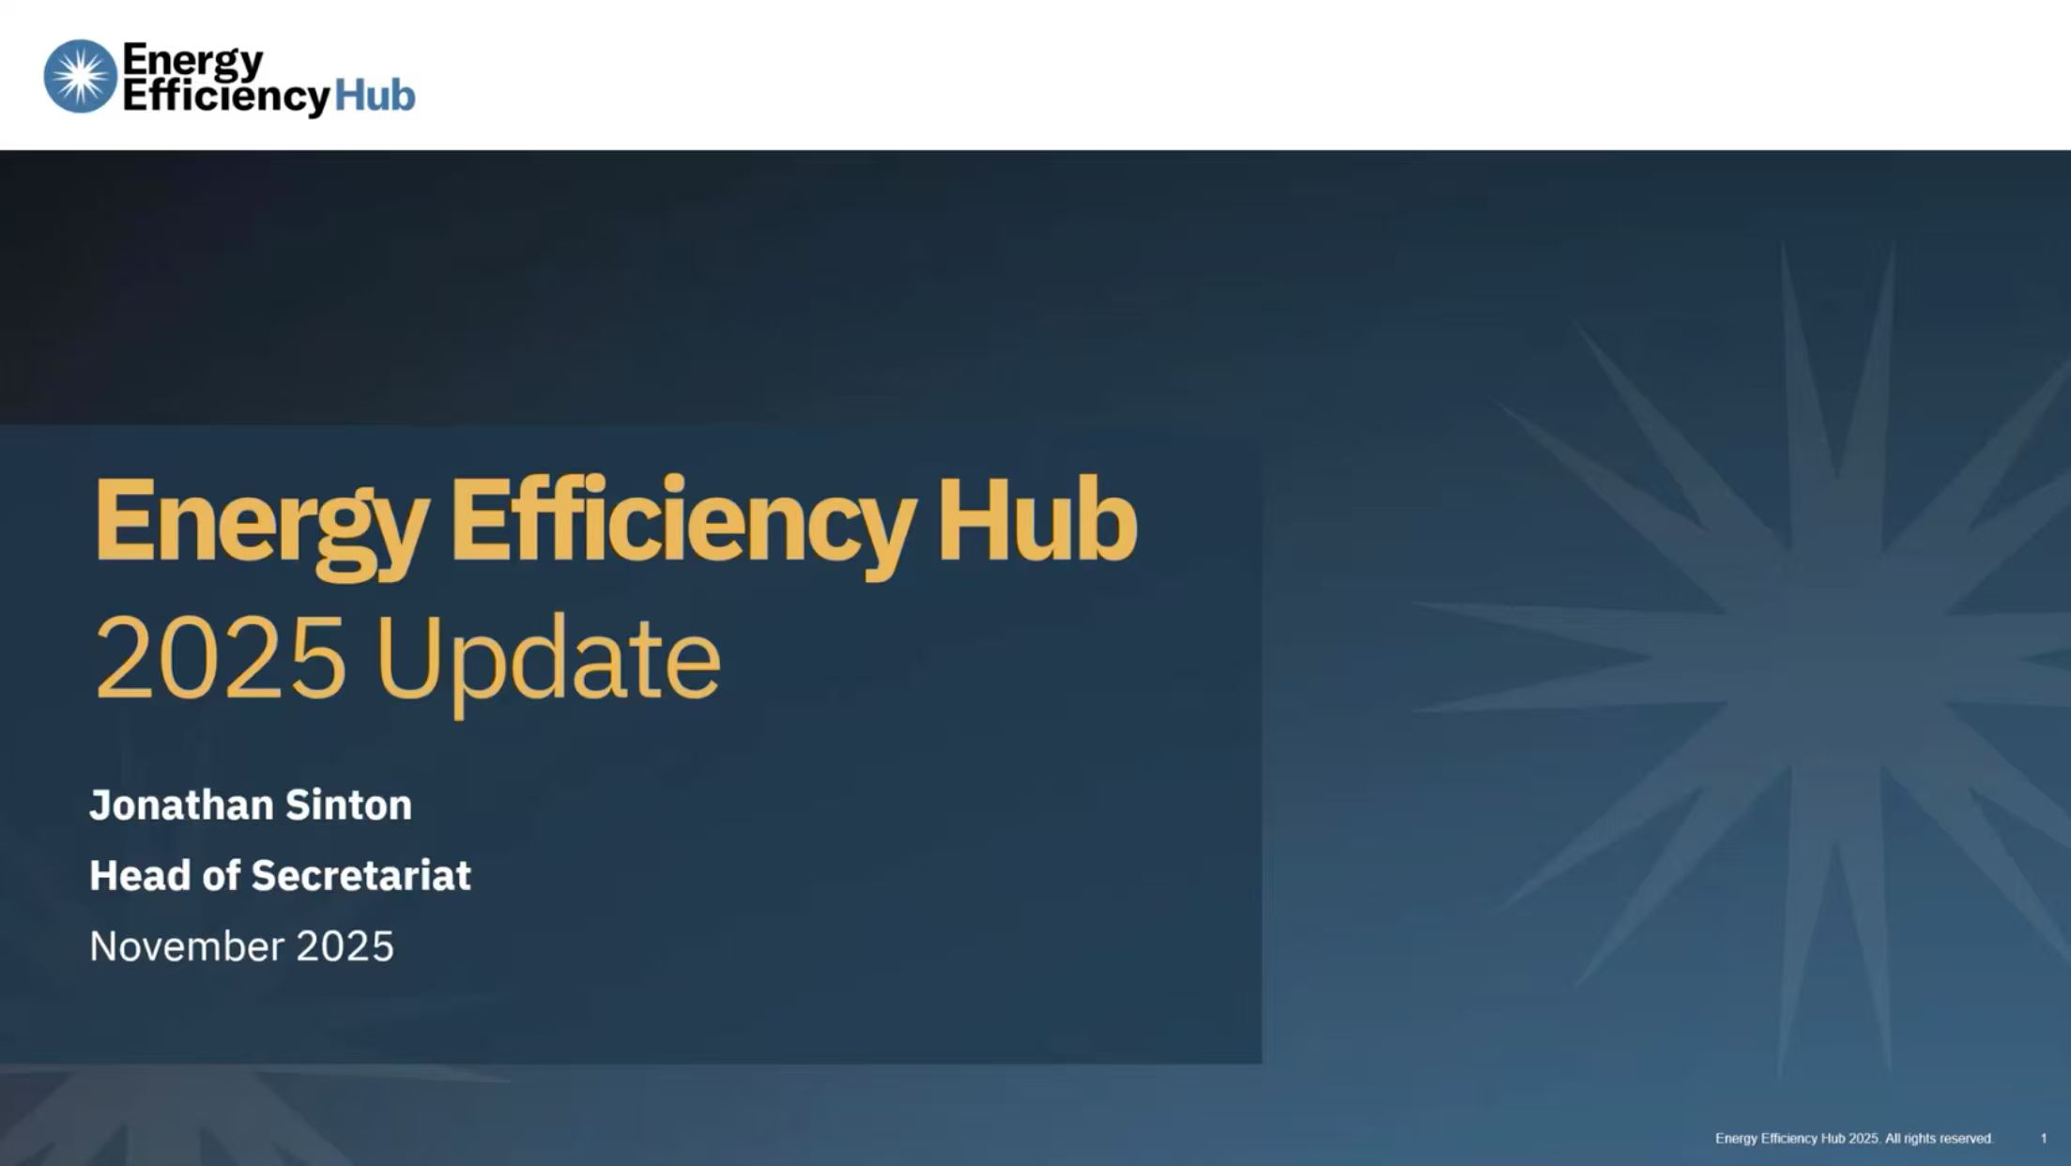
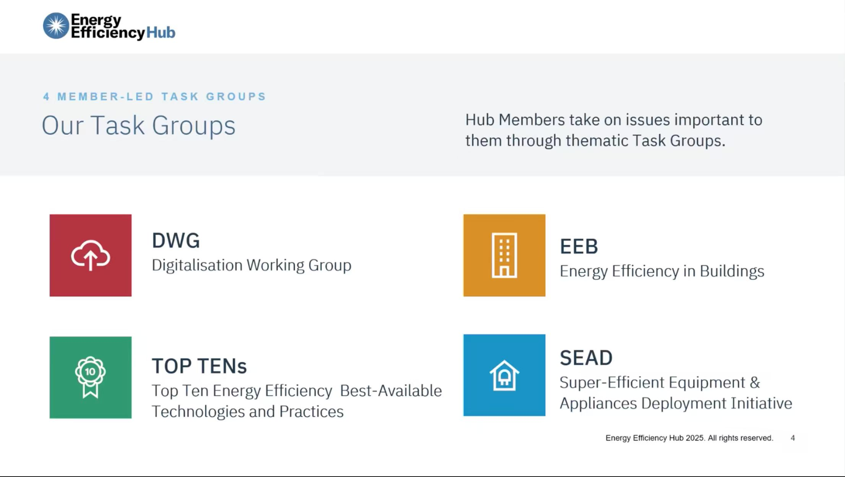
Presentation EE Hub: Energy Efficiency Hub
Introduce the Energy Efficiency Hub mission, member and
  the four task groups(DWG, SEAD, TOP -TENs,EEB).
  Introduce the latest work and of TGs:
    Digitalisation Working Group (DWG) - lead by China
    Super-Efficiency Equipment & Appliance Deployment Initiative (SEAD) - lead by UK
    Top Ten Energy Efficiency Best Available Technologies and Practices (TOP-TENs) - lead by China
    Energy Efficiency in Buildings (EEB) - lead by EU and German
EE Hub will be invited to be guest member of EGEEC
Notes:
The Energy Efficiency Hub (EE Hub) give the update presenttation this time, EE hub is an an intergovernmental organization comprising 17 member countries collectively committed to formulating and implementing energy efficiency policies.
the head of EE hub introduced its mission and four task groups. and outlined the recent activities of each working group, including the Digitalization Working Group's focus on data centers, as well as the Building Working Group's work on financing for building energy retrofits and life-cycle analysis.
and he mentioned a series of workshops and conferences recently organized by the Hub, aimed at enhancing the visibility of energy efficiency and promoting the sharing of best practices.
According to the APEC rules for Guest Members, The Chair proposed, and all members agreed and reached consensus duiring this meeting, that the EGEEC Secretariat should invite the EE Hub to join EGEEC as a Guest Member.

Slide 8
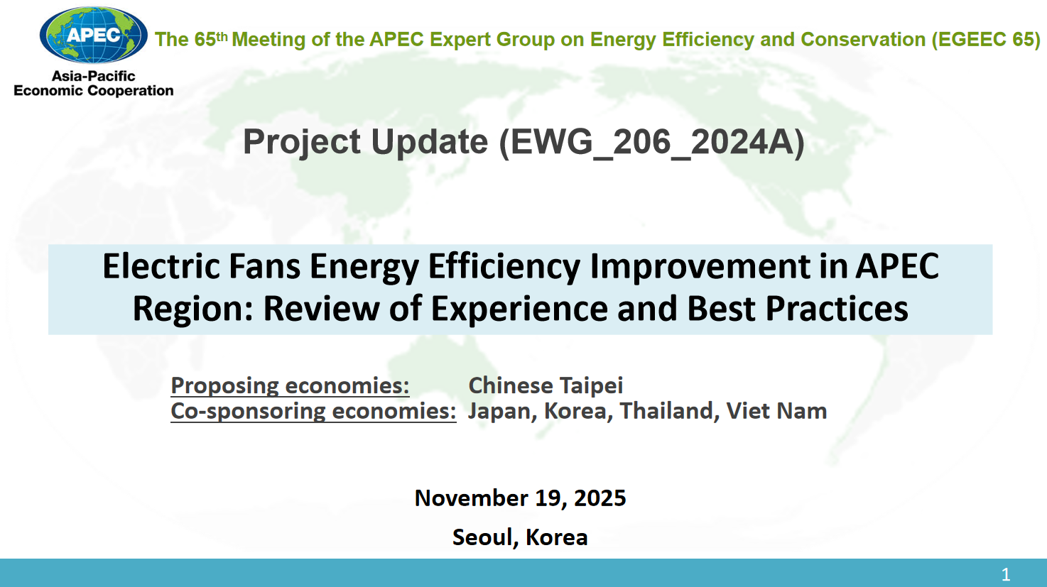
Project update
EWG 206 2024A-Electric Fans Energy Efficiency Improvement in APEC Region: Review of Experience and Best Practices
  main objective of the project is to investigate strategies for increasing the market share of high-efficiency electric fans by examine current energy-saving technologies and share best practices to APEC members.
One day workshop in 17 Nov.
  38 attendees from 11+1 economies and 5 APEC fora
  8 experts from 4+1 economies and 2 international Org
Notes:
this page shows the project update from Chineses Taipei.
项目旨在通过研讨和分享最佳实践来推动电风扇区域能效标准的协调一致，报告引用了全球行业分析师（GIA）的数据，展示了全球电风扇市场的增长趋势；
报告还介绍了11月17日“APEC电风扇能效政策、标准与最佳实践研讨会”的参会情况及会议成果。
The project aims to promote the harmonization of regional energy efficiency standards for electric fans through workshops and the sharing of best practices. The report cites data from Global Industry Analysts (GIA), demonstrating the growth trend of the global electric fan market and also provided forecasts for future trends of electric fans.
The report also presented the workshop which was held on 11 17th, and attendances and outcomes of the workshop.

Slide 9
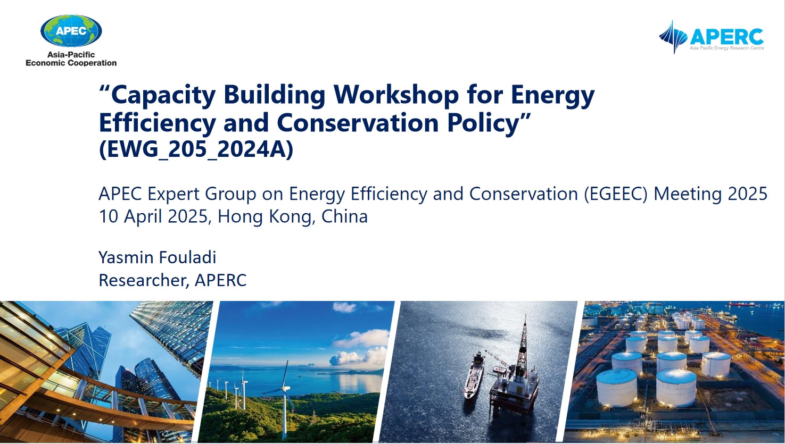
Project update
EWG 205 2024A-Capacity Building Workshop for Energy Efficiency and Conservation Policy
  main objective of the project is to support APEC members in capacity building for energy efficiency and conversation policies as they work towards the energy transition.
APERC share the workshop On 18 November. introduced the Workshop Highlights – MEPS Implementation, Challeges and Solutions.
Notes:
this page shows the project update from APERC.
(APERC) provided an update on its project, which is designed to support APEC members in implementing energy efficiency and conservation policies to advance the energy transition through Capacity Building Workshops.
The first phase of the workshop focused on Minimum Energy Performance Standards (MEPS), aiming to share implementation experiences, challenges, and best practices, and was attended by 48 participants.
The second phase is planned as a one-day workshop focusing on policies and practices for energy efficiency in the building sector, with the goal of promoting sustainable building standards."

Slide 10
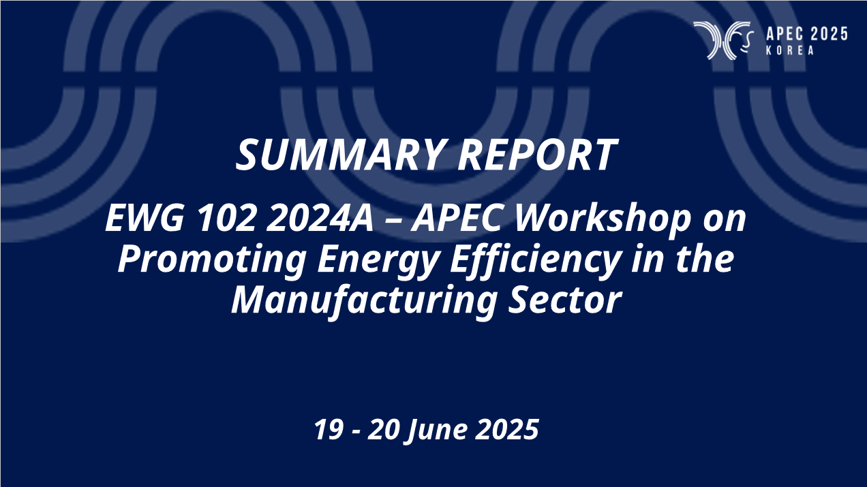
Project update
EWG 102 2024A – APEC Workshop on Promoting Energy Efficiency in the Manufacturing Sector
  main objective of the project is to help economies and stakeholders to share information, experiences on promoting energy efficiency in manufacturing industry as well as to provide recommendations on enhancing energy efficiency in this industry
Viet Nam shared the workshop of Promoting Energy Efficiency in the Manufacturing Sector On 19 and 20 June 2025.
Notes:
this page shows the project update from Viet Nam.
Viet Nam shared the workshop of Promoting Energy Efficiency in the Manufacturing Sector On 19 and 20 June 2025
The workshop brought together representatives from global organizations, research institutes, as well as government agencies, corporations, and business associations from APEC member economies. Key topics of discussion included an overview of energy demand in manufacturing, opportunities for promoting energy efficiency, innovation and financing, and case studies from multiple member economies.
The report concludes with several recommendations, emphasizing the need for awareness-raising and education, promoting R&D and collaboration, strengthening capacity building, facilitating financial access, and the proactive role that APEC should play.

Slide 11
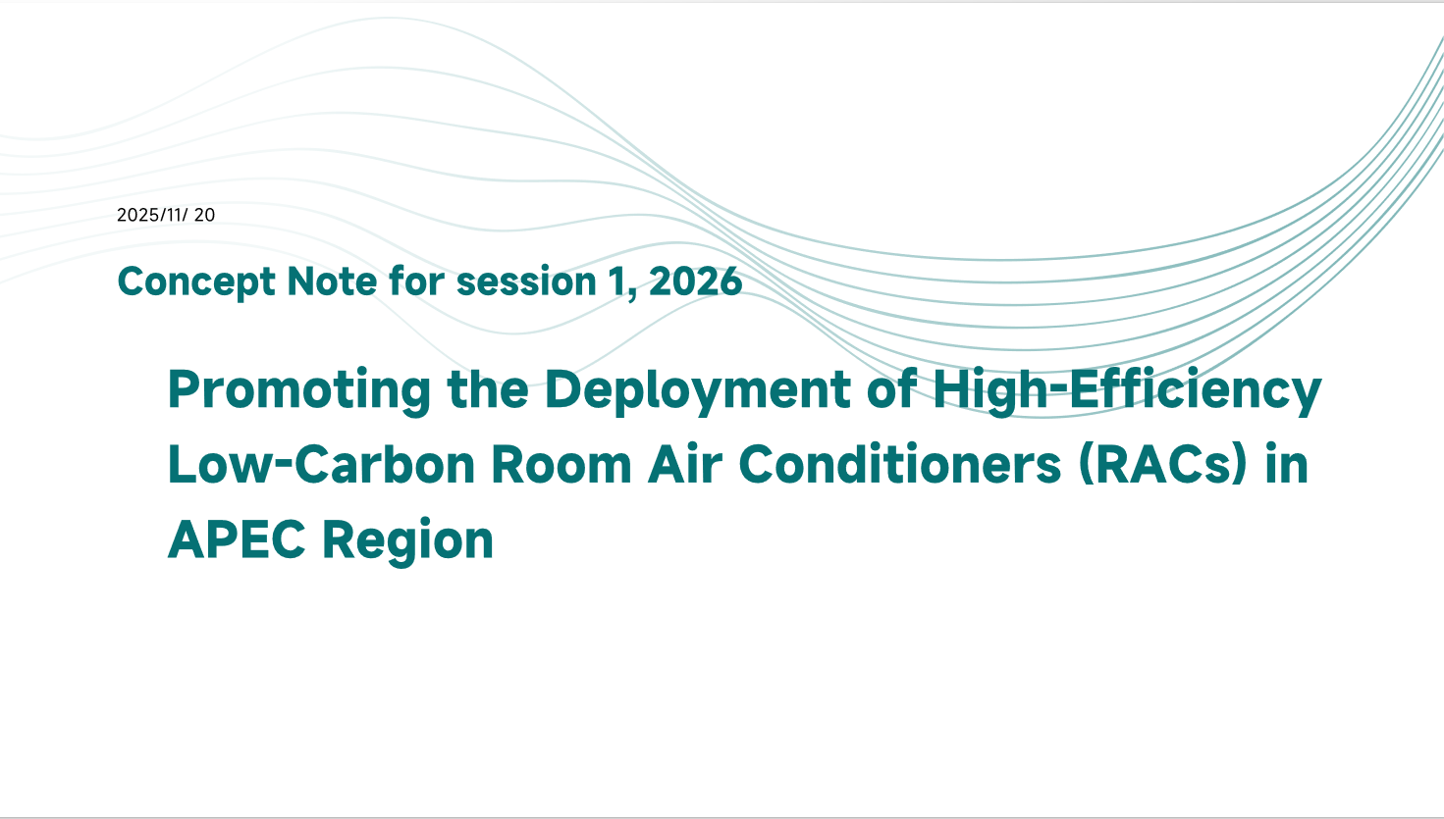
Concept Note
Promoting the Deployment of High-Efficiency Low-Carbon Room Air Conditioners (RACs) in APEC Region
  objective: Accelerate the deployment of high-efficiency, low-carbon RACs in the APEC region
  output: 1*Research Report, 2*workshops, 1*Guidebook
  China propose session 1, 2026
  seeking support
Notes:
China report the concept note,Promoting the Deployment of High-Efficiency Low-Carbon Room Air Conditioners (RACs) in APEC Region
this proposal project aim to Accelerate the deployment of high-efficiency, low-carbon RACs in the APEC region. China will submit CN to EWG to endose for session 1, 2026, they are seeking economies to support.

Slide 12

EGEEC upcoming meeting
2026: EGEEC 66
  Thailand will organise the EGEEC and EGNRET joint meetings and related workshops in the first half of 2026.
2026: EGEEC67
  China, will hold the 66th EGEEC meeting in the second half of 2026.
  China wil be the Chair of APEC, welcome to China
Notes:
In 2026, Korea will host the joint meetings of EGEEC and EGNRET, along with related workshops, in the second half of the year.
In 2026, Thailand will hold the EGEEC and EGNERTjoint meeting in the first half of the year，along with related workshops.
In 2026 secnond half, China will hold the EGEEC meetnig.
Chair also encourage all members to actively participate in these upcoming meetings in 2027

Slide 13
THANK YOU
Notes:
at last. I would like to sincerely thank everyone for being here today.
Thanks our Korea colleagues again, I would like to extend my heartfelt thanks to our gracious hosts in Seoul for their hard work and warm hospitality, grateful for your dedication and the wonderful reception you have provided us..
looking forward to our next meeting.

