Slide 1
Progress Report on the Expert Group on Energy Efficiency and Conservation (EGEEC)
1 April 2026
Notes:
Good morning, Lead Shepherd, delegates, and colleagues. I am Liu Meng, Chair of EGEEC. On behalf of our Chair, Dr. Liu Meng, it is my pleasure to present the progress report of the Expert Group on Energy Efficiency and Conservation to the 71st EWG meeting .

Slide 2
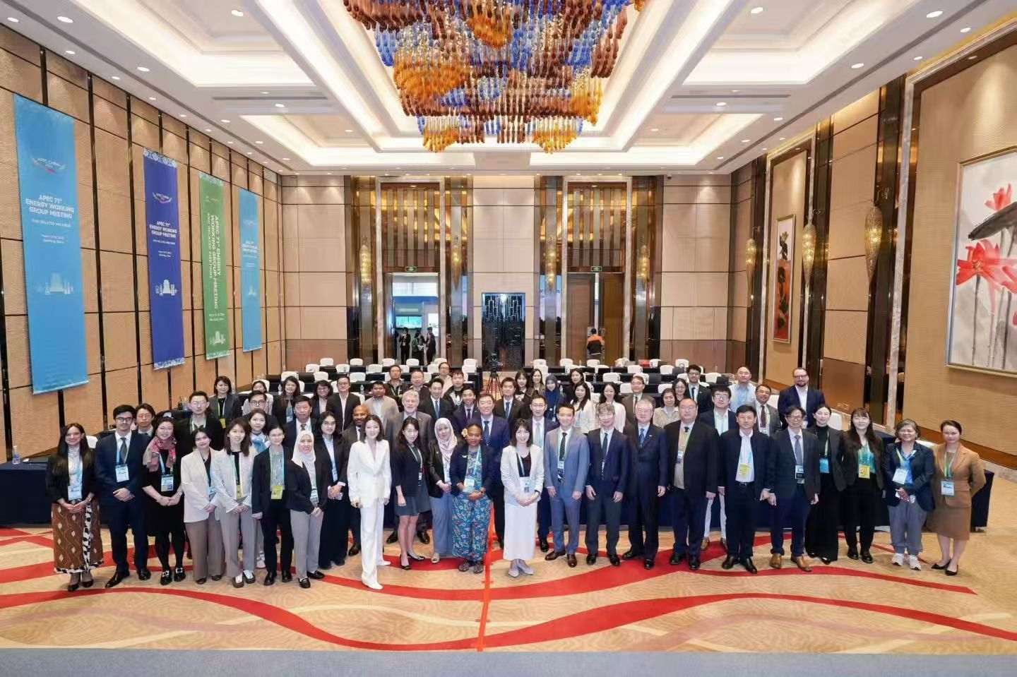
  Capacity Building Workshop on Energy Efficiency and Conservation Policy (CBWS/EECP)
  APEC Workshop on Policies, Standards, and Best Practices for Energy-Efficient Electric Fans (EWG_206_2024A)
  Off-grid Multi-Energy complementaryMicrogrid Solution: build sustainable and resilient energy systen(EWG 106 2025A)
EGEEC engagement in EWG activities
Notes:
Since our last meeting, EGEEC has been highly active. Key milestones include our joint meeting with EGNRET in Seoul last November, as well as critical workshops on energy efficiency policy and electric fan standards .

Slide 3
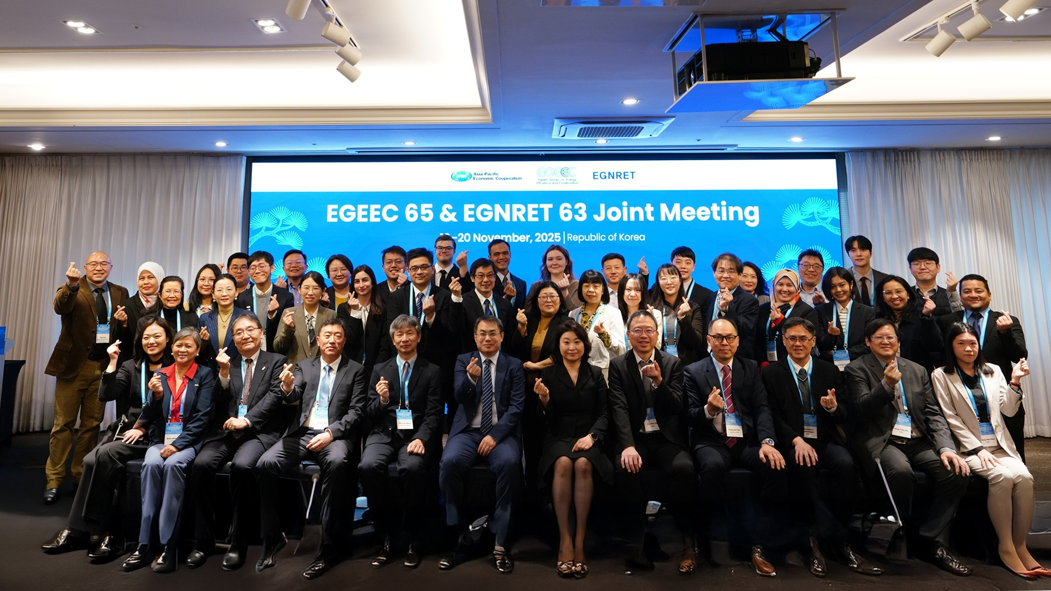
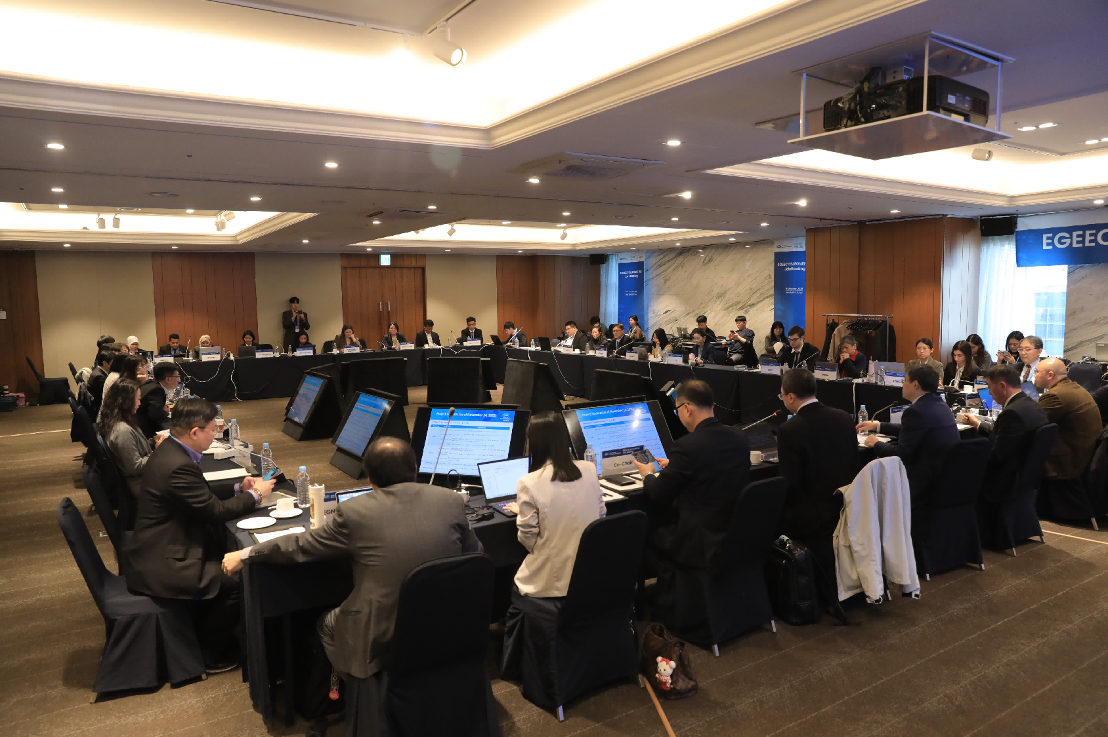
EGEEC65 and EGNERT63 joint meeting
  Date/Location: November 19-20, 2025 | Seoul, Republic of Korea
  Theme: "AI-Driven Energy Innovation"
  Participation: 11 Economies, 4 APEC Fora, 3 International Organizations (IEA, CLASP, EE Hub)
Notes:
The EGEEC 65 meeting convened 11 member economies and several international organizations. Under the theme "AI-Driven Energy Innovation," we explored how digitalization can accelerate our regional energy efficiency goals.
As you can see from our group photo in Seoul, the meeting fostered strong engagement across the APEC region, bringing together a diverse group of policy experts and technical specialists.

Slide 4
EGEEC65 and EGNERT63 joint meeting
Participating Economies and Organisations
  Economies (9):
  China, Hong Kong China, Japan ......
  Cross-fora(3):
  EWG, EGEDA, APERC
  Non-APEC Organisation (3):
  Collaborative Labeling and Appliance Standards Program (CLASP)
  Video (2): IEA, Energy Efficiency Hub (EE Hub)
Notes:
We had robust participation from 9 economies in person and virtually. Crucially, our collaboration with other APEC fora like EGEDA and APERC, and international bodies like CLASP and the IEA, continues to strengthen our technical base .

Slide 5
EGEEC65 and EGNERT63 joint meeting
Presentations
  Cross-fora updates (4):
  APEC Secretariat, EWG, EGEDA, EGCFE, APERC
  Invited presentations (4):
  Collaborative Labeling and Appliance Standards Program (CLASP)
  Energy efficiecny Hub (EE Hub), IEA
  APERC
  Projects updates and Concept Note Presentations (2):
  Projects updates (3), New concept note(1)
Notes:
The meeting featured four major cross-fora updates and invited expert presentations . We also reviewed project updates from Chinese Taipei, APERC, and Viet Nam, alongside a new concept note proposed by China .

Slide 6
Strategic Engagement & Collaborations
  IEA: share the Global energy efficiency trends and cooling demand growth.
  CLASP: Appliance efficiency can bridge 20% of the Net Zero energy gap.
  Energy Efficiency Hub (EE Hub): Updates on Digitalization and Buildings task groups.
  Partnership Updates: CLASP officially accepted as a Guest Member;
  EE Hub invited to apply for Guest Status.
Notes:
EGEEC is expanding its international network. A significant milestone is the official acceptance of CLASP as a Guest Member of EGEEC, and we have invited the Energy Efficiency Hub to apply for the same status .

Slide 7
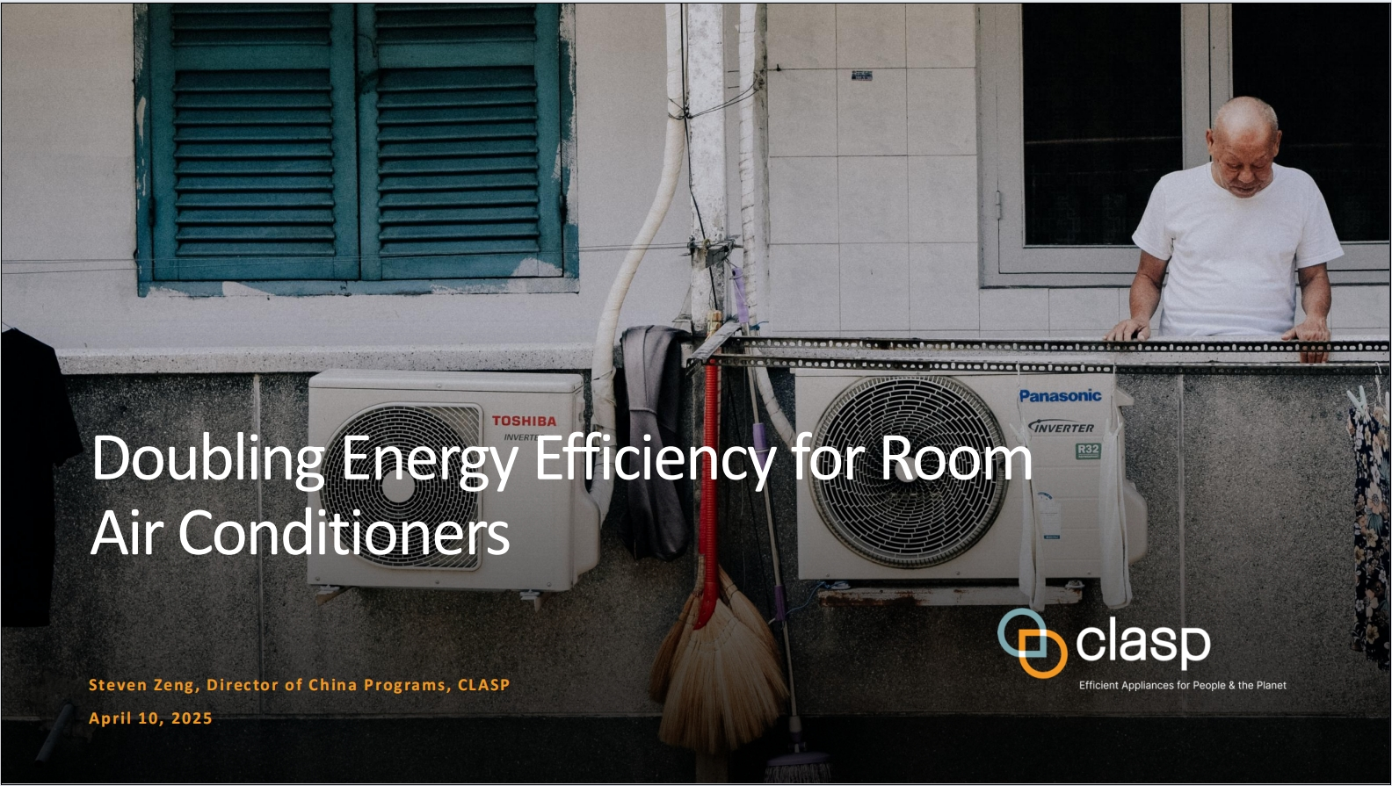
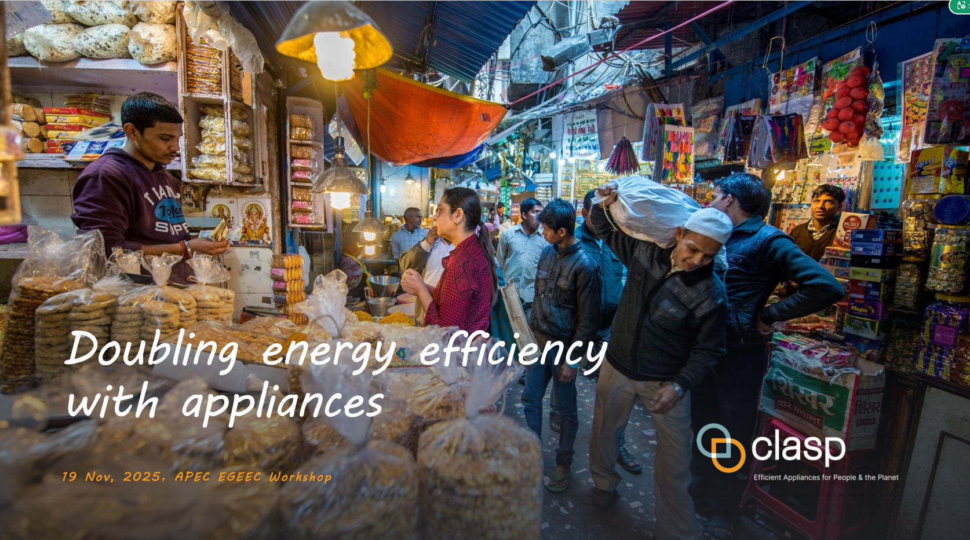
Presentation: CLASP
CLASP emphasizes that appliances and equipment account for 36% of global final energy consumption and are responsible for a significant portion of energy-related CO2 emissions. To achieve the doubling the global average annual rate of energy efficiency improvements by 2030. the report indicates that appliance energy efficiency can bridge 20% of the energy gap required to reach Net Zero emissions.
EGEEC Members are encouraged to explore cooperation opportunities with CLASP on improving energy efficiency of appliances and equipment and reduce emissions through knowledge sharing and APEC Project collaboration.
Notes:
CLASP's research underscores that appliance efficiency is a low-hanging fruit. Improving standards for equipment can bridge 20% of the energy gap needed to reach Net Zero emissions .

Slide 8
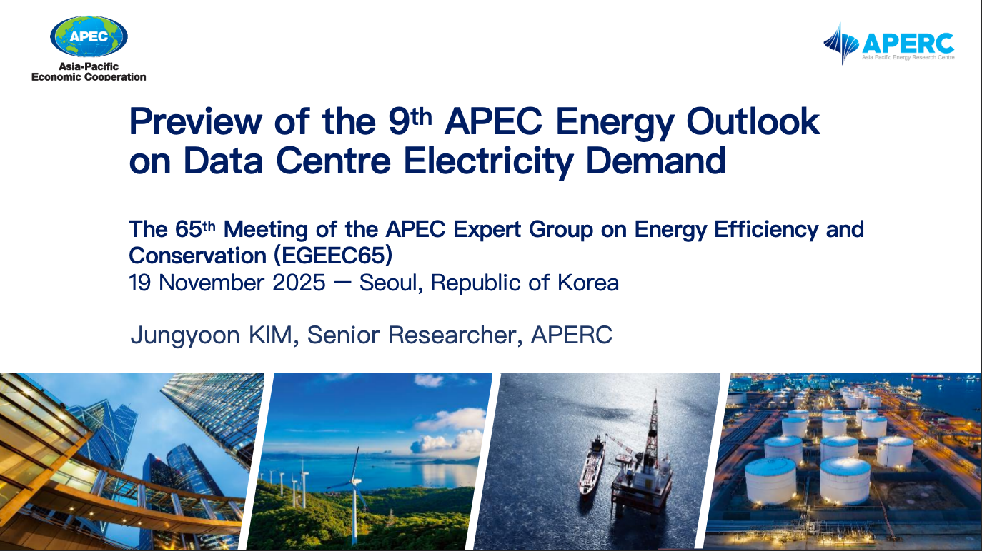
Presentation： APERC
Preview of the 9th APEC Energy Outlook on Data Centre Electricity Demand
  Data centres are essential to powering the digital economy
  Strong growth in electricity consumption in APEC economy
  Data centres drive significant electricity demand growth in most APEC subregions
  Data centre energy demand varies across economies
Opportunities: Data centres and AI expansion driving economic and energy innovation.
Challenges: Uncertainties remain in long-term energy Planning
Economies may prioritize fast and reliable power to secure competitiveness, even as they face sustainability and system-reliability challenges.
Collaboration among governments and industry is essential to manage grid bottlenecks, scale clean energy, and secure sustainable data centre growth
Notes:
APERC provided a preview of the 9th Energy Outlook, focusing on the surge in data centre electricity demand driven by AI. This growth poses new challenges for grid stability and clean energy supply.

Slide 9
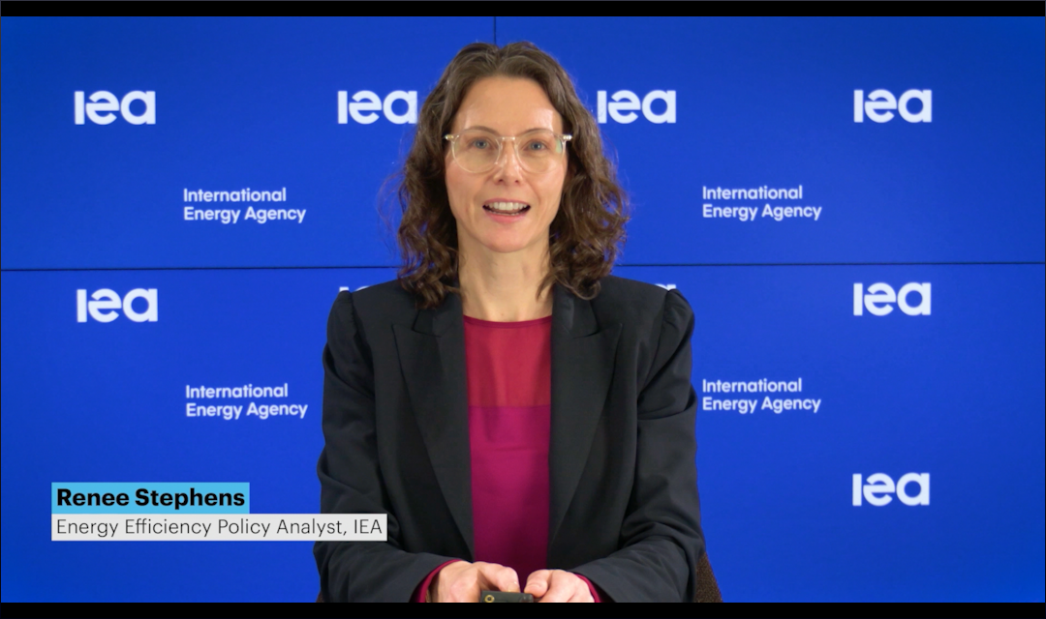
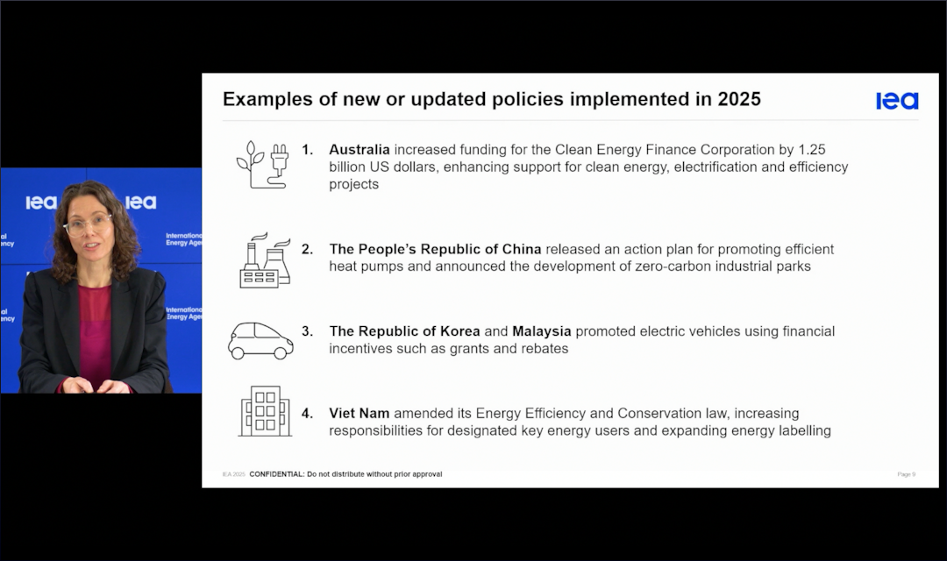
Presentation IEA
IEA Energy Efficiency 2025 Progress Report
Category | Key Insights | 2025 Progress & Policy Action
COP28 Target | Goal: Double the average annual energy efficiency improvement rate to 4% by 2030. | Urgent Need: Global efforts must accelerate, or the target will be missed.
Global Status (2019-2025) | Progress Stalled: The average annual rate of primary energy intensity improvement is only 1.3%, far below the 4% target. | Impediments: 1. Soaring industrial demand. 2. Energy efficiency standards lagging behind technology. 3. Electricity demand outpacing renewables supply. 4. Surge in cooling demand (ACs).
2025 Highlights | Uptick Expected: The estimated improvement rate for 2025 is 1.8% (up from 1% in 2024). | Policy Acceleration: Economies covering over 85% of global energy demand implemented new efficiency policies.
While energy efficiency shows signs of an uptick, progress remains in "low gear" (1.3%); policymakers must act immediately to raise standards and fill policy gaps to meet the 4% doubling target by 2030.
Notes:
The IEA reports that while energy efficiency is picking up, global progress is at 1.3%, far below the COP28 target of 4%. Policy acceleration in cooling and industry is urgently needed.

Slide 10
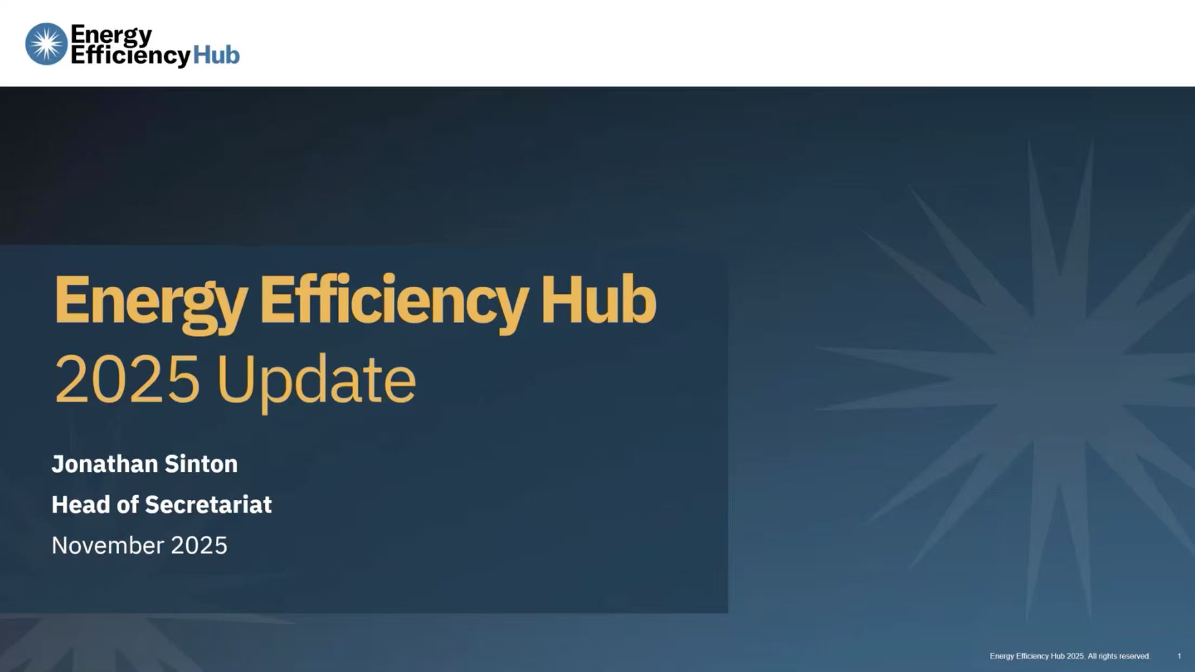
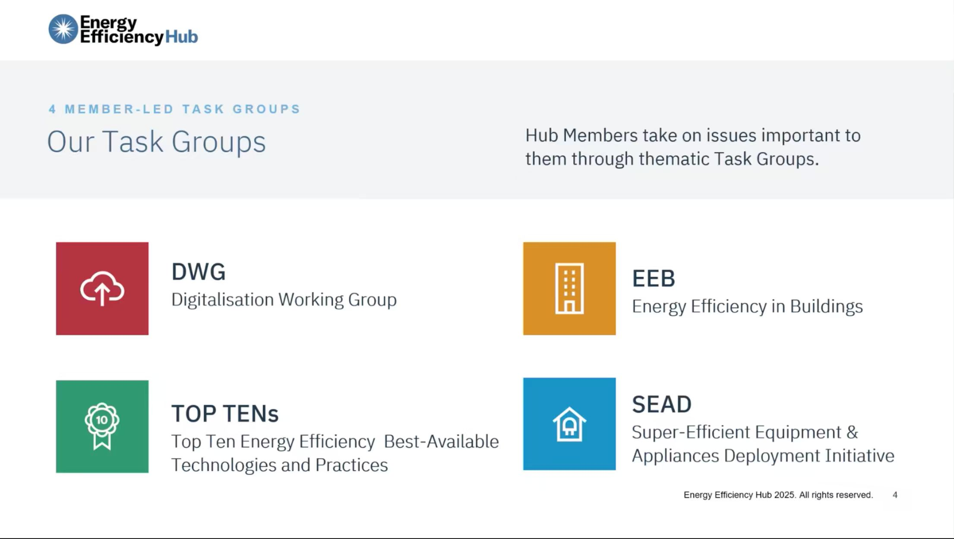
Presentation EE Hub: Energy Efficiency Hub
Introduce the Energy Efficiency Hub mission, member and
  the four task groups(DWG, SEAD, TOP -TENs,EEB).
  Introduce the latest work and of TGs:
    Digitalisation Working Group (DWG) - lead by China
    Super-Efficiency Equipment & Appliance Deployment Initiative (SEAD) - lead by UK
    Top Ten Energy Efficiency Best Available Technologies and Practices (TOP-TENs) - lead by China
    Energy Efficiency in Buildings (EEB) - lead by EU and German
EE Hub will be invited to be guest member of EGEEC
Notes:
The Energy Efficiency Hub shared updates from its four member-led task groups. We see great synergy between their work on digitalization and buildings and our own EGEEC priorities.

Slide 11
Project Portfolio Overview
Total Projects: 13 projects across different lifecycle stages.
  Current Status: Ongoing (APEC Funded): 3 major projects (Fans, Policy Capacity Building, Manufacturing).
  Completed: Final reports undergoing endorsement.
  Proposed: New Concept Notes submitted for Session 1, 2026.
# | Project Title | Project Number | Proposed Economy
1 | Electric Fans Energy Efficiency Improvement in APEC Region: Review of Experience and Best Practices | EWG_206_2024A | Chinese Taipei
2 | APEC Workshop on Cleaner and More Efficient Operation of the Fossil Energy Industry | EWG_202_2024A | Japan
3 | Capacity Building Workshop for Energy Efficiency and Conservation Policy | EWG_205_2024A | Japan
4 | APEC Practical Training on District Cooling and Heating Systems (DCHS) | EWG 101 2025A | Hong Kong, China
5 | APEC Workshop on Promoting the Application of Artificial Intelligence (AI) for Future Energy and Sustainable Development | EWG 103 2025A | Viet Nam
6 | Reaction to COVID-19: Strengthening Quality Infrastructure for Energy Efficiency of Lighting Products in Residential in the APEC region (First Follow-Up Workshop) | SMEWG 101 2025A | Viet Nam
Notes:
Currently, EGEEC manages 13 projects across various stages. This includes critical work on electric fans by Chinese Taipei, fossil energy operations by Japan, and lighting products by Viet Nam.

Slide 12
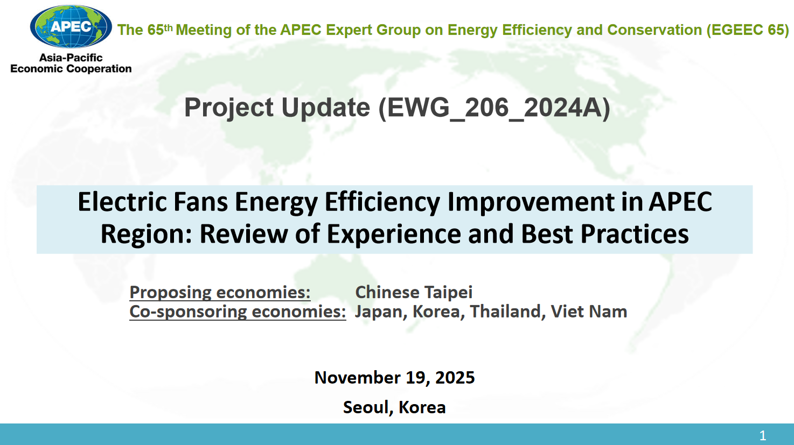
Project update
EWG 206 2024A-Electric Fans Energy Efficiency Improvement in APEC Region: Review of Experience and Best Practices
  main objective of the project is to investigate strategies for increasing the market share of high-efficiency electric fans by examine current energy-saving technologies and share best practices to APEC members.
One day workshop in 17 Nov.
  38 attendees from 11+1 economies and 5 APEC fora
  8 experts from 4+1 economies and 2 international Org
Notes:
The project on electric fans held a successful workshop in Seoul with 38 attendees . The goal is to investigate strategies to increase the market share of high-efficiency fans across APEC members.

Slide 13
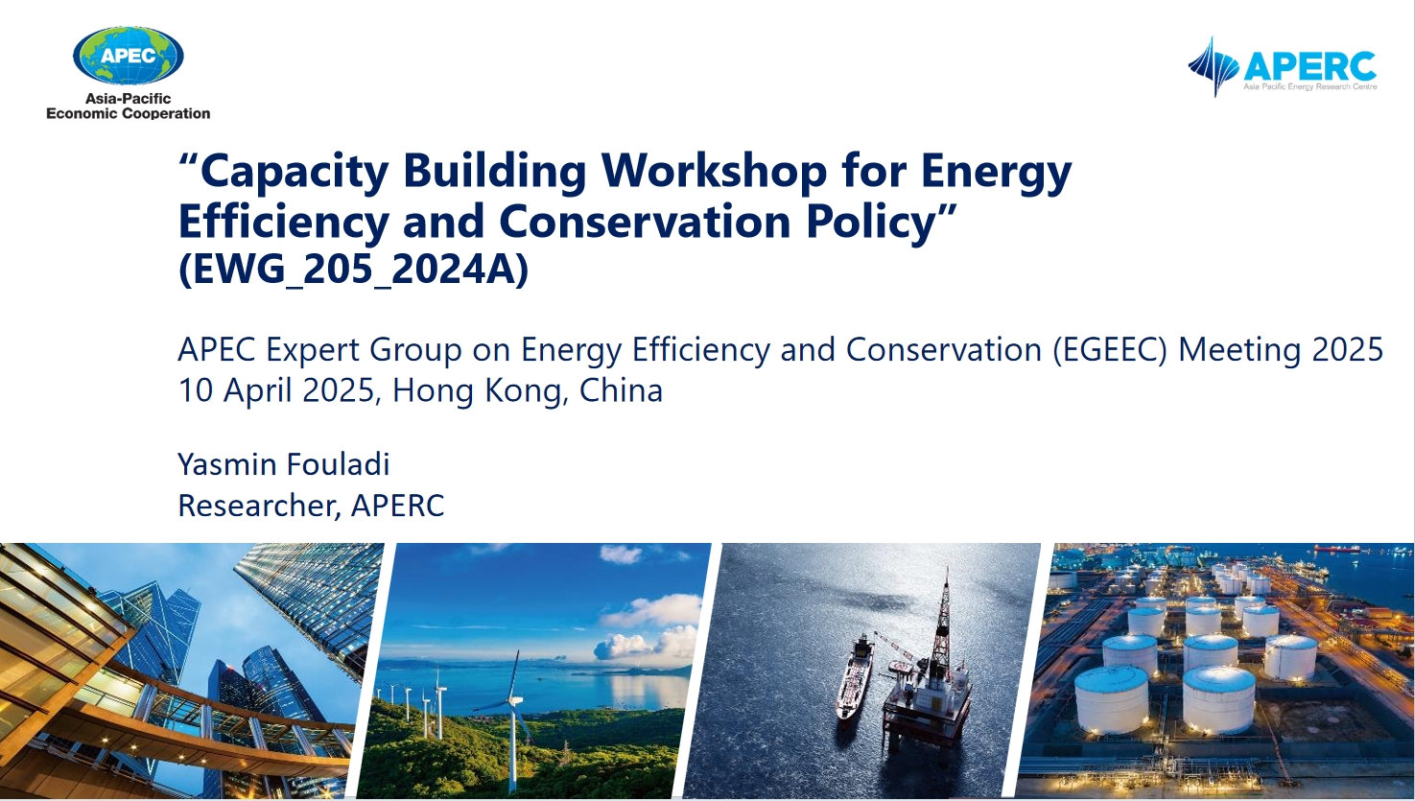
Project update
EWG 205 2024A-Capacity Building Workshop for Energy Efficiency and Conservation Policy
  main objective of the project is to support APEC members in capacity building for energy efficiency and conversation policies as they work towards the energy transition.
APERC share the workshop On 18 November. introduced the Workshop Highlights – MEPS Implementation, Challeges and Solutions.
Notes:
APERC's capacity-building workshop focused on the practical challenges and solutions for implementing Minimum Energy Performance Standards (MEPS).

Slide 14
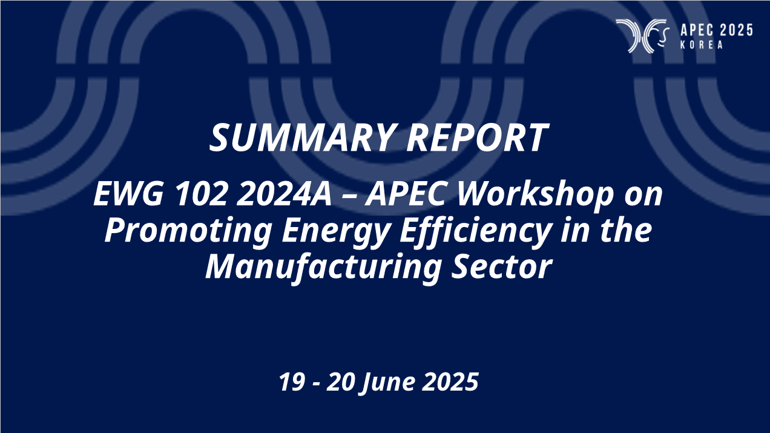
Project update
EWG 102 2024A – APEC Workshop on Promoting Energy Efficiency in the Manufacturing Sector
  main objective of the project is to help economies and stakeholders to share information, experiences on promoting energy efficiency in manufacturing industry as well as to provide recommendations on enhancing energy efficiency in this industry
Viet Nam shared the workshop of Promoting Energy Efficiency in the Manufacturing Sector On 19 and 20 June 2025.
Notes:
Viet Nam hosted a workshop in Da Nang last June, facilitating information sharing on promoting energy efficiency within the manufacturing sector .

Slide 15
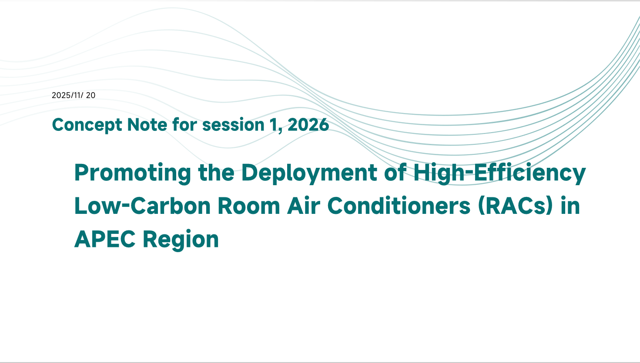
New Concept Note (Session 1, 2026)
Promoting the Deployment of High-Efficiency Low-Carbon Room Air Conditioners (RACs) in APEC Region
  objective: Accelerate the deployment of high-efficiency, low-carbon RACs in the APEC region
  output: 1*Research Report, 2*workshops, 1*Guidebook
  China propose session 1, 2026
  5 consponsors support
Notes:
China has proposed a new project for 2026 session 1 focusing on high-efficiency, low-carbon Room Air Conditioners. This project aims to accelerate RAC deployment through a research report and technical guidebook .

Slide 16
THANK YOU
Notes:
Thank you for your attention

