Slide 1

APSEC Updates for EGNRET 64 & EGEEC 66 Joint Meeting
Prof. Steivan DEFILLA
Assistant President, APEC Sustainable Energy Center
EGNRET 64 & EGEEC 66 Joint Meeting, 30 March – 2 April 2026, Bangkok, Thailand

Slide 2

Outline
Updates on Activities & Projects
APSEC Workshop in EWG 71
International Team Construction
Work Plan for China Year and afterwards

Slide 3
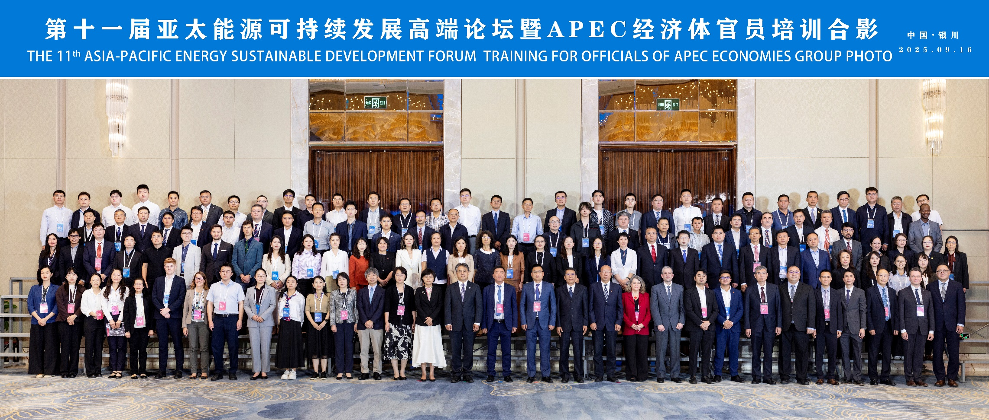
Asia-Pacific Energy Sustainable Development Forum (ESDF)
The 11th Asia-Pacific Energy Sustainability Development Forum (ESDF 11)
The 11th Asia-Pacific Energy Sustainability Development Forum and Training for APEC Officials was successfully held from 16th to 19th September 2025 in Yinchuan, China. Over 240 delegates from governments, businesses, research institutes and international organizations participated the event, representing 13 APEC member economies and 5 international organizations.

Slide 4
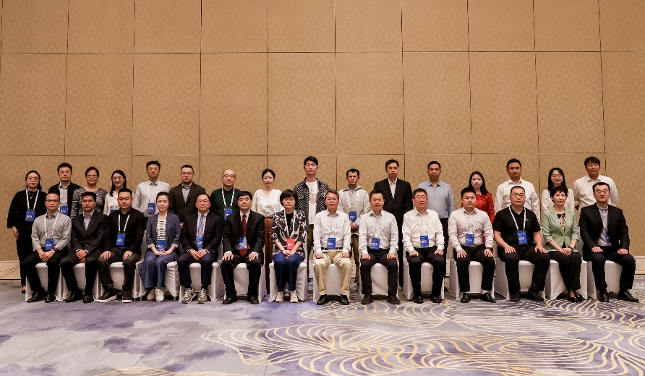
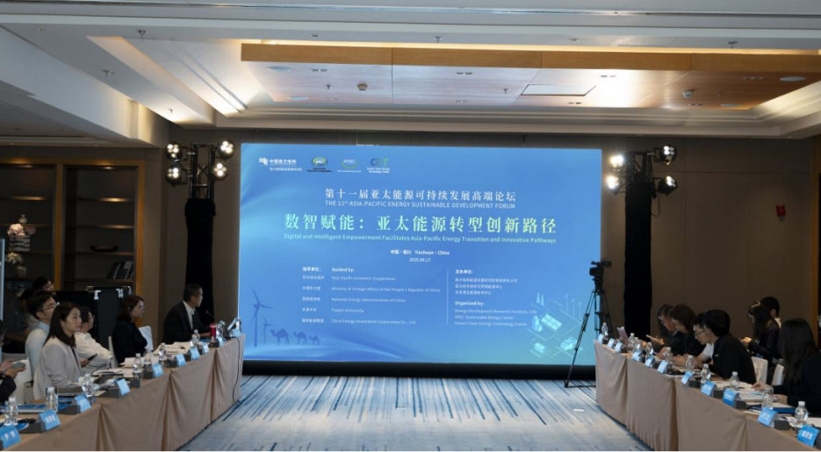
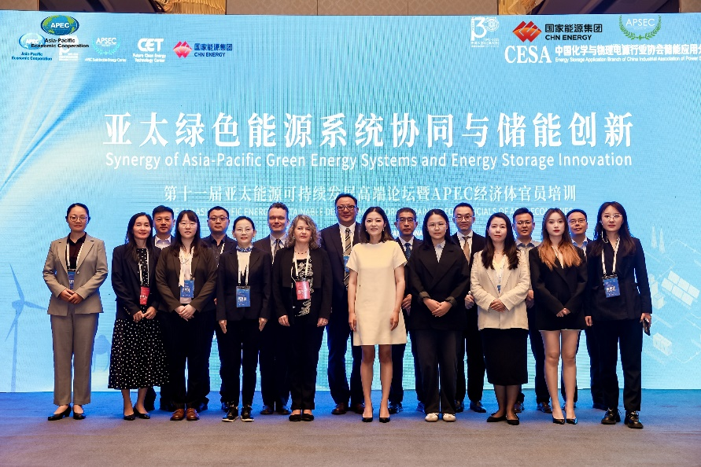
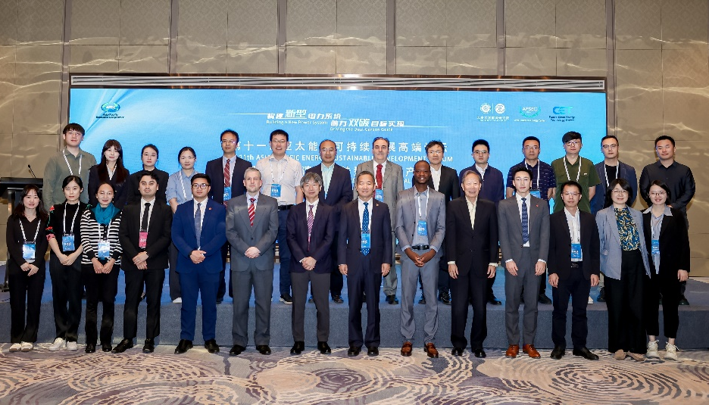
The 11th Asia-Pacific Energy Sustainability Development Forum (ESDF 11)
The theme of the Forum was “Building a Renewable Dominant New Power System to Help Achieve Decarbonization Goals”. The Forum also included four parallel sub-forums:
Sub-forum Ⅰ
Energy Transition Drives the High-Quality Development of Fossil Energy Enterprises
Sub-forum Ⅲ
Digital and Intelligent Empowerment Facilitates Asia-Pacific Energy Transition and Innovative Pathways
Sub-forum Ⅱ
Synergy of Asia-Asia-Pacific Green Energy Systems and Energy Storage Innovation
Sub-forum Ⅳ
New Energy Development Accelerating Energy Transition and Regional Industrial Synergy

Slide 5
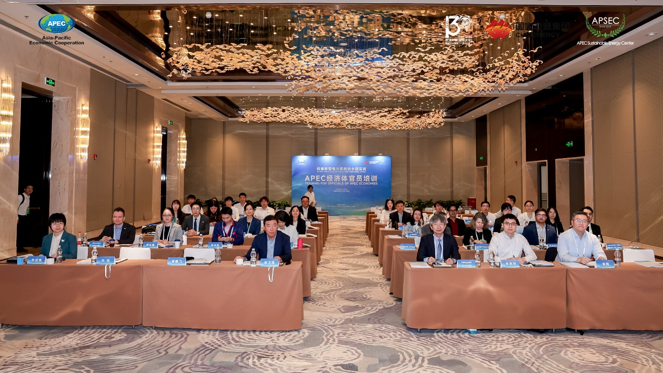
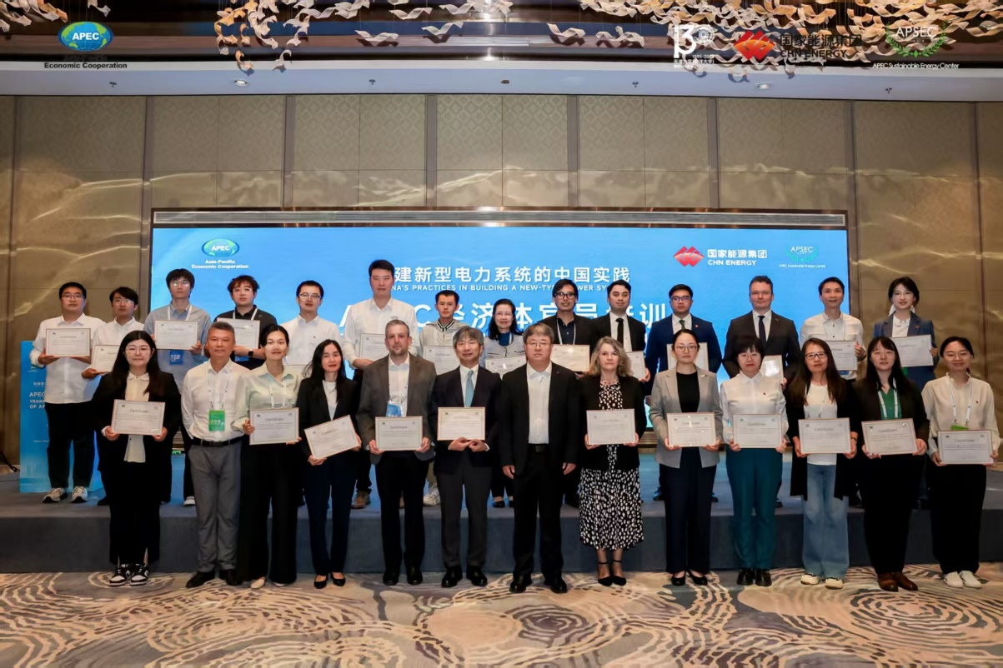
The 11th Asia-Pacific Energy Sustainability Development Forum (ESDF 11)
Training for APEC Officials: The theme of the Training Program was ”Renewable Energy Development, Energy Storage and the New Power System”.

Slide 6
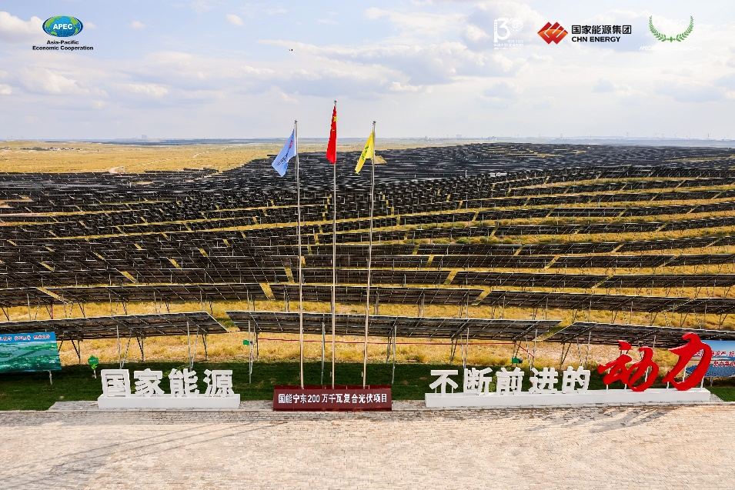
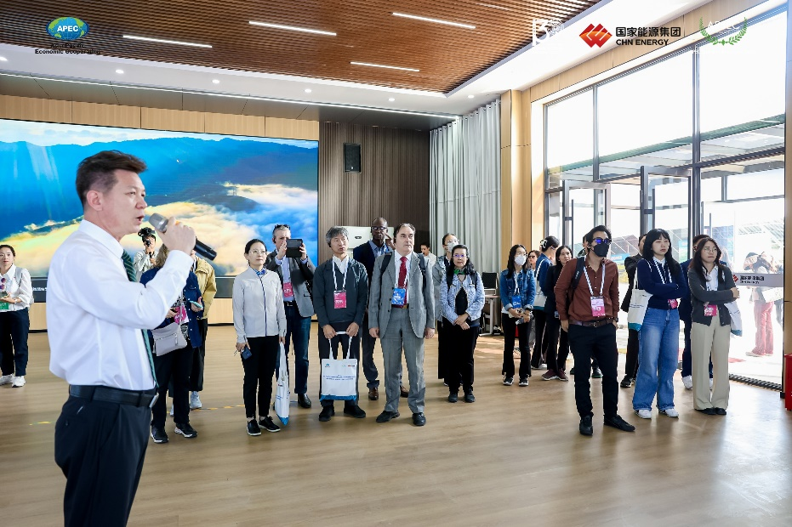
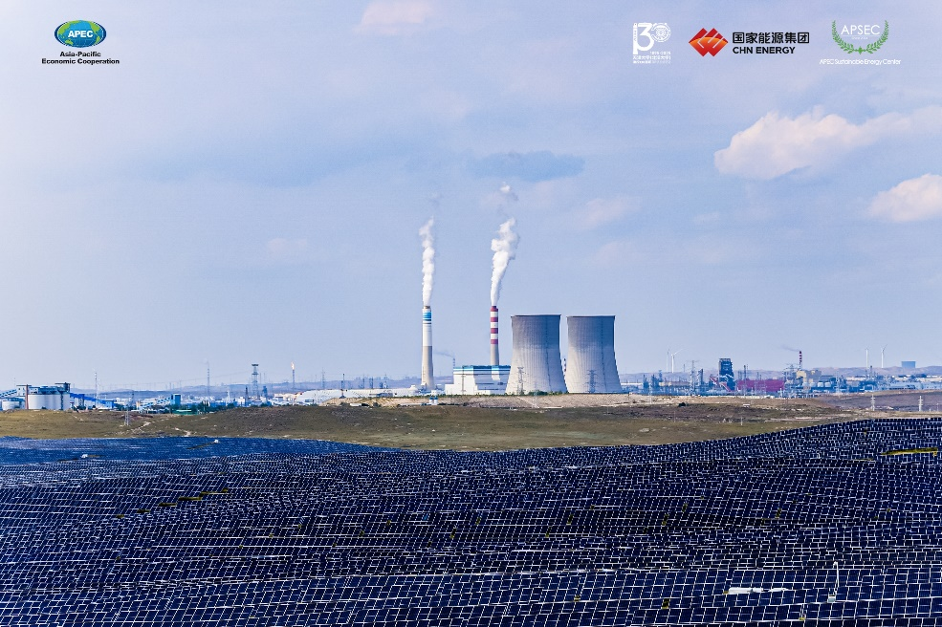
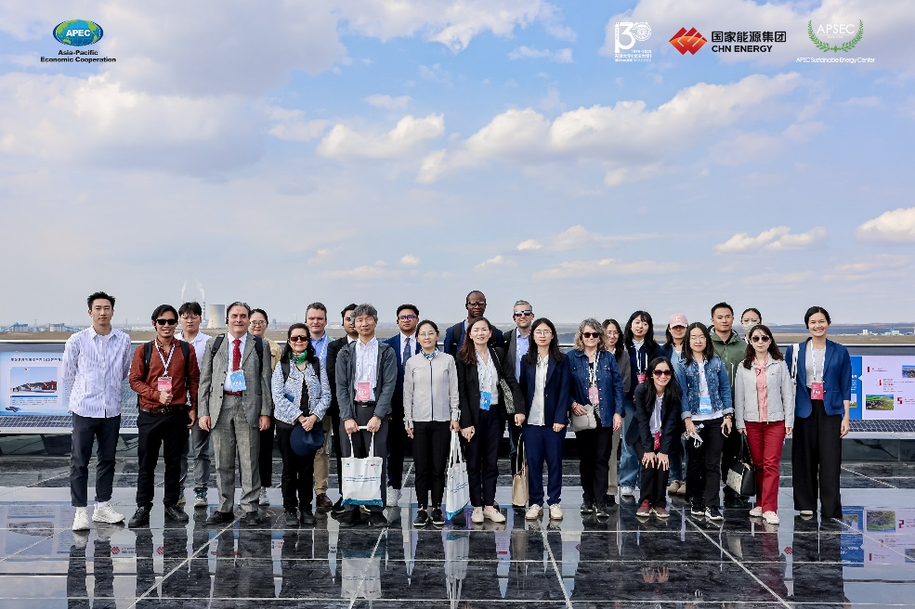
The 11th Asia-Pacific Energy Sustainability Development Forum (ESDF 11)
Technical Visit: CHN ENERGY Investment Group's New Energy Practical Demonstration Projects (Ningdong New Energy Base)

Slide 7
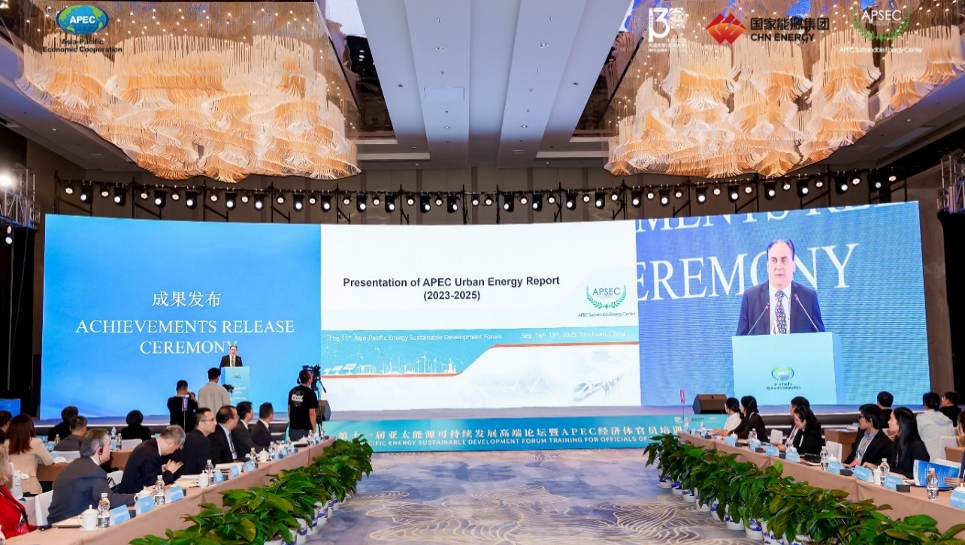
APEC Urban Energy Report (2023-2025)
Flagship Reports: APEC Urban Energy Report
With the rapid advancement of urbanization, the relationship between urban development and energy transition under the backdrop of carbon neutrality has attracted widespread attention. Conducting research on urban energy within the APEC framework holds significant importance in practically advancing low-carbon transformation, as well as promoting sustainable development of energy and the environment in the APEC region. To this end, APSEC proposed in 2022 to initiate APEC urban energy-themed studies starting from 2023, aiming to produce a flagship report titled APEC Urban Energy Report.
Achievements Release Ceremony of APEC Urban Energy Report (2023-2025) was held during ESDF 11 on 16 Sep. 2025
The goals of the flagship report are to provide tailored and highly actionable high-quality urban energy development strategies and pathways for the member economies of APEC, strengthen regional collaboration in the urban energy sector, and offer a systematic theoretical foundation and practical guidance for accelerating the clean, sustainable, equitable, affordable, and inclusive energy transition in the APEC region.

Slide 8
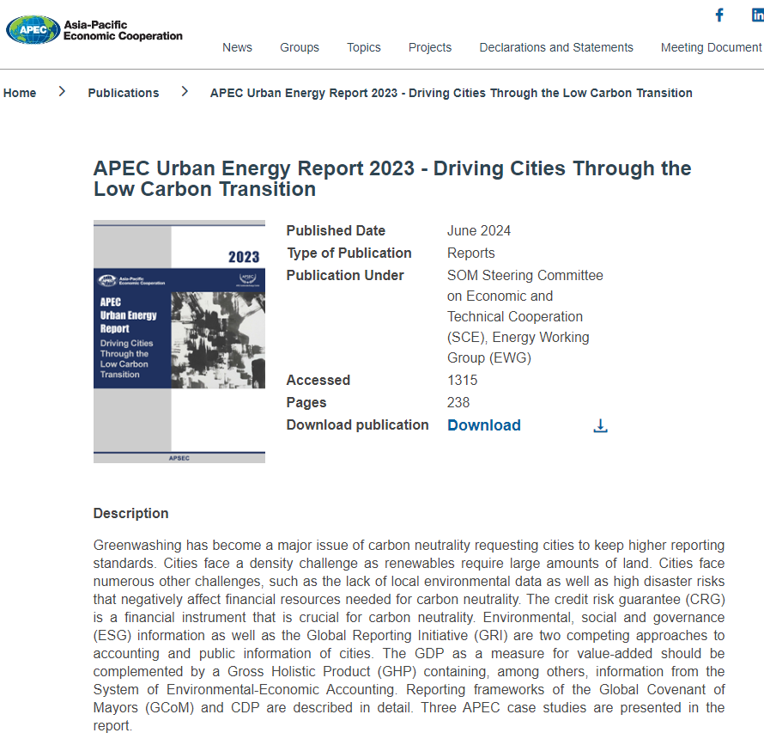
APEC Urban Energy Report 2023——Driving Cities Through the Low Carbon Transition
EWG 01 2023S: Research on Energy Strategies driving APEC Cities through the Low-Carbon Transition
Start Date: Jan. 2023
Completion Date: Jun. 2024
Project summary
Cities count for 56% of world population and for more than 70% of global energy consumption and associated emissions but produce more than 80% of global GDP. Most APEC economies are making plans to become carbon neutral, pulling their cities along this pathway. Dealing with pressures from population, economy and the environment, cities also started to act in response to their own necessities. This project aims at researching challenges and formulating strategies for driving APEC cities through the low-carbon transition. This project completed research on challenges and formulation of strategies for driving APEC cities through the low-carbon transition.
Project output
APEC Publication Download Access
https://www.apec.org/publications/2024/06/apec-urban-energy-report-2023---driving-cities-through-the-low-carbon-transition
APEC Publication

Slide 9
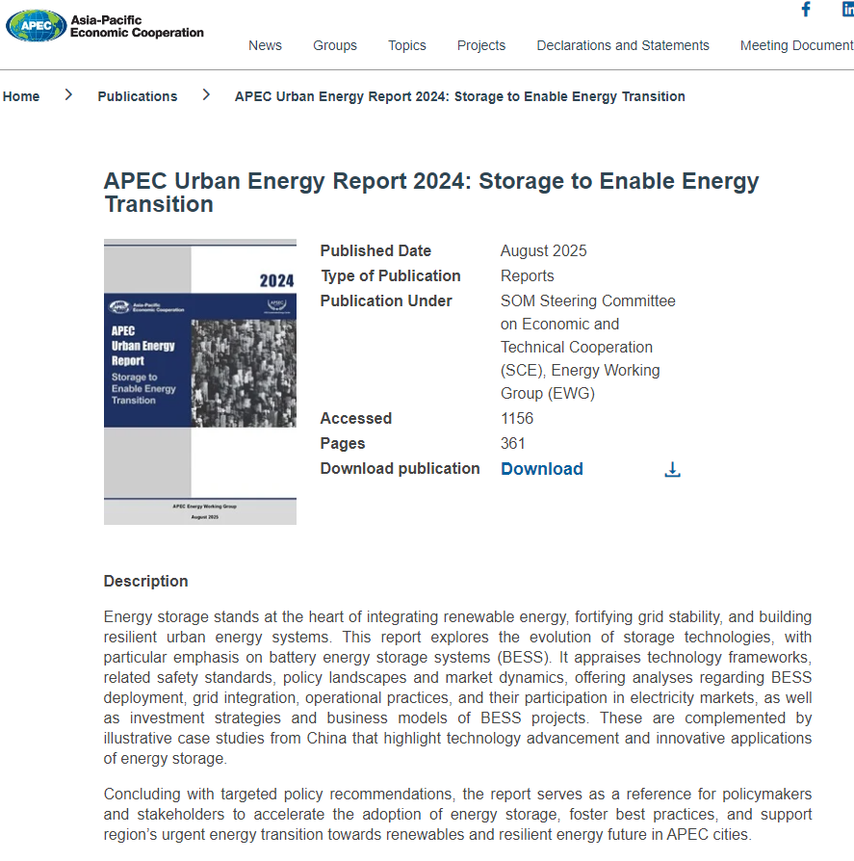
APEC Urban Energy Report 2024——Storage to Enable Energy Transition
EWG 03 2024S: Research on Energy Storage to Enable Energy Transition in APEC Cities
Start Date: Mar. 2024
Completion Date: Aug. 2025
Project summary
With the rising proportion of variable and less predicable renewable energy in the energy system, there is a strong need for more flexible and resilient energy system to ensure the security and reliability of system operation and electricity supply. In this regard, the development and deployment of energy storage technologies could play significant roles. This project, in the urban settings, completed research on the development and application of energy storage technologies, the approach to support the deployment of storage, and formulating strategies to enhance resilience of the energy system and accelerate green energy transition in APEC cities.
Project output
APEC Publication Download Access
https://www.apec.org/publications/2025/08/apec-urban-energy-report-2024--storage-to-enable-energy-transition
APEC Publication

Slide 10
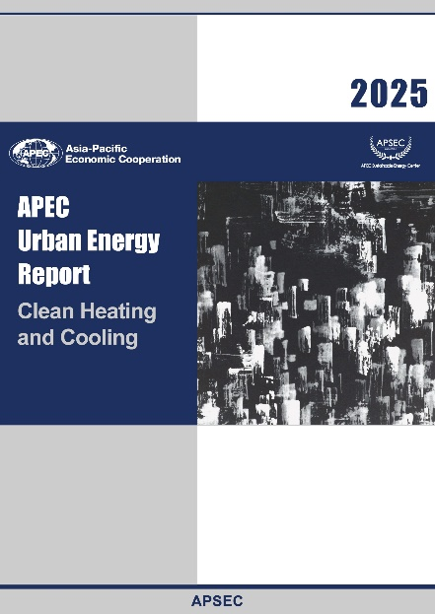
APEC Urban Energy Report 2025——Clean Heating and Cooling
EWG 03 2025S: Research on Clean Heating and Cooling in APEC Cities
Co-Sponsoring Economies: Hong Kong, China; Singapore
Start Date: May 2025
Expected Completion Date: May 2026
Project summary
As APEC cities accelerate the transition toward clean energy, heating and cooling systems have become key to achieving energy efficiency and climate goals. This project addresses the urgent challenge of decarbonizing urban heating and cooling in APEC cities through clean energy. Based on the analysis of climate zones, and the current state of heating and cooling in APEC cities, clean energy will be studied. The research results and policy recommendations will be summarized and disseminated to more APEC cities and economies.
Project output
APEC publication
The APEC Urban Energy Report 2025
is expected to be published in the first half of 2026

Slide 11

APEC Projects
EWG 02 2025S: Research and Capacity Building on Construction New-type Power System in APEC
Expected Start Date: 01/06/2025
Expected Completion Date: 31/05/2026
Project summary
The construction of a new-type power system that adapts to the gradually increasing share of renewable energy has become a common challenge for APEC economies. This project combines systemic research and capacity-building training to address this issue. The research component will focus on analyzing the technical, policy, and market mechanisms required for APEC’s new-type power system development, outstanding cases that promote the construction of the new-type power system in China and other APEC economies will be investigated.
For capacity-building, a high-level exchange and training event on construction new-type power system has been hosted in September 2025, in Yinchuan, Ningxia, China.
Training Event on Construction New-type Power System
18-19 Sep. 2025, Yinchuan, Ningxia, China
Project outputs
Event: Organized the Exchange and Training on New-Type Power System during the 11th Asia Pacific Sustainable Energy Forum of APSEC in September 2025
APEC Publication: China's Practices in Building a New-type Power System and Its Implications for APEC Economies

Slide 12
EWG 06 2025S: Ten Years' Implementation Review of APEC Cooperation Initiative for Jointly Establishing an Asia-Pacific Urbanization Partnership
Co-Sponsoring Economies: Hong Kong, China; Singapore
Start Date: 01/11/2025
Expected Completion Date: 31/12/2026
Timeline | Tasks | Deliverables
Nov-Dec 2025 | Preliminary research material collection; Create an outline for the report | An outline of the report
Jan-Aug 2026 | Conduct review, Produce the draft report | A draft report
Sep 2026 | Workshop on experience sharing of APEC urbanization achievements | PPT presentations by speakers of the workshop exclusively for notetaking
Oct-Nov 2026 | Revision of the report, produce the final report “Ten Years’ Implementation of APEC Urbanization Partnership”. | A final report, to be published by APEC
Dec 2026 | Project Completion Report | A project completion report, be to submitted to the APEC Secretariat
Project summary
Asia-Pacific is currently experiencing booming urbanization. We realize that sustained and healthy development of urbanization is conducive to promoting innovative growth and realizing robust, inclusive and sustainable development in the Asia-Pacific. This project addresses the ten years’ implementation of APEC Cooperation Initiative for Jointly Establishing an Asia-Pacific Urbanization Partnership, and experience sharing of sustainable urban development in APEC region.
Based on the ten years’ APEC sustainable urban development, the achievements of APEC urbanization will be shared. The policy recommendations will be summarized and disseminated to more APEC cities and economies.
Project outputs
The report, “Ten Years’ Implementation of APEC Urbanization Partnership”
Relevant workshop on experience sharing of APEC urbanization achievements

Slide 13
EWG 02 2026S: The Energy-AI Nexus: Strategic Imperatives for Sustainable Energy for AI Infrastructure
Start Date: 01/02/2026
Expected Completion Date: 31/03/2027
Timeline | Tasks | Deliverables
Feb – Mar 2026 | Development of research program and specification of research activities | Research program
Apr – Aug 2026 | Review, investigation and analysis, synthesis and report development | Progress outcome
Sep 2026 | Participation in workshop | Presentation and knowledge dissemination at the workshop
Nov 2026 | Draft project report | Draft project report
Dec 2026 – Jan 2027 | Revision and finalization of project report | Progress outcome
Feb 2027 | Completion of final project report | Submission to the APEC Secretariat
Mar 2027 | Preparation of project completion report | Submission to the APEC Secretariat
Project summary
The project undertakes a comprehensive examination of AI infrastructure development, explores mechanisms and best practices for increasing renewable energy utilization in AI data centers, and assesses regulatory frameworks governing energy efficiency and optimal energy management strategies at AI infrastructure..
Through the research and investigation, the project seeks to promote the development of reliable AI infrastructure, support digital and AI transformation, thereby securing APEC’s energy resilience and environmental stewardship.
Project outputs
Workshop on the Energy-AI Nexus, September 2026
Project report, The Energy-AI Nexus: Strategic Imperatives for Energy for AI Infrastructure in the APEC Region

Slide 14
[For endorsement] APEC Self-funded Project: Long-term impact of the renewable energy on energy access
Co-Sponsoring Economies: Thailand; Chile; Viet Nam; Indonesia
Expected Start Date: February 2026
Expected Completion Date: February 2027
Timeline | Tasks | Deliverables
Spring 2026 | Hybrid capacity-building workshop | PPT presentations by speakers and recording of the workshop exclusively for notetaking.
Sep 2026 | Presentation of preliminary results within the 12th Anniversary Forum of APSEC | PPT presentation
Dec 2026 | Final Report submitted to EWG for endorsement | Submitted to APEC Secretariat
Feb 2027 | Completion Report | Submitted to APEC PMU
Project summary
This project proposes to analyse and improve the impact of renewable energy on energy access by way of a longitudinal study analysing the evolution of participating APEC economies over time, as well as by having special regard for challenging situations of difficult energy access as listed in the 2020 Energy Access Initiative.
The project will first provide hybrid capacity building to elaborate the skills of collecting and elaborating the relevant data. Based on the data, the final report elaborates a general model and furthermore discusses innovative technological solutions for challenging cases of difficult energy access.
Project outputs
Hybrid Capacity-building workshop
Final Report to be endorsed by EWG and published in APEC Publications

Slide 15
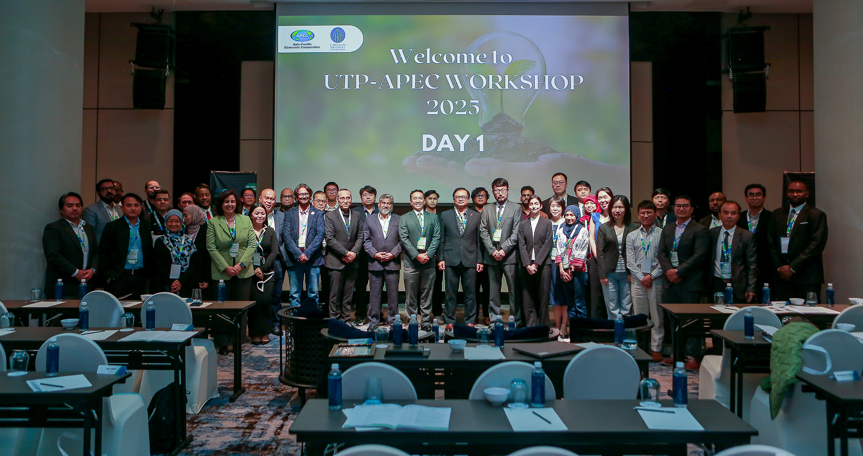
Attended APEC Workshop "Implementation of Eco-innovation and AI-Big Data: Fusing the two to produce Carbon Neutrality"
APSEC attended APEC Public Policy on Science Technology and Innovation (PPSTI) Project Workshop "Implementation of Eco-innovation and AI-Big Data: Fusing the two to produce Carbon Neutrality", held on 5-6 November 2025 in Kuala Lumpur, Malaysia.
Brought together visionaries, innovators, and energy leaders to shape the future of sustainability and technology and support APEC economies in enhancing their capacity for AI applications in the energy sector.
Over 60 representatives from 9 APEC economies attended the seminar, including government departments and regulatory agencies, academic institutions, utilities, industry, think tanks, and international organizations.
Prof Jinlong MA was invited to attend, delivering a keynote speech and participated as a moderator in the roundtable discussion.

Slide 16
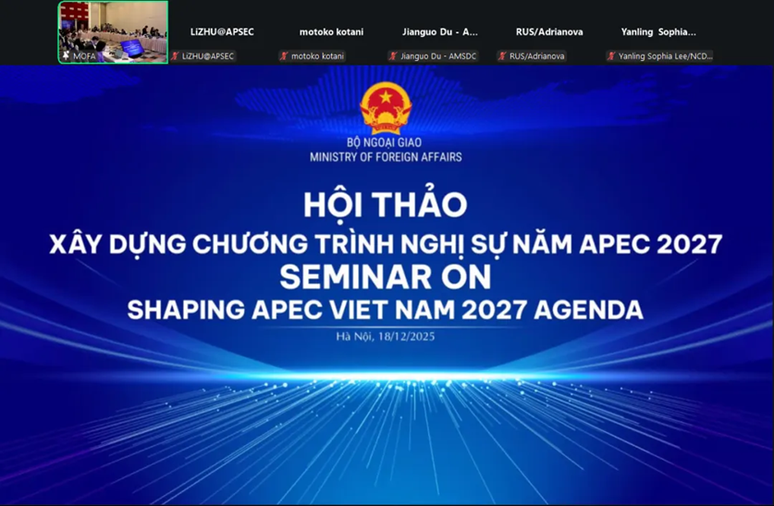
Attended the International Workshop "Shaping APEC Viet Nam 2027 Agenda"
APSEC attended the international workshop "Shaping APEC Viet Nam 2027 Agenda", organized by Viet Nam in preparation for its APEC 2027 host year. The event was held on 18 December 2025 in a hybrid format. Delegates included about 70 in-person and online participants from APEC economies, relevant international organizations, and Vietnamese government and academic institutions.
President Li ZHU analyzed energy challenges and opportunities in Viet Nam and the APEC region, and proposed priority areas aligned with their energy goals: advancing sustainable energy transition, strengthening energy security through system resilience and power interconnection, developing smart material industrial chains, and promoting new energy storage, AI-enabled technologies and new energy vehicles. She underscored the role of APEC and multilateral mechanisms in driving sustainable energy development via practical cooperation.

Slide 17
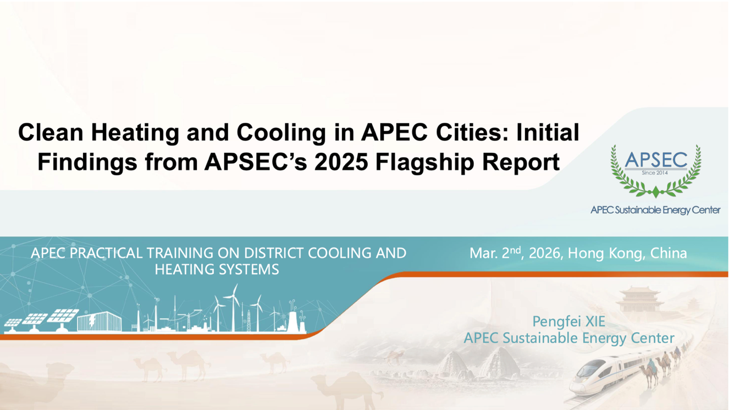
Attended APEC Workshop (EWG 101 2025A) “APEC Practical Training on Districting Cooling and Heating Systems”
APSEC attended the APEC workshop (EWG 101 2025A) “APEC Practical Training on Districting Cooling and Heating Systems”, held on 2-3 March 2026 in Hong Kong, China. This training aimed at promoting the deployment of district cooling and heating systems in the Asia-Pacific region by imparting core knowledge on land use planning, infrastructure layout, system design and operation, and the application of innovative technologies.
This workshop convened delegates from APEC economies, research institutes and think tanks, international organizations, and business sectors to exchange views on district cooling and heating systems.
Professor Pengfei XIE was invited to attend the workshop and delivered a keynote speech titled “Clean Heating and Cooling in APEC Cities: Initial Findings from APSEC’s 2025 Flagship Report”.

Slide 18
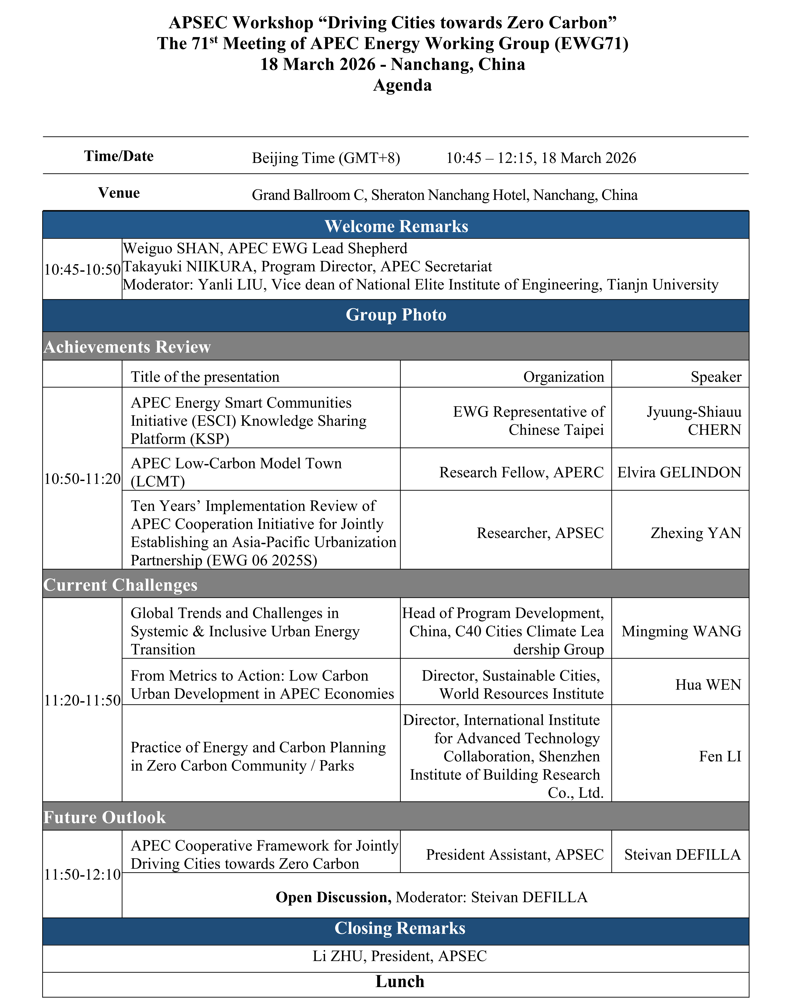
APSEC Workshop in EWG 71
The APSEC workshop on the theme “Driving Cities towards Zero Carbon” was held during EWG71. The workshop firstly reviewed the implementation of the APEC Cooperation Initiative for Jointly Establishing an Asia-Pacific Urbanization Partnership over the past ten years by APSEC, LCMT and ESCI. Thereafter, cooperative partners such as C40, WRI discussed the current challenges of the path towards zero carbon. Finally, APSEC presented the concept of a new APEC Cooperative Framework for Jointly Driving Cities towards Zero Carbon, a framework designed to guide future APEC work focusing on cities and open it for discussion with active participation of member economies.

Slide 19
APEC Cooperative Framework for Jointly Driving Cities towards Zero Carbon
Vision and Objectives
  The vision of this framework is to implement the APEC Putrajaya Vision 2040 at the level of APEC cities, driving the Asia-Pacific community to implement the overall vision of sustainable development, connectivity, and common prosperity in cities. The framework pursues the goals of "inclusive growth, sustainable development, synergetic governance, common prosperity", while respecting differences in development stages among economies, to explore key pathways such as optimizing urban energy structures and enhancing resilience, promoting green, zero-carbon, and smart urban development, and establishing holistic urban economy-energy-carbon emissions statistics and accounting systems. It will support the development of cities towards zero carbon and related application scenarios, such as zero-carbon industrial parks, communities, and campuses. It is expected that the 21 APEC economies will work together, jointly building green, smart, resilient, and people-centered APEC cities moving towards zero carbon.

Slide 20
Key Areas of Focus
  Focus Area 1: Building Clean, Low-Carbon, Secure, Resilient, and Efficient Urban Energy Systems
  Focus Area 2: Enhancing Green, Zero-Carbon, and Intelligent Urban Development and Construction
  Focus Area 3: Establishing Urban Economy-Energy-Carbon Accounting Systems and Market-Based Mechanisms
  Focus Area 4: Building a Synergetic Governance Platform for APEC Cities towards Zero Carbon

Slide 21
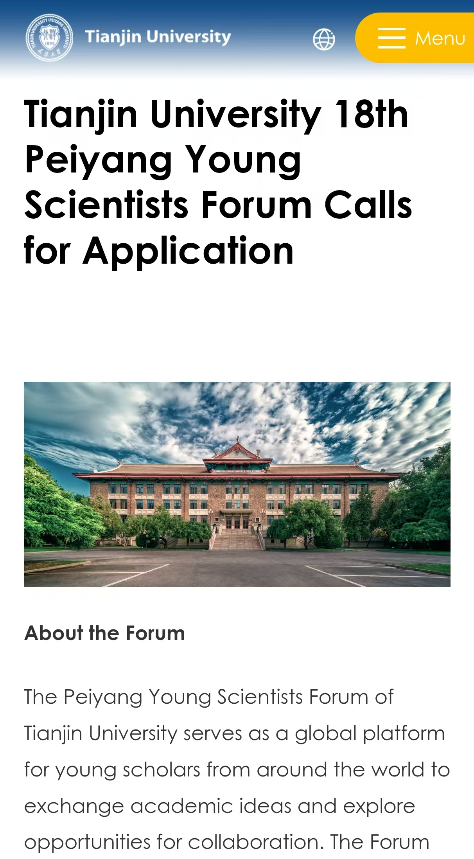
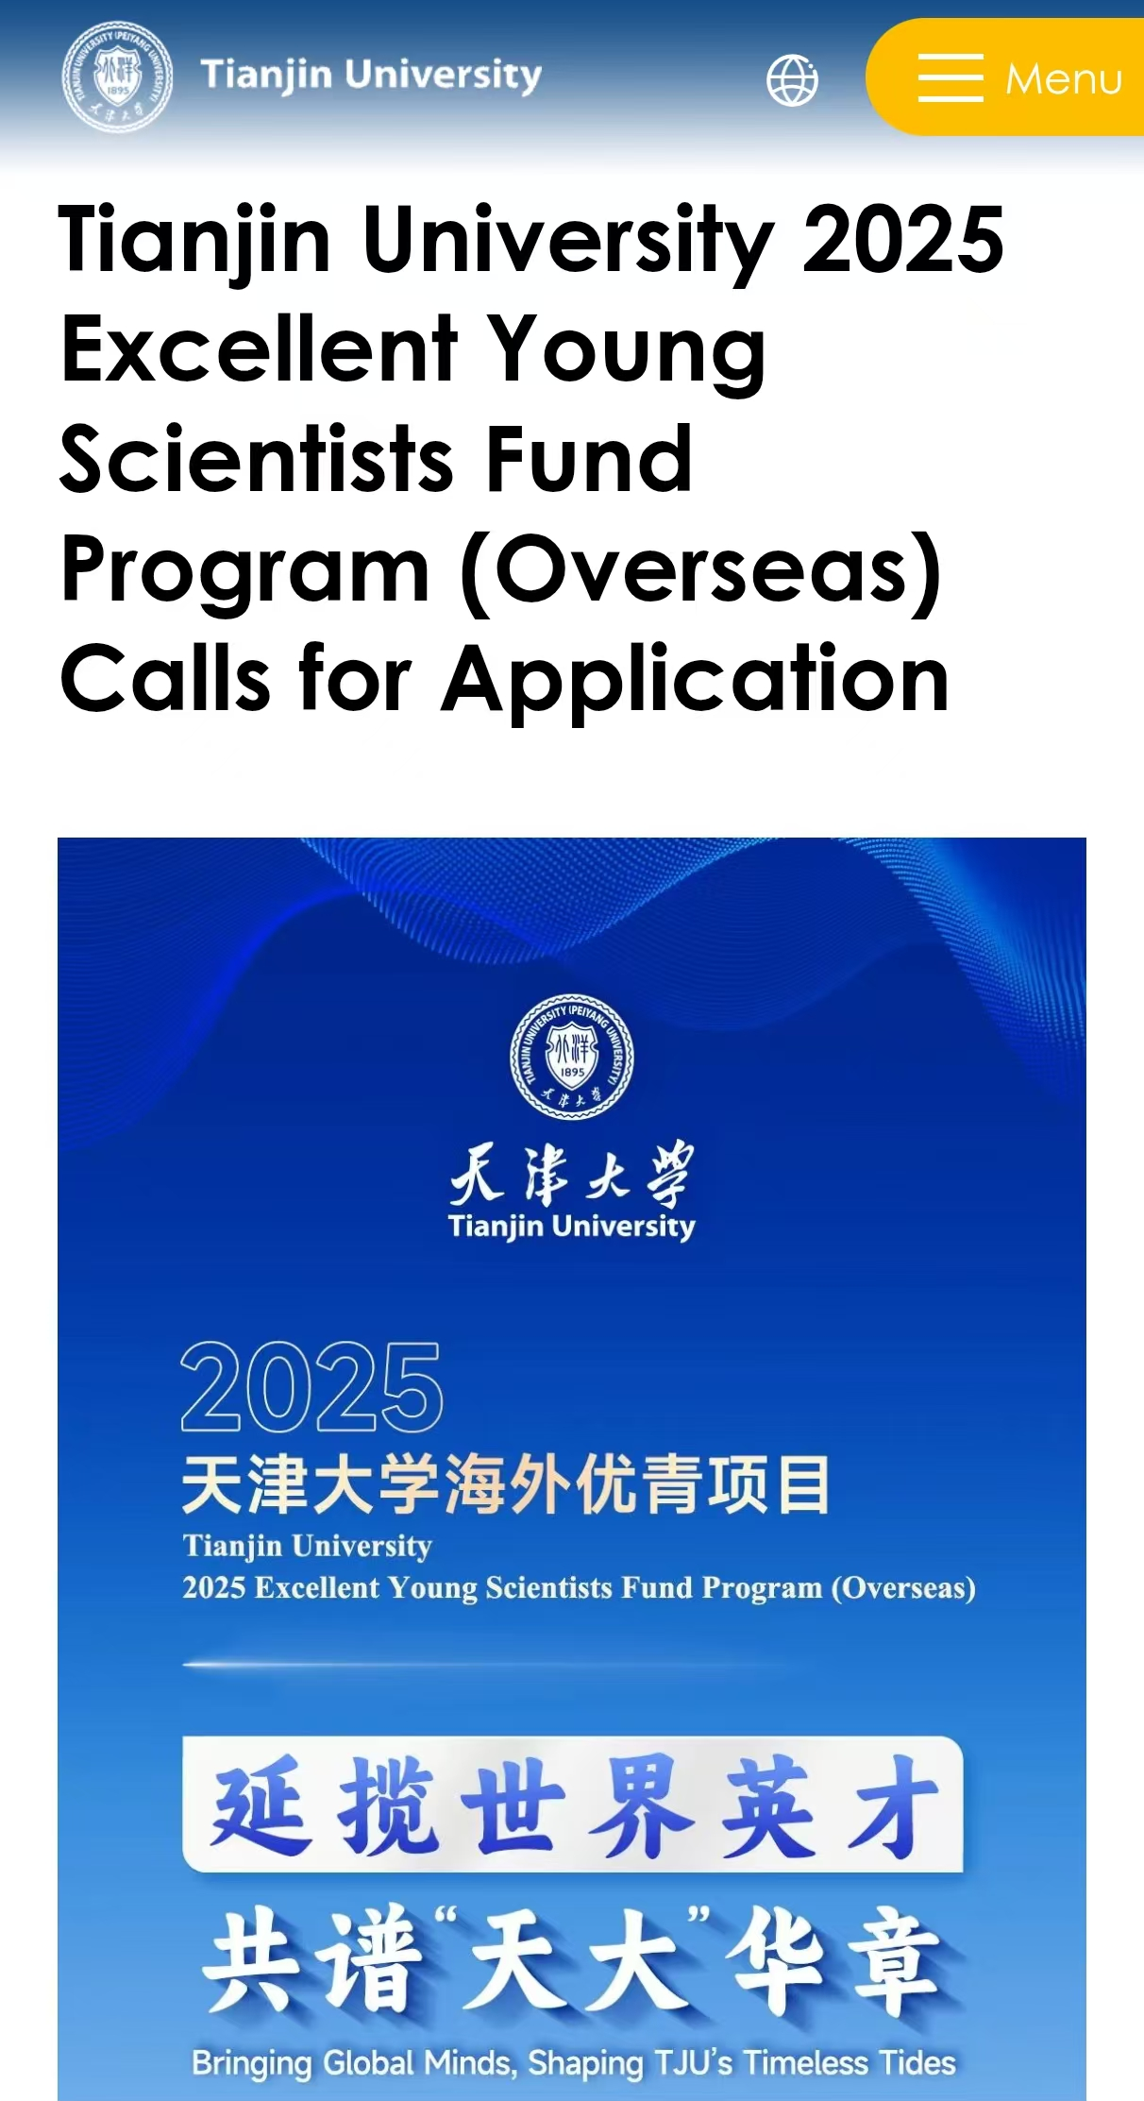
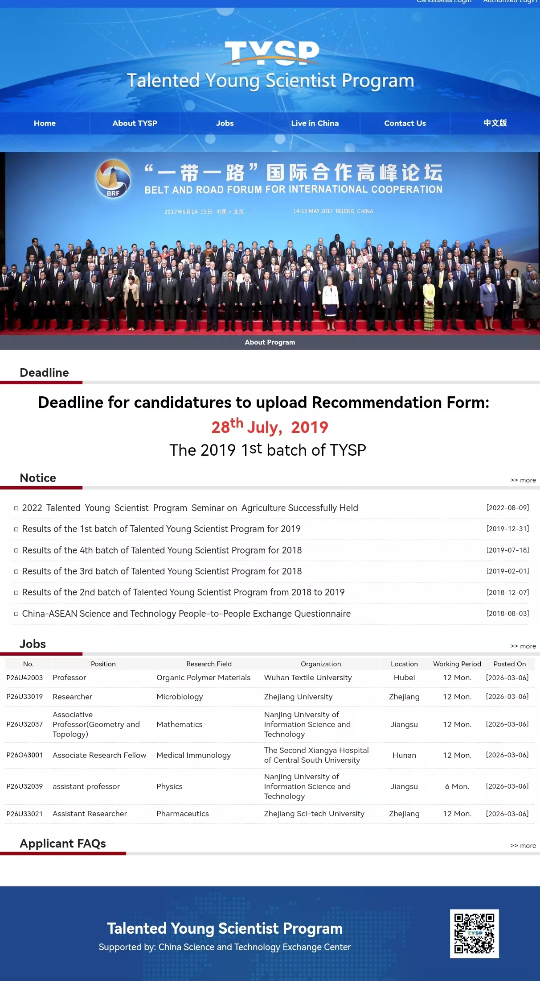
International Team Construction of APSEC
APSEC offers a variety of approaches and channels for international scholars and senior researchers to join APSEC.
Tianjin University Peiyang Scientists Forum
Tianjin University Excellent Young Scientists Fund (Overseas)
Talented Young Scientist Program (TYSP)

Slide 22
International Team Construction of APSEC
Major Job Types Available at APSEC
Professional Fields for APSEC Recruitment
APSEC Senior Researcher (Outstanding Professor/Associate Professor).
The term of employment is generally five years.
APSEC Visiting Scholar (Postdoctoral).
The term of employment is generally three years.
Professional Field | Planned Recruitment
Energy Economics and Policy | 4~5 persons in 2026–2027 3~4 persons in 2028–2030
Smart Energy and Energy Security
International Politics / International Relations (Energy Track)
New Energy Science and Engineering
Electric Power Engineering
Energy Economics

Slide 23
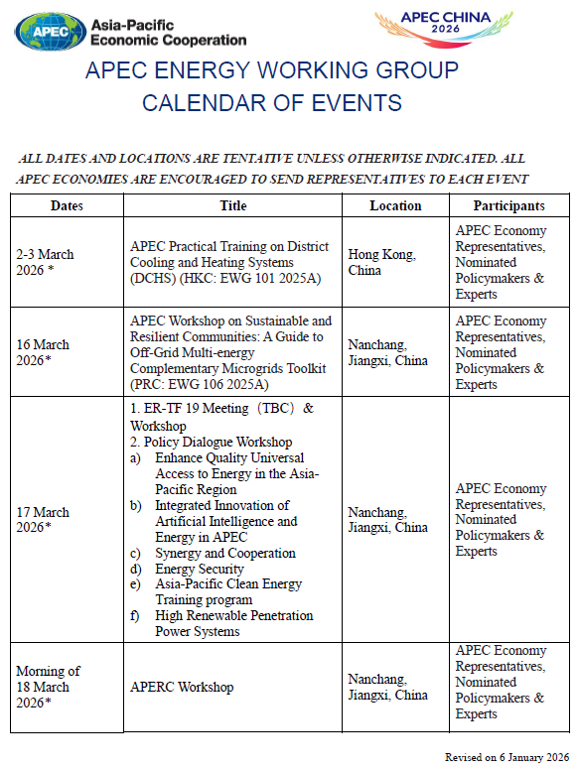
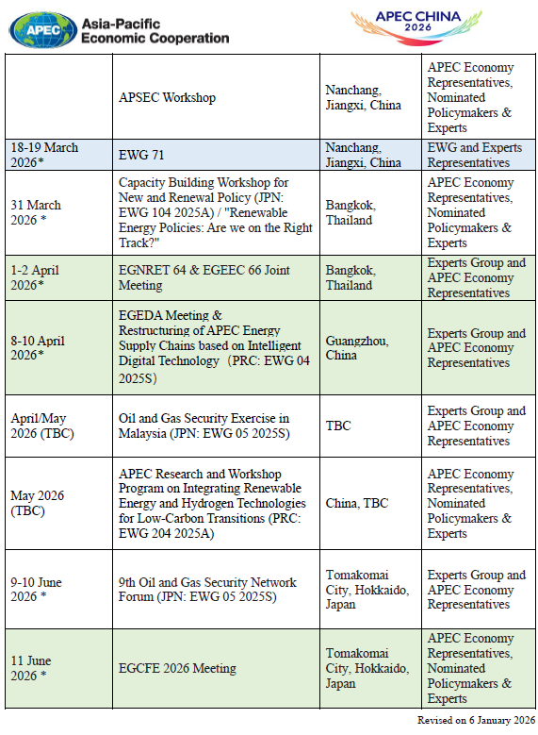
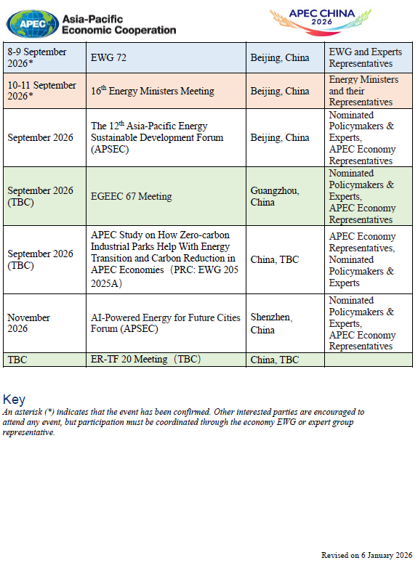
The Follow-up Events of APSEC in APEC CHINA 2026

Slide 24
The Follow-up Events of APSEC in APEC CHINA 2026
Dates | Title | Location | Participants
September 2026 | The 12th Asia-Pacific Energy Sustainable Development Forum (APSEC) | Beijing, China | Nominated Policymakers & Experts, APEC Economy Representatives
November 2026 | AI-Powered Energy for Future Cities Forum (APSEC) （TBC） | Shenzhen, China | Nominated Policymakers & Experts, APEC Economy Representatives

Slide 25
Research Program for APEC CHINA 2026 and beyond until 2030
Research Logic of APEC Urban Energy Report (2026-2030)
Respond to Related Initiatives and Guidelines of APEC
Year
Promotion and Implementation of Innovative Technologies
APEC Cooperation Initiative for Jointly Establishing an Asia-Pacific Urbanization Partnership (2014)
Initiative to Enhance Energy Access in APEC (2020)
APEC Energy Resiliency Principle (2020)
APEC Energy Security Initiative (2022)
Just Energy Transition Initiative (2024)
APEC Policy Guidance to Develop and Implement Clean and Low-carbon Hydrogen Policy Frameworks in The Asia-pacific (2024)
APEC Artificial Intelligence (AI) Initiative (2026-2030) (2025)
AI+Energy
Hydrogen Energy
2026
2027
Enhancing the Quality and Efficiency of Energy Systems
Multi-energy Integration
Coordination of Transmission–Distribution-Microgrid Network
2028
Respond to EWG Strategic Plan for
2025-2030
Respond to Priorities for APEC 2026 Energy Sector
2029
Strengthen Energy Security
Enhance Energy Resilience and Promote Energy Access
Facilitate Energy Trade and Investment
Accelerate Clean, Sustainable, Just, Affordable, and Inclusive Energy Transitions
Energy for All
AI+Energy
Synergistic Cooperation
Facilitating the Acceleration of Carbon Neutrality Processes
Cities towards Zero Carbon
2030

Slide 26
Research Program for APEC CHINA 2026 and beyond until 2030
Planned Research Activities of APEC Urban Energy Report (2026-2030)
Year
Research Theme
Key Research Content
2026
AI+Energy
Conduct research on the integration of “AI + Energy” to empower future cities, including an APEC chair economy special chapter (China), and accelerate the digital-intelligent transition of urban energy systems.
2027
Hydrogen Energy
Conduct research on the diversified applications of hydrogen energy in urban contexts, including an APEC chair economy special chapter (Viet Nam), and expedite deep decarbonization of urban end-use energy.
2028
Multi-energy Integration
Conduct research on the multi-energy integration for urban energy system, including an APEC chair economy special chapter (Mexico), and facilitate high-quality transition of urban energy systems.
2029
Coordination of Transmission-Distribution-Microgrid Network
Conduct research on the coordination of transmission-distribution-microgrid network for urban power system, including an APEC chair economy special chapter (TBC), and support urban resilience against high penetration of variable renewable energy (VRE).
2030
Cities towards Zero Carbon
Conduct research on the cooperative framework and action plan for zero-carbon cities, including an APEC chair economy special chapter (Singapore), and to accelerate the zero-carbon cities from planning blueprints to practical implementation.
Expected Research Outcomes: APEC Urban Energy Report (2026–2030) and related thematic research reports, and a series of supporting forum activities.
APSEC anticipates recommendations and seeks collaborative support from member economies!

Slide 27
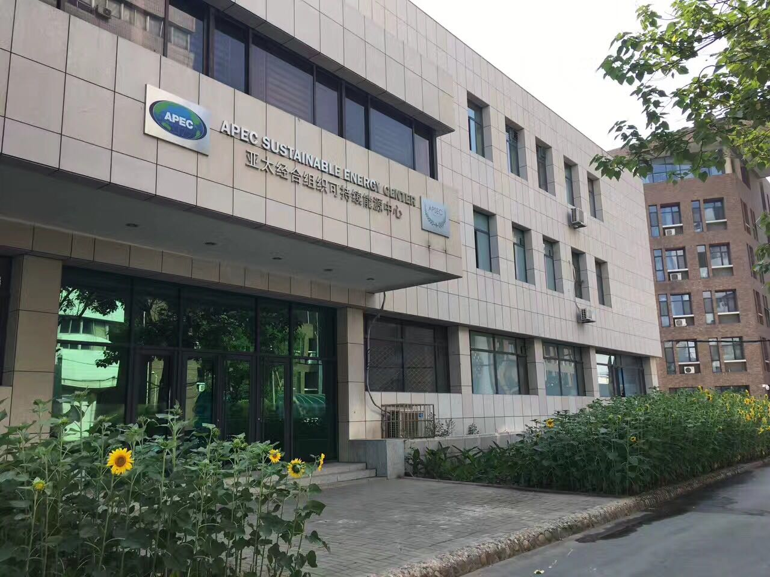
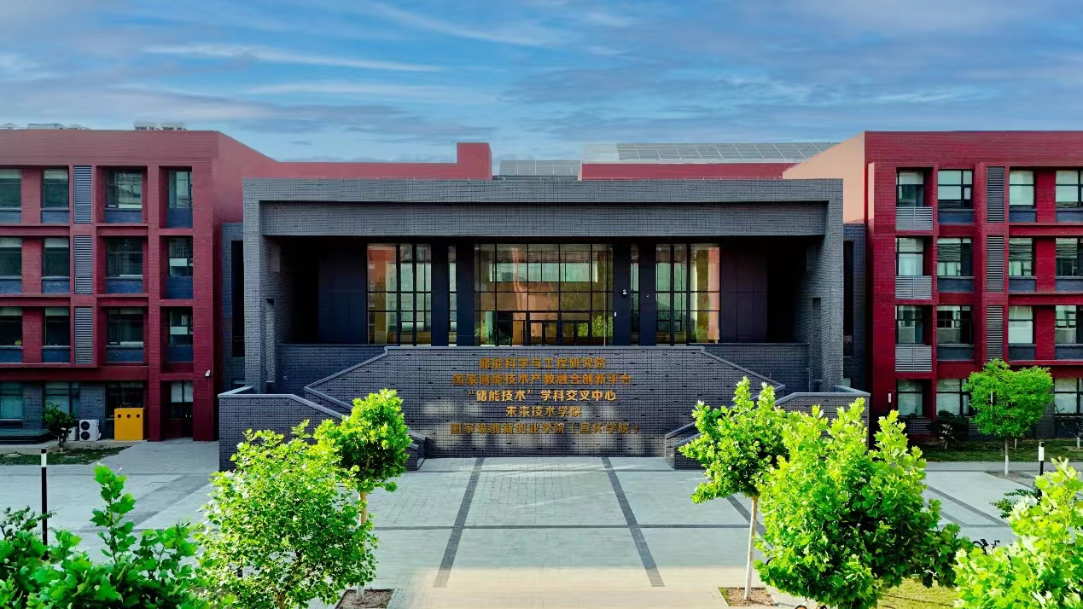
THANK YOU!

