Slide 1



The 66th Meeting of the APEC Expert Group on Energy Efficiency and Conservation (EGEEC 66)
Economy Update in Chinese Taipei
(Transforming the energy landscape: accelerating Bio Circular Economy with clean energy and AI-driven energy efficiency)
30 March - 02 April 2026
Directed:
Administrated:

Slide 2


The Core of Commercial Decarbonization
Under the global trend toward Net Zero Emissions by 2050, energy conservation is the primary goal for achieving net zero and energy transition.
Chinese Taipei introduced a 2026 flagship carbon reduction plan^{[1]} focusing on energy management, aiming for a 0.465 MtCO₂e reduction by 2030.
Residential Sector：29.718 MtCO₂e
Commercial Sector：27.835 MtCO₂e
Non-electricity Emissions
14.18%
Residential,
Commercial Sectors
20.66%
Commercial
Sector
Energy, Manufacturing, Transportation,
Agriculture, and Environment Sectors
79.34%
Electricity-related Emissions
85.82%
Greenhouse Gas Emissions Share by Sector
in Chinese Taipei, 2023 ^{[2]}
Greenhouse Gas Emission Structure of the Commercial Sector
in Chinese Taipei, 2023 ^{[2]}
Resource：[1] Residential and Commercial Sector Carbon Reduction Action Plan (2025), CT Development Council
[2] NDC Phase III GHG Mitigation Action Plan for Residential & Commercial Sectors (2026), CT Development Council

Slide 3
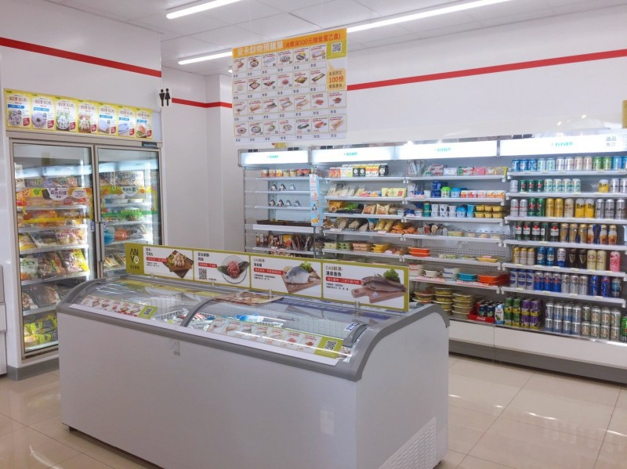
A Strategic Necessity for Retail Stores
With 14,236 convenience stores ^{[1]}, Chinese Taipei has the Top 3 highest store density in the world.
Freezers account for about 50%~70%^{[2]} of a retrail store's energy use, and frost buildup makes them inefficient.
EMS (Energy Management System) preserves precious workforce by minimizing equipment maintenance and failure workloads.
EUI, Energy Use Intensity ^{[3]} : kWh/(m².yr)
168 Office
250 Museum
266 Department store
295 Hotel (5-star)
351 Hypermarket
891 Supermarket
1,086 Convenience store
Resource：[1] Monthly Survey of Wholesale, Retail, and F&B Services (2025), MOEA
[2] Energy Saving Case Studies for Refrigeration and Cold Storage Systems in Small and Medium-sized Food Retailers (2020)
[3] Building Energy Efficiency Rating System (BERS) Manual (2024), ABRI

Slide 4
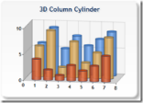
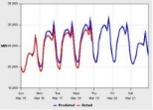


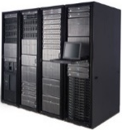

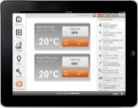
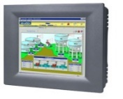

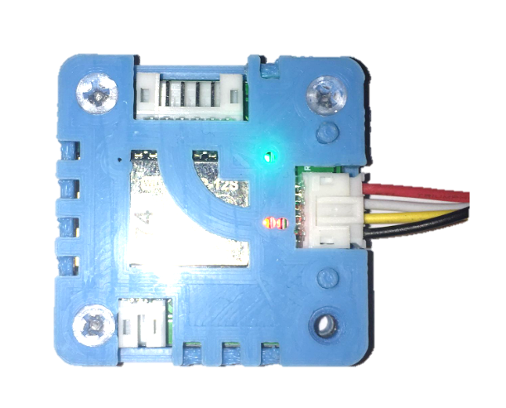
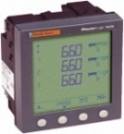
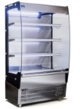
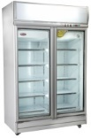

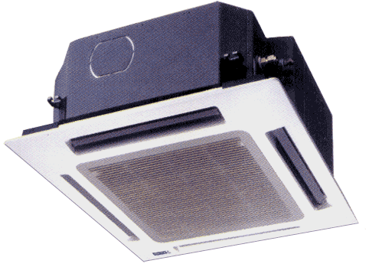
AIoT Energy Management System Structure
~0 % Hardware cost
  Cloud service fee
>7 % Energy saving
  With dynamic analysis & control
<2 Years of Payback Period
3 Extra benefits
  Remote Monitoring & Maintenance
  Predictive Maintenance
  Demand Response in Smart Grid Interaction
Energy Consumption Comparison and Efficiency Analysis
Predictive Maintenance for Equipment
Cloud Server
AI
Demand Response in Smart Grid Interaction
Remote Monitoring
Intelligent Energy-Saving Equipment Control :
Refrigeration
HVAC
Lighting
EMCS Controller
99 % Hardware cost
  Sensor, Communication Module, Controller
3 % Energy saving
  With manual setup on EMCS
~7 Years of Payback Period
0 Extra benefit
  Without remote service
WiFi
Communication Module
IoT
Equipment
Smart
Meter
Open
Refrigerators
Freezers
Lighting
HVAC

Slide 5
AIoT - EMS Field Applications
EMS Installation and Applications
Features and Benefits
Developing an AIoT-EMS for Convenience stores, and being successfully deployed in more than 3,000 FamilyMart convenience stores in Chinese Taipei.
Wireless IoT architecture resolves construction difficulties.
Flexible to build and expand, and can be replicated in large quantities.
AI energy-saving machine learning and control strategy.
for a typical store, Energy saving >10% and Payback Period < 2 years.
an AIoT-EMS under proof of concept test in 5 supermarket brands.
Installation in 25 Carrefour convenience stores.
Continuously adopt AIoT-EMS to proof of concept test in Hypermarket .

Slide 6
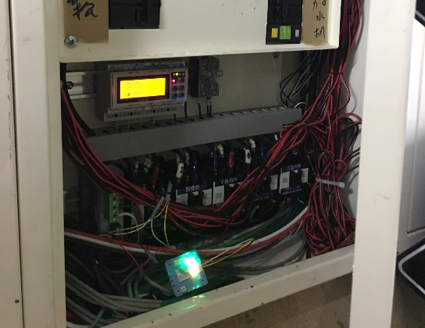
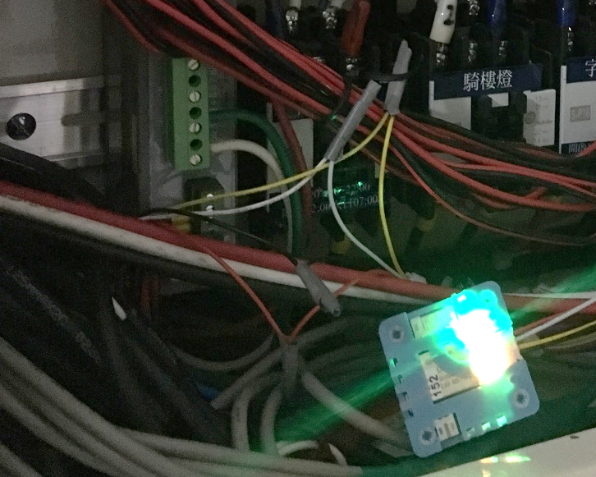
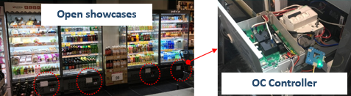
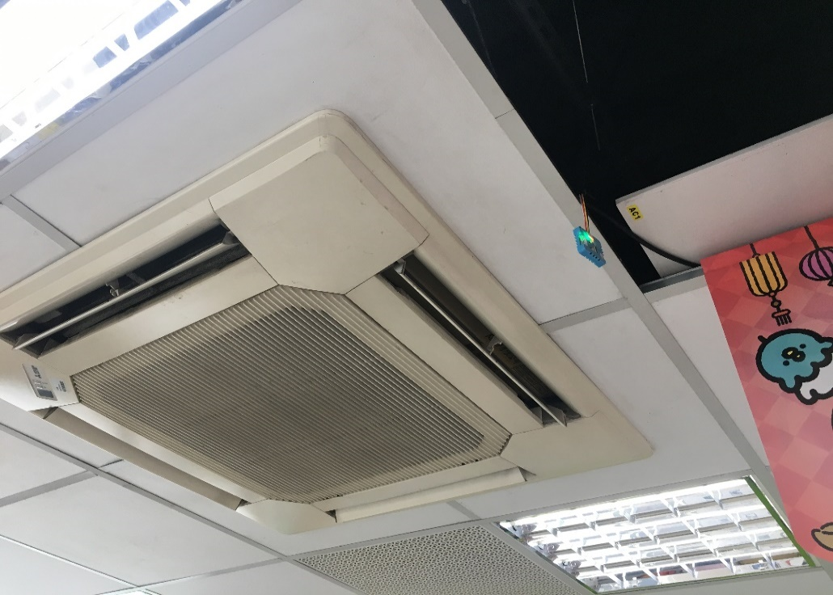
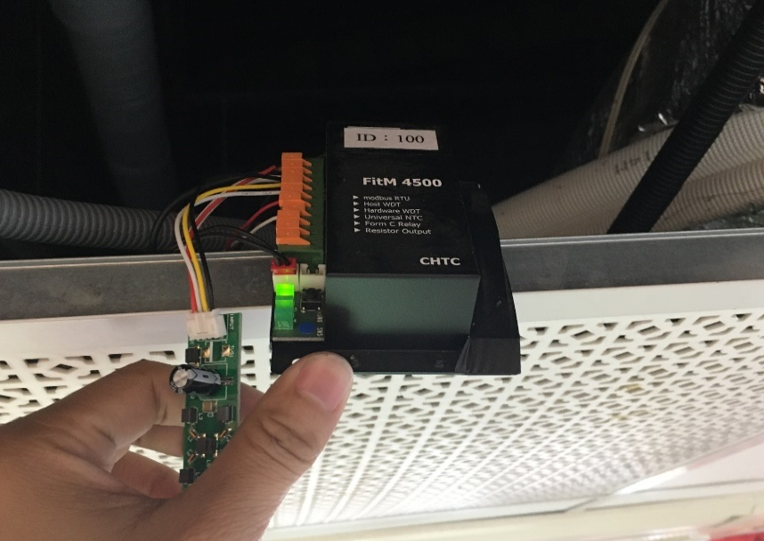
AIoT - EMS Installation in a Supermarket
Electrical Panel
Smart Meter
Energy Saving Control Algorithms
  Freezers: Smart defrost on demand
  AC: Dynamical operation settings
Site: Small to Medium-Sized Supermarket
  Approximately 600 square meters
Period: 15 October ~ 19 November
Energy Saving：
  energy saving ⬅➔ Non-energy saving
  Average Hourly Electricity Consumption During Energy Saving Period: 48.23 kWh
  Average Hourly Electricity Consumption During Non-Energy Saving Period: 53.61 kWh
  Total Store Energy Savings: ~10.03%。
Wi-Fi Dongle
Open showcases
OC Controller
AC Controller

Slide 7

Thank You for Your Attention!

