Slide 1
Project Updates:
Capacity Building Workshop on Energy Efficiency and Conservation Policy (EWG_205_2024A)
APEC Expert Group on Energy Efficiency and Conservation (EGEEC 66)
1 April 2026 – Bangkok, Thailand
Ms Jungyoon KIM, Senior Researcher, APERC

Slide 2
Outline
  Background
  Phase 1 Workshop Overview
  Key Takeaways from Phase 1
  Phase 2 Project Outline
  Tentative Timeline for Phase 2

Slide 3
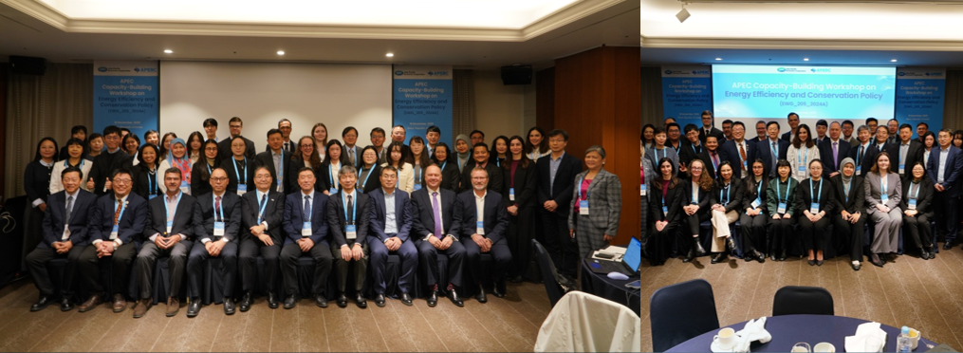
Background
The project “Capacity Building Workshop on Energy Efficiency and Conservation Policy” aims to support APEC economies in strengthening their capacity to develop and implement energy efficiency and conservation policies.
The need for capacity building is particularly high across the diverse APEC region, where economies differ in development levels, energy resources, infrastructure, and policy frameworks.
The project aligns with APEC’s Putrajaya Vision 2040 and Aotearoa Plan of Action.
A one-day in-person workshop is held annually alongside an EGEEC meeting.
Each workshop has a different theme and different objectives.
The project succeeds PREE (2009–2024) and expands its scope to benefit a wider range of member economies.
The Phase 1 workshop (Theme: “Members’ Journey with MEPS”) was held in Seoul in November 2025.

Slide 4
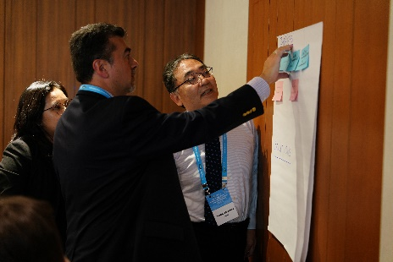
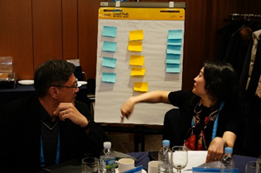
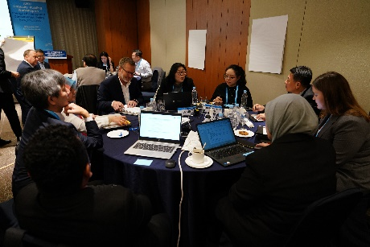
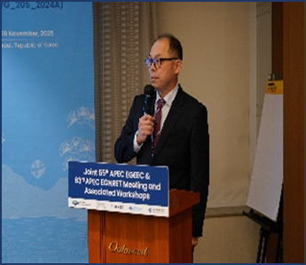
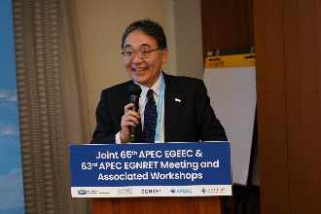
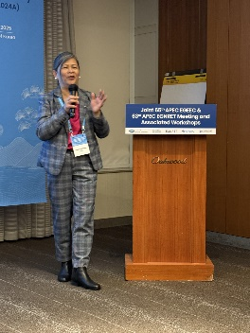
Phase 1 Workshop Overview
Theme: “Members’ Journey with MEPS” (Minimum Energy Performance Standards)
Date/Venue: November 18, 2025 / Seoul, Korea
Total Participants (52)
  Member Economies (12): CDA; PRC; HKC; JPN; ROK; MAS; MEX; PHL; RUS; CT; THA; VN
  APEC Fora (5): APEC Secretariat, EWG LS, EWG Secretariat, EGEEC, EGNRET, APERC
This Workshop aims to:
  Identify common challenges and contextual constraints in MEPS implementation across APEC.
  Facilitate peer learning through structured exchange of experiences and best practices.
  Generate actionable recommendations to strengthen MEPS design, adoption, and enforcement.

Slide 5
Key Takeaways from Phase 1
MEPS reaffirmed as a core driver of system-level efficiency gains.
Increasing recognition of MEPS within a broader policy ecosystem.
Growing momentum toward evidence-based standard setting.
Broad support for regional alignment and shared technical resources
Deeper appreciation of the role of industry, retail, and consumers.
Strong demand for peer learning, technical exchange, and practical tools
Key Outcomes
Early-stage MEPS development
  Use international standards as a starting point; establish clear institutional roles; invest in testing infrastructure; labelling integration
Strengthening existing MEPS programs
  Predictable revision cycle based on market data; Stronger compliance and enforcement; communicate co-benefits
Cross-cutting priorities (all economies)
  Focus on high-impact products (e.g. residential cooling); Strengthen data systems; leverage technical assistance
Future workshops & cooperation
  Continue structured regional technical exchange and practical training
Policy ecosystem approach
  Integrate MEPS within broader policy frameworks; strengthen governance and stakeholder engagement
Key Recommendations
Workshop Summary Report

Slide 6
Phase 2 Project Outline (EWG_208_2025A)
Project Title | Capacity Building Workshop for Energy Efficiency and Conservation Policy (Phase 2)
Proposing Economy | Japan
Co-Sponsoring Economies | Hong Kong, China; The Philippines; Chinese Taipei; Viet Nam
Objectives | Since member economies must develop their own pathways for energy transition, building capacity for policy formulation is essential. The main objective of the project is to develop policies addressing issues on energy efficiency and conservation. Specifically, this project aims to: Identify common challenges across APEC economies; Share best practices and lessons learned Develop new ideas to improve energy efficiency and conservation policies of the member economies.
Outputs | Capacity Building Workshop for Energy Efficiency and Conservation Policy Workshop Summary Report

Slide 7
Phase 2 Project Outline (EWG_208_2025A)
Date & Venue | TBD (to be held in conjunction with EGEEC66)
(Potential) Theme | “Smart Policy, Smarter Buildings”: Advancing Energy Efficiency in APEC’s Building Sector The workshop will showcase the implementation policies of member economies to boost energy performance and reduce emissions in the building sector (services and residential sector). The best practices sharing by member economies on effective building standards will help in empowering APEC economies to lead in sustainable building practices.
Draft Agenda | Host Economy Presentation Policy Review and Expert Insights Economy Presentations; policy implementation experiences and challenges Expert Discussion: Observations and Recommendations

Slide 8
Tentative Timeline for Phase 2
Date | Actions
April 2026 | Selection of consultant Identify and invite speakers and experts
End of May 2026 | Share General Information Circular (GIC) Finalise draft agenda Confirm experts and participants
June 2026 | Seek nominations from member economies
Early August 2026 | Conduct Phase 2 workshop in conjunction with EGEEC67
December 2026 – April 2027 | Draft Workshop Summary Report
May 2027 | Submit Workshop Summary Report
We would like to encourage active engagement from APEC member economies throughout Phase 2 project.

Slide 9
Thank you.
https://aperc.or.jp

