Slide 1

Electric Fans Energy Efficiency Improvement in APEC Region: Review of Experience and Best Practices
The 66th Meeting of the APEC Expert Group on Energy Efficiency and Conservation (EGEEC 66)
          Project Update (EWG_206_2024A)
Proposing economy: | Chinese Taipei
Co-sponsoring economies: | Japan, Korea, Thailand, Viet Nam
April 1, 2026
Bangkok, Thailand

Slide 2
Outline
Project purpose
Project outcome
  Workshop: APEC Workshop on Policies, Standards, and Best Practices for Energy-Efficient Electric Fans
  Final report
Future work
2

Slide 3
Global electric fan market growth drivers
Both historical trends and future forecasts show that PRC, APAC, and LATAM are consistently the fastest-growing regions in the global electric fan market. (GIA, 2025)
Global and Regional Electric Fan Sales:
Historical (2015–2023) and Future (2024–2030) Growth Trends (%CAGR)
Source: Global Industry Analysts (2025) Electric Fans – A Global Strategic Business Report (MCP24820)

Slide 4
Global electric fan market share
US & EU maintain steady growth and strong share due to their large market base, but PRC & APAC grow rapidly, with PRC projected to become the No.1 market by 2030.
Regional Electric Fan Market Share Comparison:
2015 vs. 2023 vs. 2030
Source: Global Industry Analysts (2025) Electric Fans – A Global Strategic Business Report (MCP24820)

Slide 5
Current EE policy for electric fans in APEC region
Disclaimer: For non-responding economies, information was sourced online. This project is not liable for any errors or resulting losses. 9 out of 21 ECs submitted the pre-survey questionnaire

Slide 6
Project Objectives
Choose a relevant case study to investigate strategies for increasing the market share of high-efficiency electric fans.
Examine current energy-saving technologies for electric fans within the context of energy efficiency regulations.
Share project results, best practices, and gather feedback throughout the APEC region.

Slide 7
Outline
Project purpose
Project outcome
  Workshop: APEC Workshop on Policies, Standards, and Best Practices for Energy-Efficient Electric Fans
  Final report
Recent completed work & Future work

Slide 8
38 attendees from 11+1 economies and 5 APEC fora
12 economies
CDA, PRC, HKC, INA, ROK, MAS, MEX, PHL, CT, THA, VN, IN
5 APEC fora
EWG, APEC Secretariat, EGEEC, EGNRET, APERC
34% female participation
13/25 (F/M)
Female
Male
APEC economies
APEC Fora
8

Slide 9
30 participants from 10 economies and 5 APEC fora
20% of participants applied for APEC support fund for TU, 6 participants from 4 economies.
10 economies
CDA, PRC, HKC, ROK, MAS, MEX, CT, PHL, THA, VN
*11 economies attended the EGEEC & EGNRET meeting
(RUS and JPN only join the meeting)
5 APEC fora
APEC Secretariat, EWG, APERC, EGEEC, EGNRET
37% female participation
11/19 (F/M)
★

Slide 10
8 experts from 4+1 economies and 2 international Org.
Including all speakers and moderators
5 economies (4 APEC economies)
PRC, INA, CT, THA,IN
2 International Organization
IEA, IEC
25% female participation
2/6 (F/M)
Female
Male
APEC economies
International Org.

Slide 11
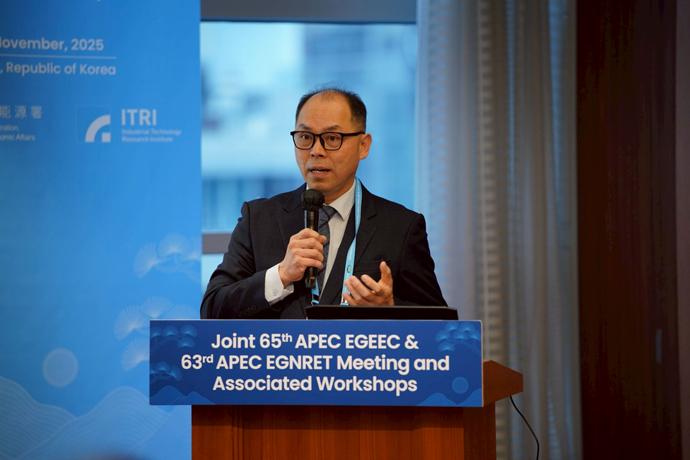
Special thanks to the Korea Energy Agency, ROK.
11

Slide 12
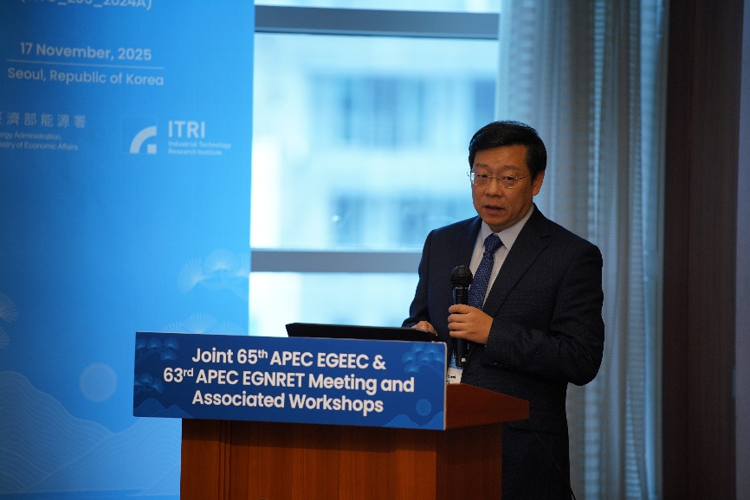
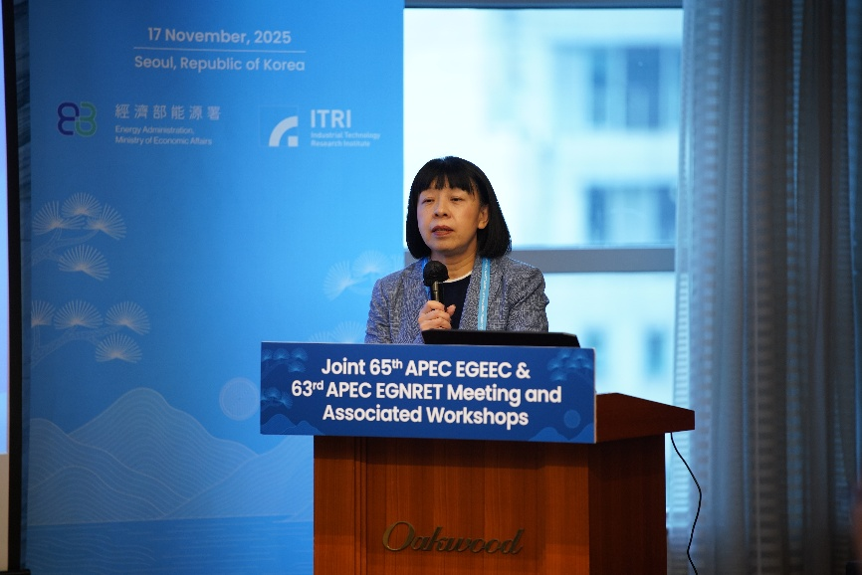
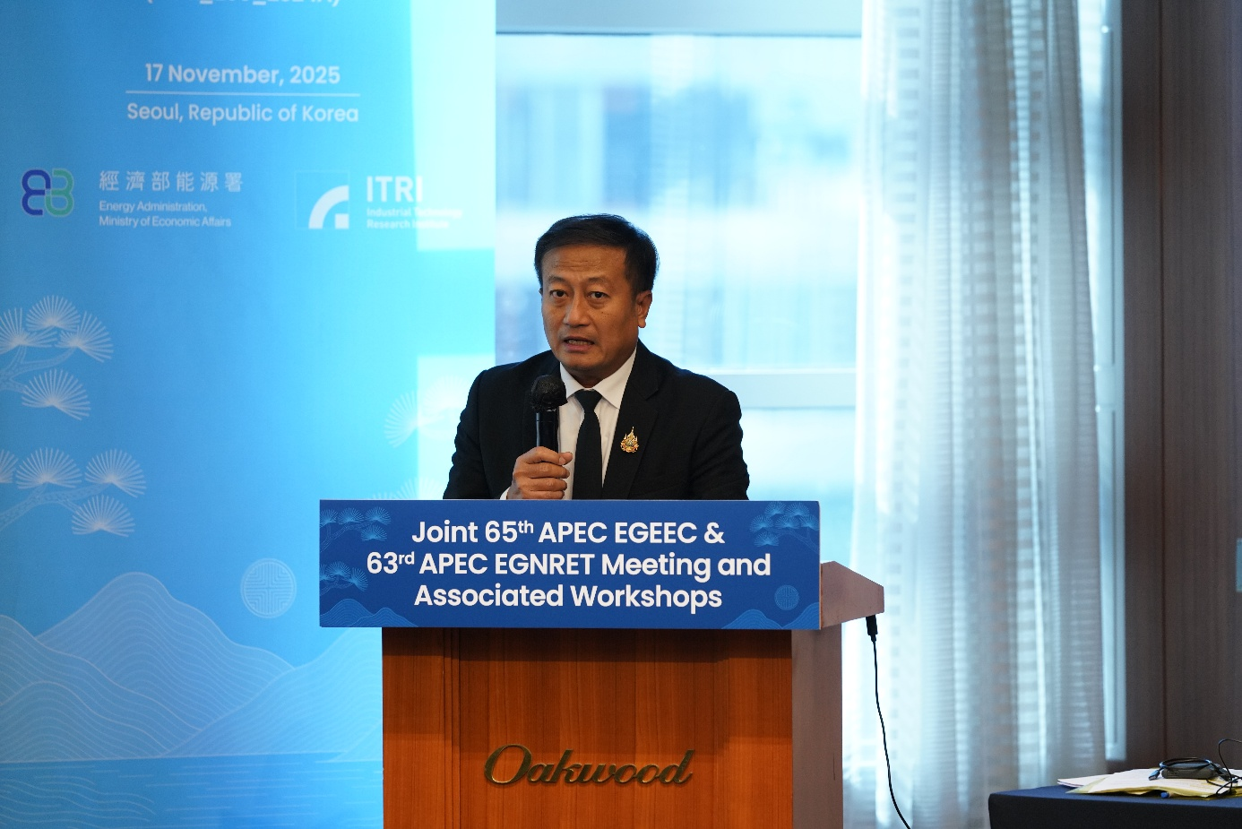
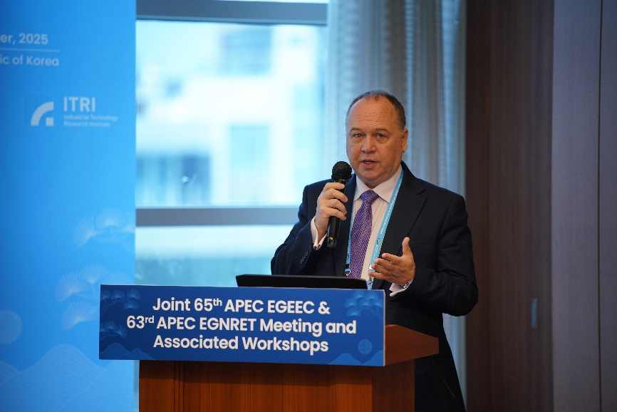
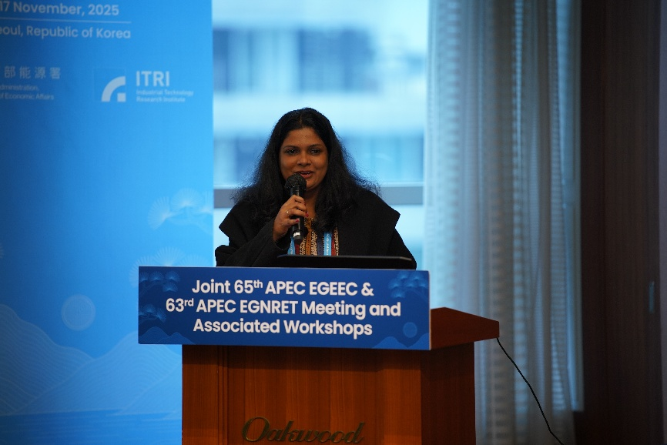
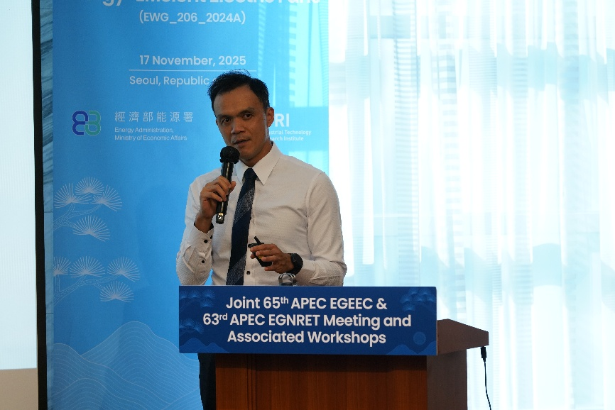
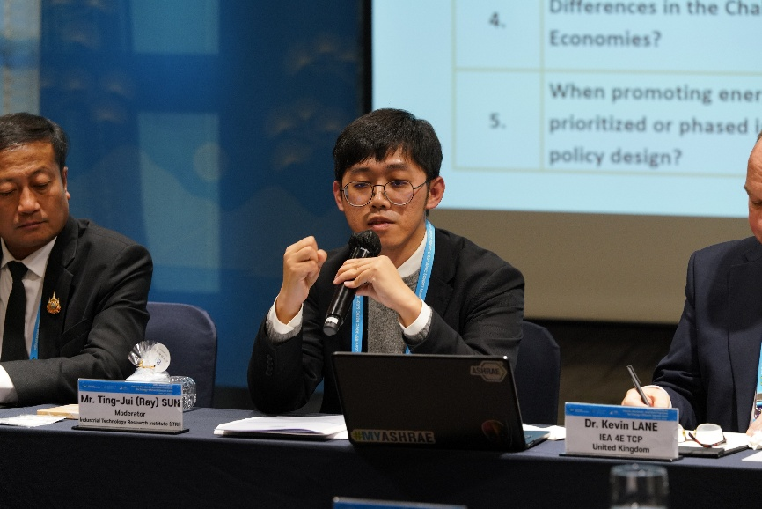
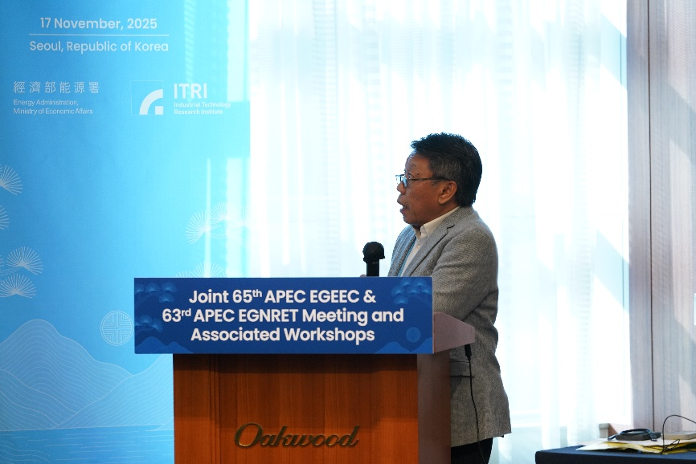
Thanks to all the experts!
12

Slide 13



Energy Efficiency Policy Practices for Electric Fans
Across Economies
Joint Procurement (India)
Market Monitoring & Enforcement
Equipment Subsidies & Incentives
Led by EESL (State-owned enterprise): A Bulk procurement project for 10 million 5-star BLDC ceiling fans.
Design Consideration:
  Emphasizes aesthetic design (valued by female consumers) and compatibility with interior decor.
IEA Recommendation:
  Focus monitoring on products identified as "high risk" or "likely to be non-compliant ".
CLASP Effective Practices:
  Whistleblowing by competitors、Holding e-commerce platforms accountable、Establishing consumer hotlines.
Consumer Subsidies (China): "Trade-in" (Old-for-New) policy. 20% subsidy for Grade 1 efficiency; 15% for Grade 2. Maximum subsidy of 2,000 RMB.
Producer Subsidies (India): Encourages Local Manufacturing of high-efficiency fans. Offers a tiered 4%~6% production linked incentive.

Slide 14
Outline
Project purpose
Project outcome
  Workshop: APEC Workshop on Policies, Standards, and Best Practices for Energy-Efficient Electric Fans
  Final report
Recent completed work & Future work

Slide 15
Final report
The final report of the proposal was submitted to the APEC Secretariat in February.
The content includes key points from the experts' workshop presentations, along with suggestions for promoting energy conservation and economic policy recommendations.
15

Slide 16
Policy Recommendations
Suggestion 1：Establishing Measurement and Verification Capabilities as a Policy Foundation
  Strengthen local MEPS if testing capacity exists; otherwise, adopt IEC standards or mutual recognition to reduce costs.
Suggestion 2：Market Incentives and Product Life Cycle Management
  Achieve energy-saving and circular economy goals through tiered subsidies, high-efficiency motor promotion (e.g., BLDC), and repair mechanisms to extend product lifespans and reduce waste.
Suggestion 3：Standard Harmonization and Market Integration
  Aligning with international standards like IEC 60879 reduces trade barriers (TBT) and compliance costs, boosting consumer confidence in product performance and safety.
16

Slide 17
Outline
Project purpose
Project outcome
  Workshop: APEC Workshop on Policies, Standards, and Best Practices for Energy-Efficient Electric Fans
  Final report
Future work

Slide 18
Future work
Preparation of the completion report is currently underway.
Harmonization of electric-fan energy efficiency standards across the APEC region presents significant opportunities and will require continued efforts from all APEC economies, with IEC playing a key leadership role.
18

Slide 19
Thank You for Your Attention!
19

